Slide 1

PRODUCT LAUNCH
Resque Rooibos Barrier Cream 50ml
Notes:
Discover the power of everyday skin protection with Resque Rooibos Barrier Cream — where nourishment, comfort and barrier care come together for the whole family.

Slide 2
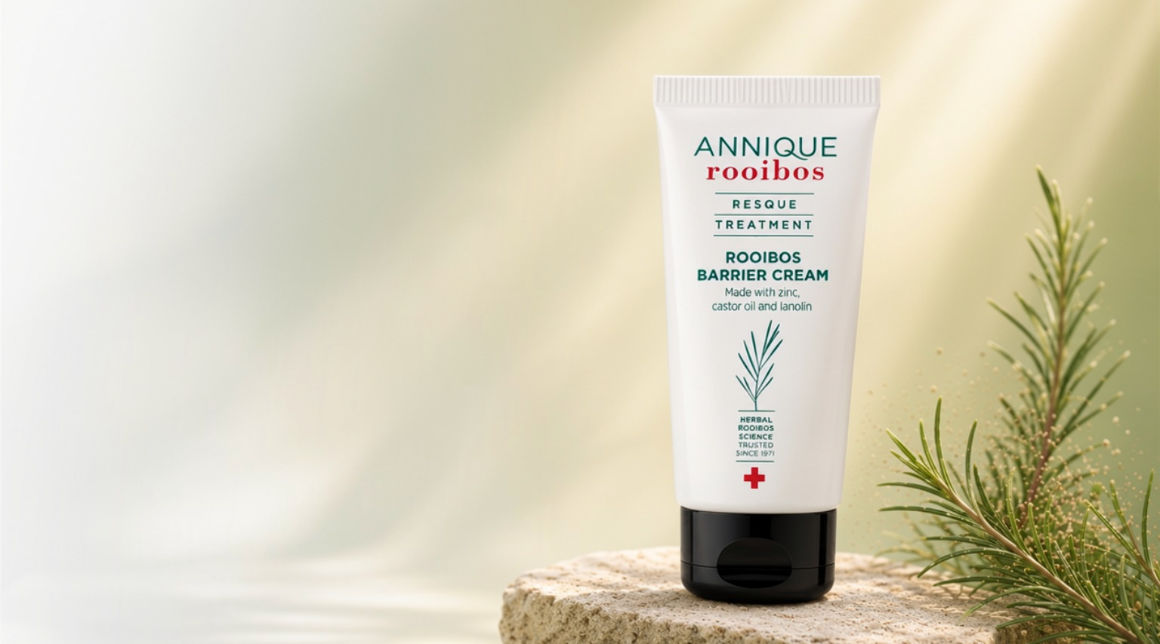
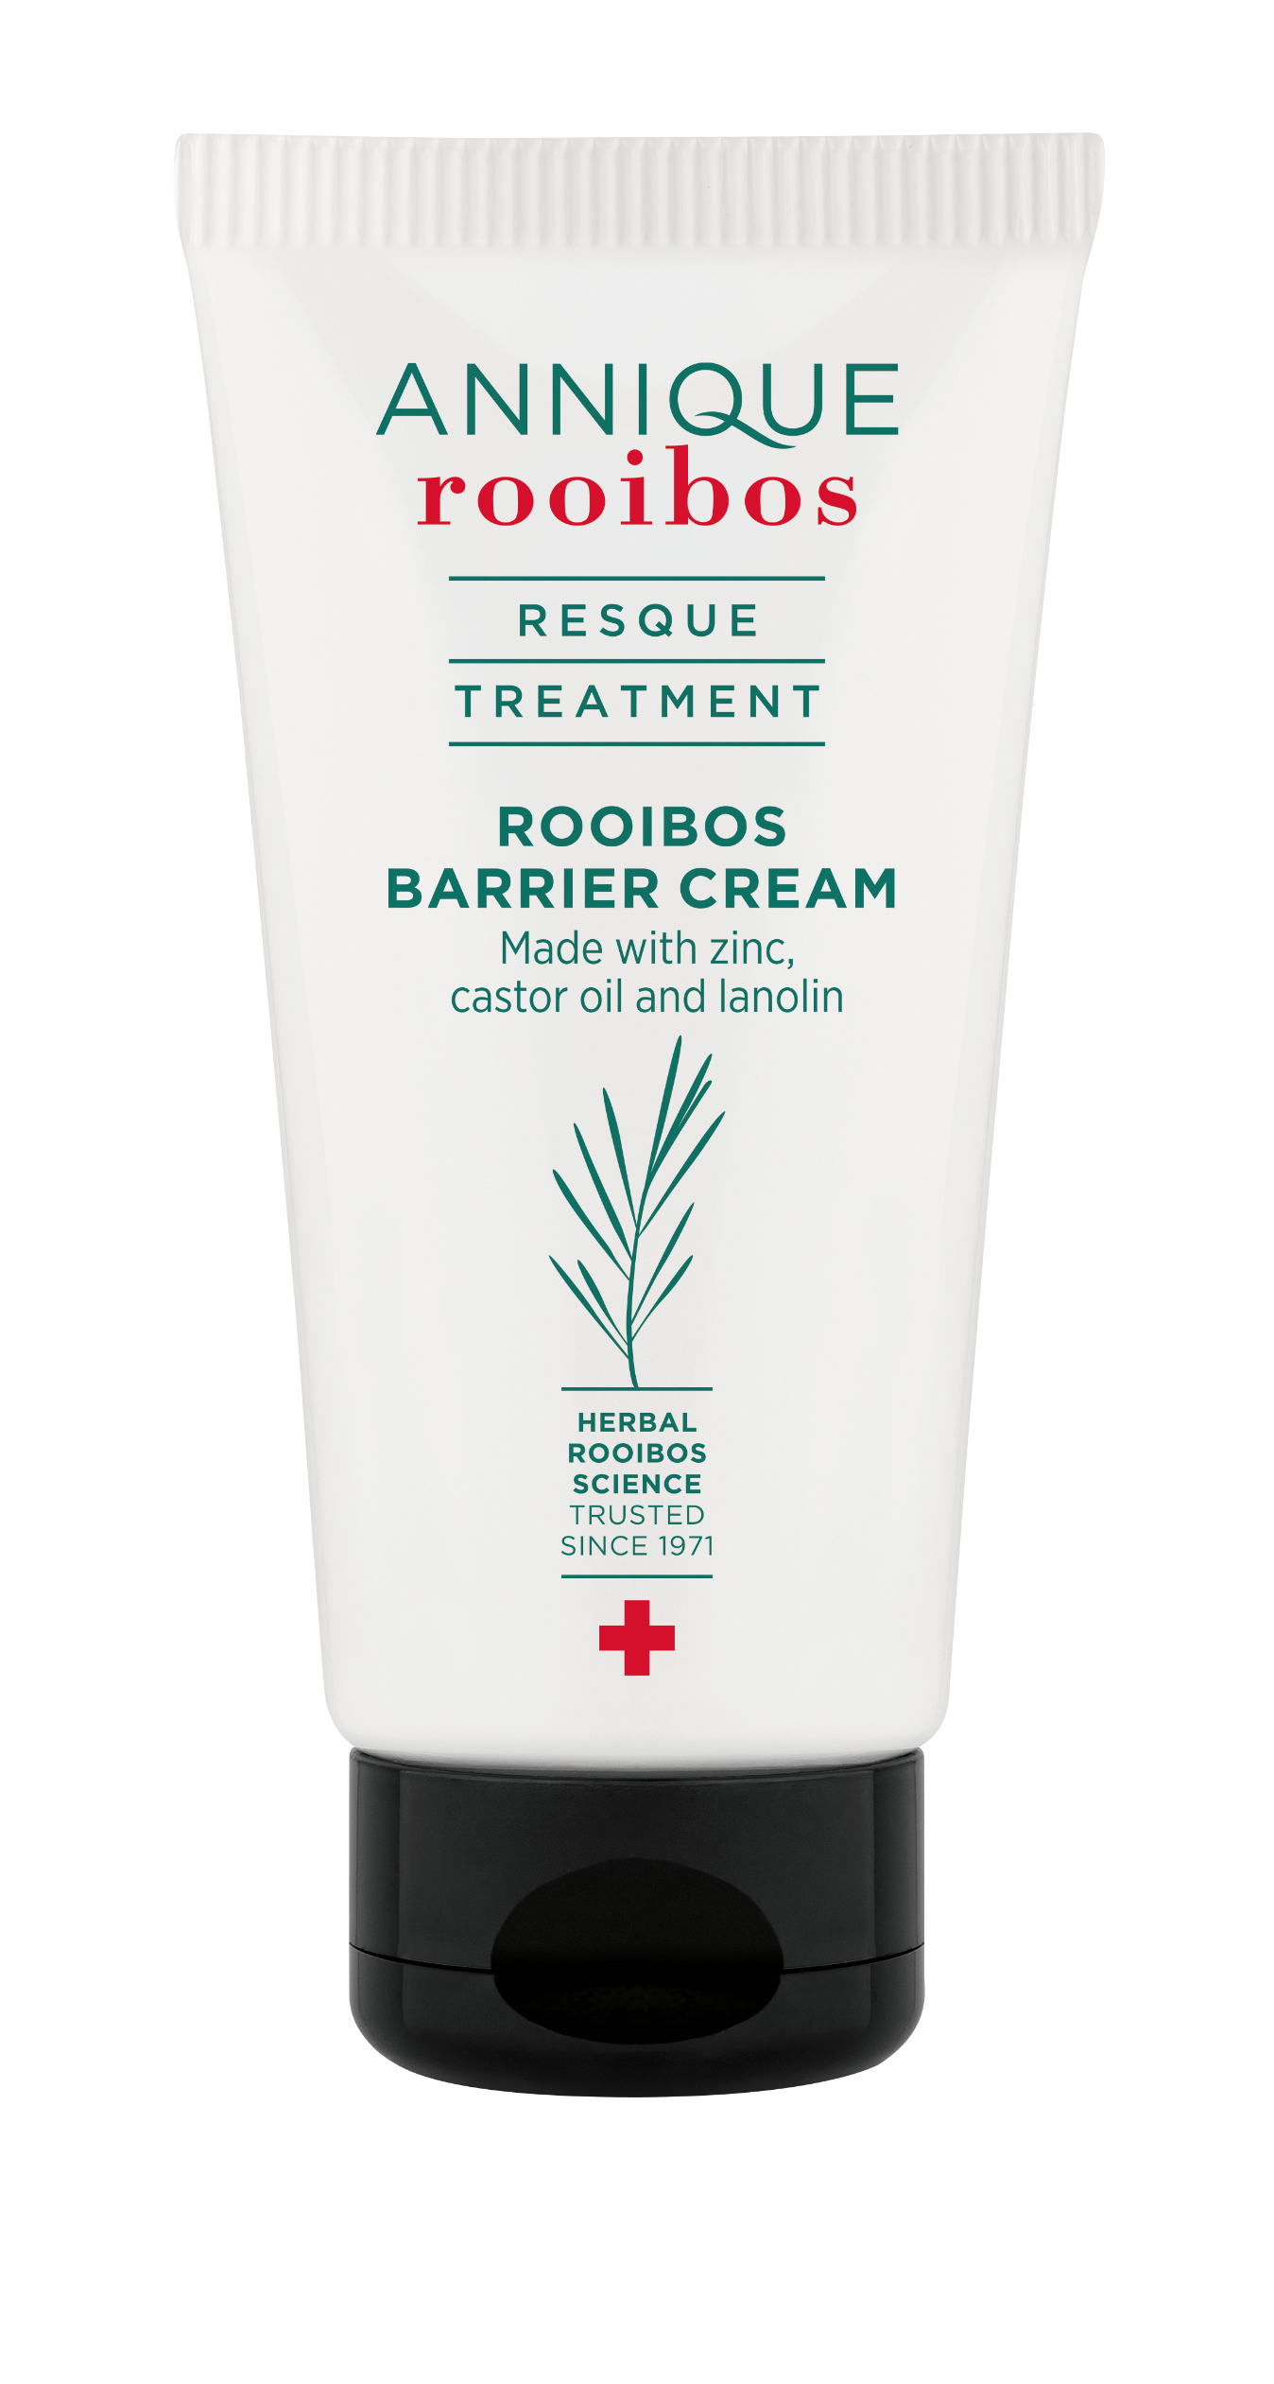



RESQUE ROOIBOS BARRIER CREAM
50ml
Multi-purpose body treatment cream
Protective care for everyday skin stress
Helps comfort dry, rough and chafed skin
Ideal for active lifestyles and family use
Rich barrier-supporting protection
Notes:
Resque Rooibos Barrier Cream is positioned as a versatile body product designed for everyday life.
It serves as a practical everyday ‘skin rescue’ solution for the whole family, helping to protect and comfort skin exposed to friction, weather, sweating, shaving, exercise, dehydration and frequent washing.”
It helps provide a comforting, protective waterproof layer that supports skin exposed to these challenges.
Its rich texture and barrier-supporting ingredients make it ideal as an all-round treatment cream that families can keep on hand for dry, compromised or overworked skin.

Slide 3
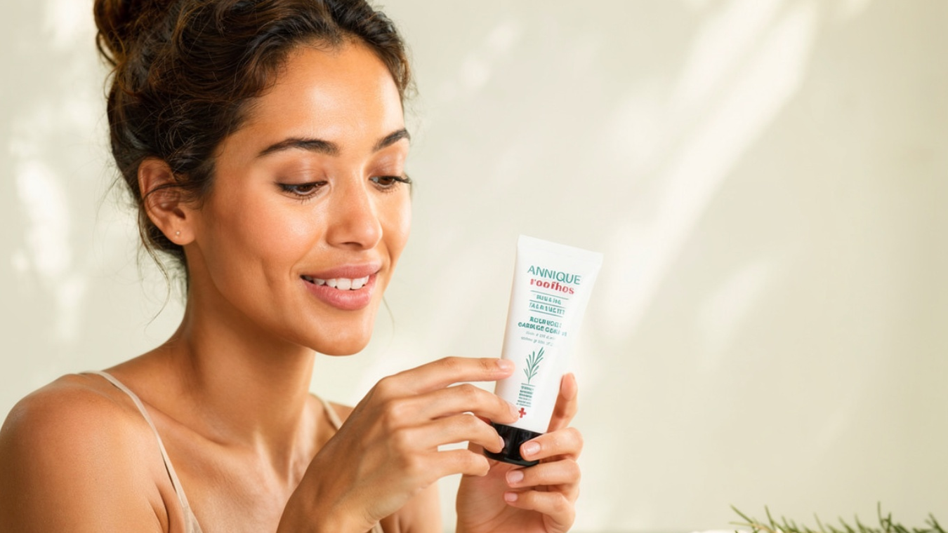
KEY INGREDIENTS
Zinc helps support skin protection
Castor oil nourishes and softens
Lanolin helps lock in moisture
Rooibos soothes stressed skin
Notes:
The ingredient combination is central to the Resque Rooibos Barrier Cream story. Zinc is widely known for its protective and comforting properties, especially in formulas designed for compromised or stressed skin.
Castor oil is a deeply nourishing emollient that helps soften dry skin and improve smoothness. Lanolin is highly valued for its moisture-locking abilities, helping to create a long-lasting protective effect on the skin surface.
Together, these ingredients create a treatment-focused barrier cream that aligns with the nurturing and protective philosophy associated with the Annique Rooibos ranges.

Slide 4

ACTIVE LIFESTYLE PROTECTION
Ideal for runners and cyclists
Helps reduce friction discomfort
Supports skin exposed to sweat and rubbing
Comforts dry or wind-exposed skin
Protective care for outdoor activities
Notes:
One of the key functions of Resque Rooibos Barrier Cream is helping to reinforce the skin’s protective barrier.
For runners, cyclists and active individuals, skin is constantly exposed to friction, perspiration and environmental stress.
Areas such as inner thighs, underarms, feet and around tight clothing can become uncomfortable due to rubbing and dryness.
Resque Rooibos Barrier Cream can be used as a protective body treatment to help comfort these areas and create a moisture-protective barrier on the skin surface.
The nourishing formula helps skin feel softer and more protected during and after physical activity.

Slide 5

FAMILY AND HOUSEHOLD USES
Everyday family skin rescue
Helps comfort dry hands and elbows
Ideal for rough knees and heels
Protective care during winter months
Multi-purpose treatment for the household
Notes:
It works exceptionally well as a family body treatment product because of its versatility.
It can be used on dry hands caused by frequent washing, rough elbows, cracked heels, dry knees and areas prone to irritation from environmental exposure.
During colder months, skin often becomes drier and more sensitive, making barrier support especially important.

Slide 6

BABY AND DELICATE SKIN SUPPORT
Gentle protective barrier care
Helps comfort delicate dry skin
Ideal for dry patches and friction areas
Supports skin exposed to moisture and rubbing
Nourishing protection for sensitive areas
Notes:
The protective nature of this product also makes it useful for delicate skin areas that need extra comfort and barrier support.
Babies and young children often experience dryness or skin discomfort in areas exposed to moisture, rubbing or environmental irritation. The rich protective texture helps shield vulnerable skin while keeping it nourished and moisturised.
Parents are often drawn to products that feel comforting, protective and easy to use for the entire family. The cream’s barrier-supporting properties make it a practical addition to every family.

Slide 7
LAYERING WITH OTHER BODY CARE TREATMENT PRODUCTS
Use body creams as the treatment base
Creates an extra protective moisture seal
Ideal for winter, sports and compromised skin
Customisable body care for different needs
Notes:
The Barrier Cream does not only have to be seen as a standalone product but can also be used as a “skin protection booster” within the broader body care routine.
It works exceptionally well when layered with other nourishing body products in the range, allowing consumers to customise their body care routine depending on their skin needs and lifestyle.
The recommended approach is to first apply a moisturising treatment cream such as the Resque Crème or the Rooibos & Hemp Body Cream as the base layer. These products help nourish, soften and hydrate the skin over larger body areas.
Once the treatment cream has been absorbed, Resque Rooibos Barrier Cream can then be applied over areas that need extra protection or intensive care. This layering approach helps “seal in” moisture while creating an additional protective barrier over compromised or vulnerable areas.

Slide 8

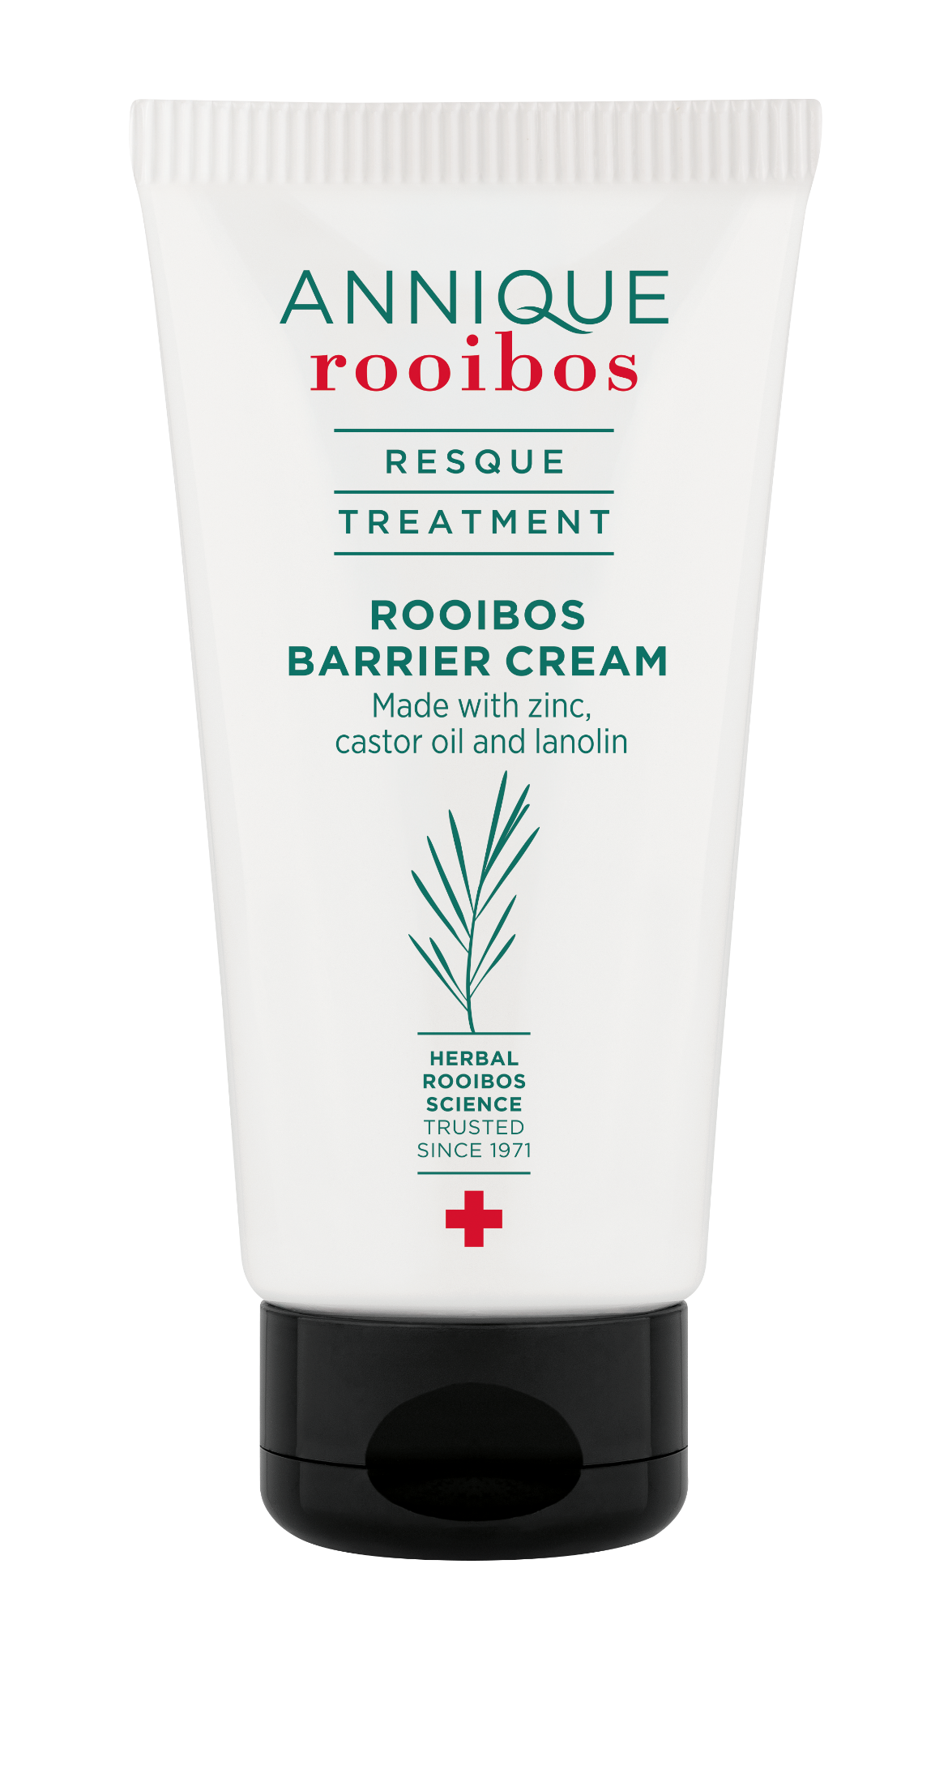
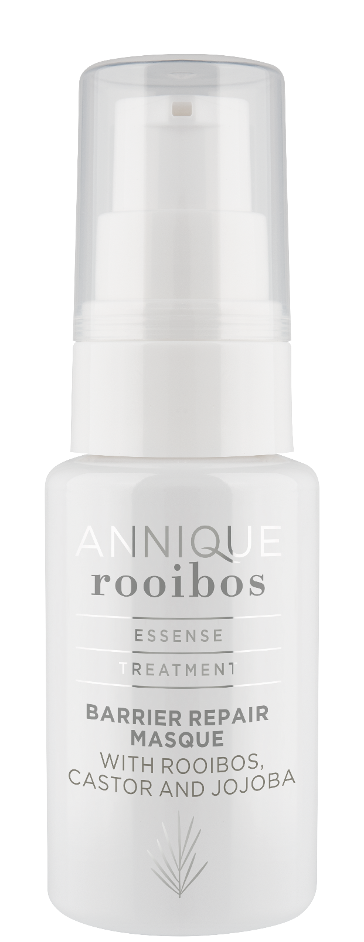
ESSENSE BARRIER REPAIR MASQUE
VS
RESQUE BARRIER CREAM
Essense Barrier Repair Masque | Resque Barrier Cream
Intensive overnight skin recovery masque | Protective everyday barrier treatment
Focuses on restoring compromised facial skin | Focuses on protecting dry, stressed body skin
Lightweight nourishing treatment texture | Rich protective barrier cream texture
Helps replenish and comfort the skin barrier | Helps shield and protect against moisture loss
Ideal for dehydrated, sensitised facial skin | Ideal for dry patches, friction and family use
Notes:
Now that we’ve explored how Resque Rooibos Barrier Cream can be used as a powerful booster with layering of other body treatment products, it’s important to understand how it differs from the Essense Barrier Repair Masque — because although both support barrier care, they serve very different treatment purposes
The easiest way to explain the difference is:
Essense Barrier Repair Masque = Skin Recovery
Resque Rooibos Barrier Cream = Skin Protection
Essense Barrier Repair Masque is primarily a facial treatment product designed to help restore and replenish compromised skin.
It is focused on: Deep nourishment, Barrier recovery , Hydration support and Comforting sensitised or overworked skin
Its texture is designed to feel more treatment-focused and cosmetically elegant for facial use, allowing it to absorb into the skin while delivering nourishing barrier-support ingredients.
Resque Rooibos Barrier Cream is more of a protective body treatment product.
Its purpose is to: Create a protective layer on the skin , Help reduce moisture loss , Comfort dry, rough or stressed areas , Shield vulnerable skin from friction and environmental stress
The texture is richer and more occlusive because the goal is protection rather than absorption alone.

Slide 9

RESQUE ROOIBOS BARRIER CREAM
50ml
Notes:
Resque Rooibos Barrier Cream is more than just another typical body care product — it is a practical, treatment-focused barrier cream designed for real everyday body care needs. Whether skin is exposed to friction, harsh weather, dryness, exercise, frequent washing or environmental stress, the cream helps to provide comforting protection and moisture support where the skin needs it most.
Resque Barrier Cream is the “protective shield” in the body care routine — helping skin feel comforted, supported and protected every day

