Slide 1



ABC PLAN CHANGES
NEW FAST START PROGRAMME
NEW STARTER PACKS
NEW RRI PROGRAMME
2026 / 2027
WELCOME
Tuesday, 23 June 2026

Slide 2
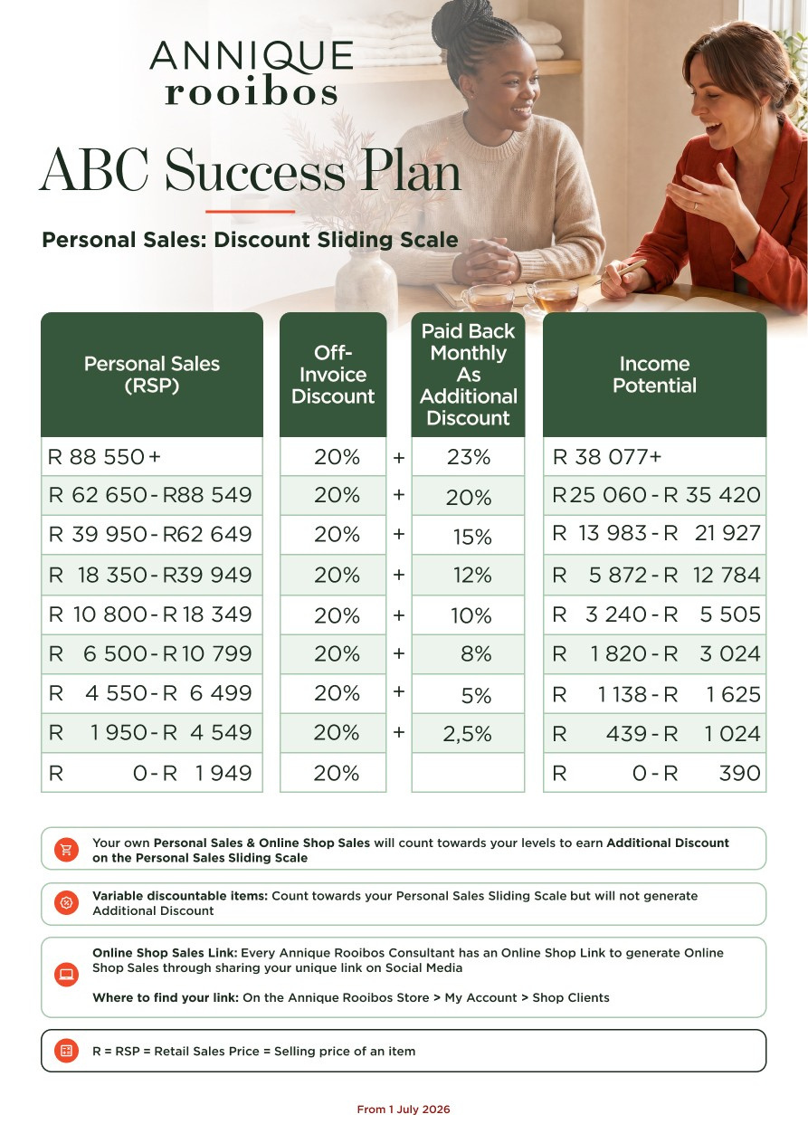
ABC SUCCESS PLAN
The levels increased
Implementation date
1 July 2026

Slide 3
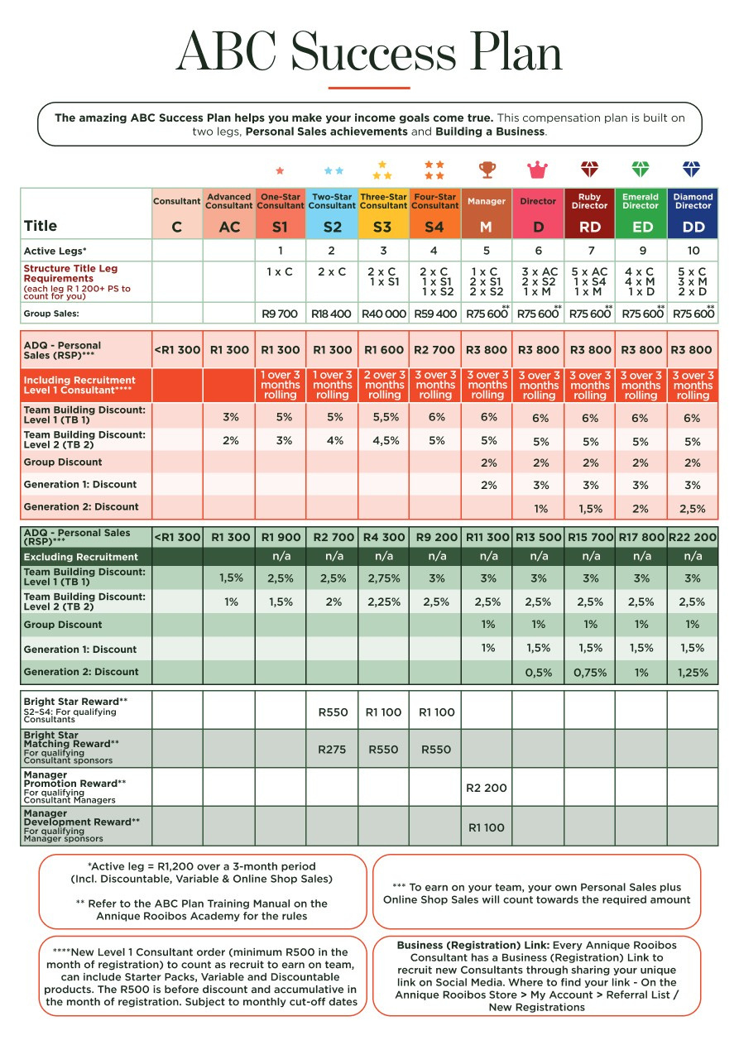
ABC SUCCESS PLAN
Group Sales qualified amount changed
ADQ Personal Sales qualified amount changed
ADQ Personal Sales qualified amount changed
Team Building 1 & 2 % changed
AC

Slide 4
ABC SUCCESS PLAN
Training Manual
Videos
Business Booklet
* Will communicate when available

Slide 5
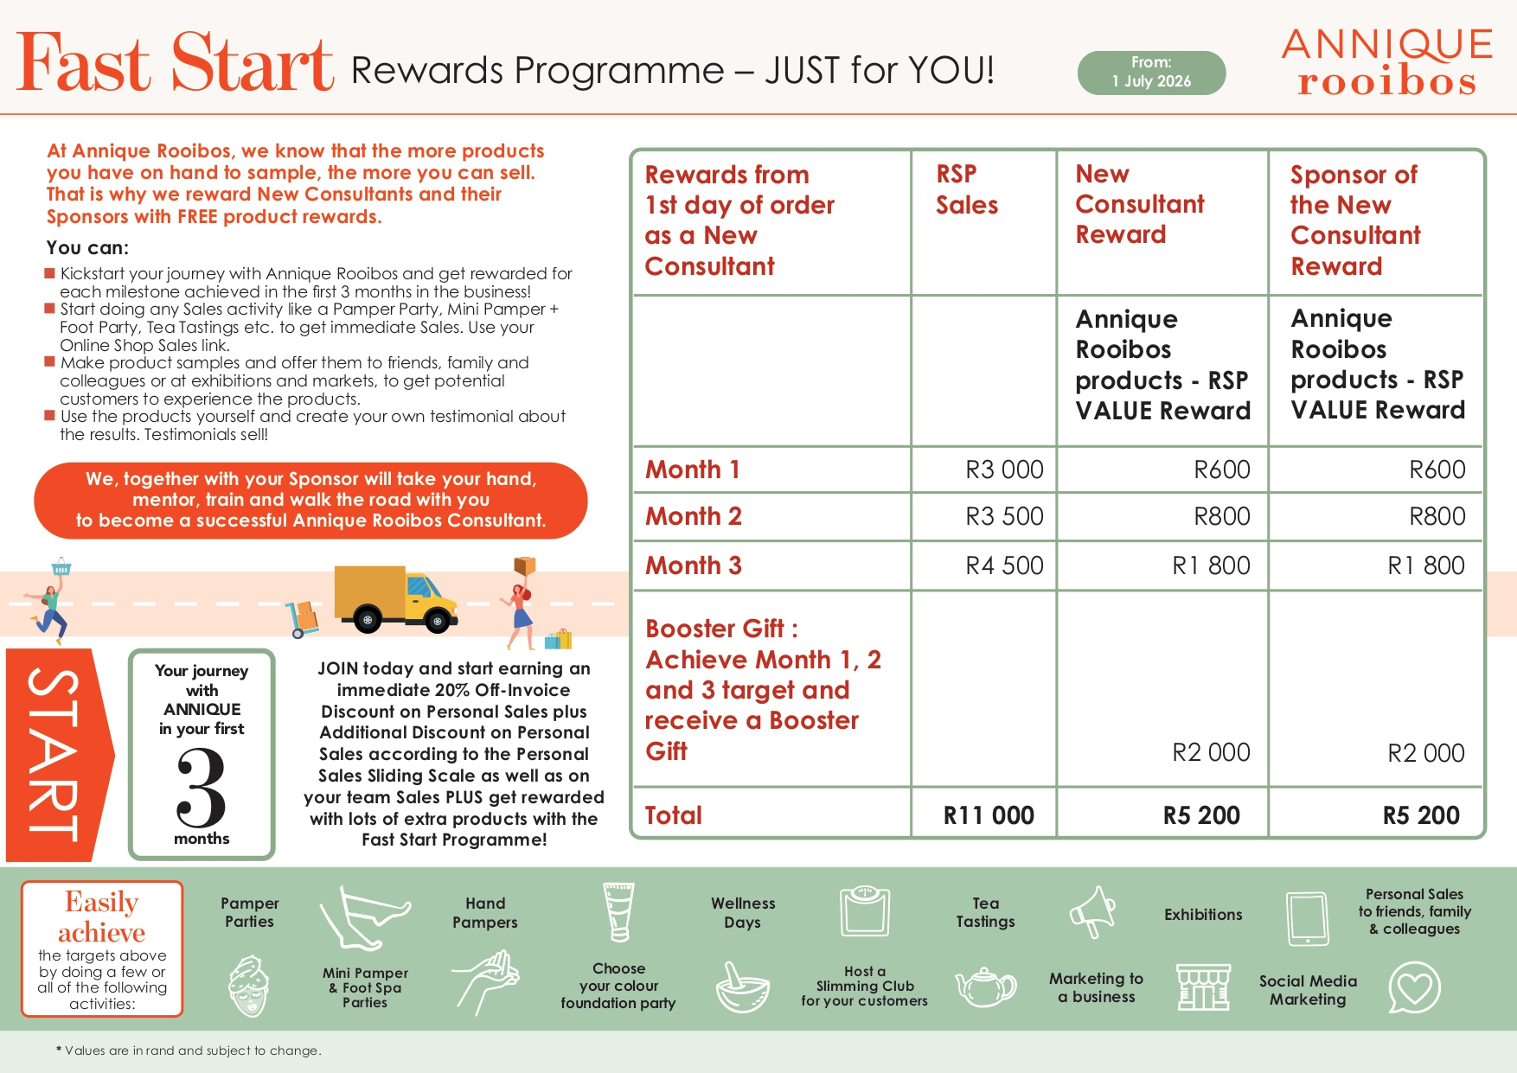

FAST START PROGRAMME
for new Consultants and Sponsors
12

Slide 6

Month 1
Qualify for Annique Rooibos Products
to the value of
R 600
(Sponsor & New Consultant)
R 3 000 Sales (RSP)
R 675
off your R 3 000 (Discountable Products - 22.5% PS Sliding Scale)
receive
R 600 Annique Rooibos Products
Total of = R 1 275 for only R 3 000 Sales
The Sponsor will also qualify for R 600 Annique Rooibos Products

Slide 7
Month 2
Qualify for Annique Rooibos Products
to the value of
R 800
(Sponsor & New Consultant)
R 3 500 Sales (RSP)
R 788
off your R 3 500 (Discountable Products - 22.5% PS Sliding Scale)
receive
R 800 Annique Rooibos Products
Total of = R 1 588 for only R 3 500 Sales
The Sponsor will also qualify for R 800 Annique Rooibos Products

Slide 8
Month 3
Qualify for Annique Rooibos Products
to the value of
R 1 800
(Sponsor & New Consultant)
R 4 500 Sales (RSP)
R 1 012
off your R 4 500 (Discountable Products – 22.5% PS Sliding Scale
receive
R 1 800 Annique Rooibos Products
Total of = R 2 812 for only R 4 500 Sales
The Sponsor will also qualify for R 1 800 Annique Rooibos Products

Slide 9
Achieve
Month 1 Sales in Month 1 (R 3 000)
Month 2 Sales in Month 2 (R 3 500)
Month 3 Sales in Month 3 (R 4 500)
RECEIVE
R 2 000 Booster Gift
Annique Rooibos Products
New Consultant PLUS Sponsor

Slide 10
Question & Answer
If the new Consultant achieves Month 1, 2 & 3 Sales in one month will the Sponsor and the new Consultant receive their gifts together?
YES!
MONTH 1, 2 & 3's Gift
PLUS
Booster Gift

Slide 11

SUMMARY

Slide 12
SUMMARY – SPONSOR GIFTS
Based on Sponsor having Manager Title - Below will differ based on Sponsor Title

Slide 13

Question & Answer
When does the Programme start?
The first day the new Consultant's order is invoiced. Month 1, 2 & 3 are calendar months.
For Example :
DAY 1 = 10 JUNE
End of Month 1 = 09 July
Special Note : Subject to month-end, cut-off dates as communicated per monthly newsletter

Slide 14
Question & Answer
Which Annique Rooibos products can you purchase to qualify for the reward ?
Starter Packs
Any Special Offers
Standard Line Products
Variable Discountable Products
Online Shop Sales of Customers on the personalised link
Notes:
Eerder produk foto’s

Slide 15
Question & Answer
When does Home Office calculate the Rewards ?
Daily - at the end of each business day.
Will show on the New Consultant's and Sponsor's VDS Statement the next morning

Slide 16
Question & Answer
When will the Rewards be available to claim?
New Consultant
The DAY AFTER qualifying
Must claim the total of the Reward once-off
Redeem the Reward in a 2-month period after qualifying (not - redeem - forfeit)
Sponsor
Once Additional Discount Qualified the Sponsor can claim
Must claim the total of the Reward once-off
Redeem the Reward in a 2-month period after qualifying (not - redeem – forfeit and not ADQ in the month - forfeit)

Slide 17
Question & Answer
Must the New Consultant place one order of R 3 000 to qualify for the Reward?
NO,
the New Consultant can place cumulative orders to the value (within the month)
EXAMPLE
He / She can place 2 orders of R 1 500 each in Month 1
Notes:
Eerder produk foto’s

Slide 18
Question & Answer
If the New Consultant does not achieve the R 3 000 in Month 1, can he/she still qualify in Month 2 and 3 for gifts?
YES,
only when the New Consultant achieves Sales of R 6 500 (accumulative) in Month 2.
GIFT will be
R 800 Annique Rooibos Products
(Not Month 1 GIFT - only Month 2 GIFT)
(Applicable to the Sponsor as well)

Slide 19
Question & Answer
If the new Consultant does not achieve the R3 000 in Month 1 and R 3 500 in Month 2, can she still qualify in Month 3 for the gifts?
YES,
only when the New Consultant
achieves Sales of R 11 000 (accumulative) in Month 3.
GIFT will be
R 1 800 Annique Rooibos Products
(Not Month 1 & Month 2 GIFT - only Month 3 GIFT)
(Applicable to the Sponsor as well)

Slide 20
Question & Answer
How does the new Consultant qualify for the Booster GIFT of R 2 000?
The new Consultant must achieve the Sales of
R 3 000 in Month 1
R 3 500 in Month 2
R 4 500 in Month 3
(The Sponsor will only qualify for Booster Gift if Consultant achieved Sales of Month 1, 2 and 3)

Slide 21
Question & Answer
If the Sales of the new Consultant is
R 11 000 in Month 1 will he / she qualify for all the GIFTS?
YES,
the New Consultant will qualify for
Month 1's GIFT = R 600
Month 2's GIFT = R 800
Month 3's GIFT = R 1 800
Booster GIFT = R 2 000
TOTAL = R 5 200

Slide 22
Question & Answer
If the new Consultant had no Sales in Month 1 and 2 and R11 000 Sales in Month 3
will he / she still qualify for the BOOSTER GIFT?
NO,
to qualify for the Booster Gift, new Consultant must achieve Month 1, 2 and 3 Rewards.

Slide 23

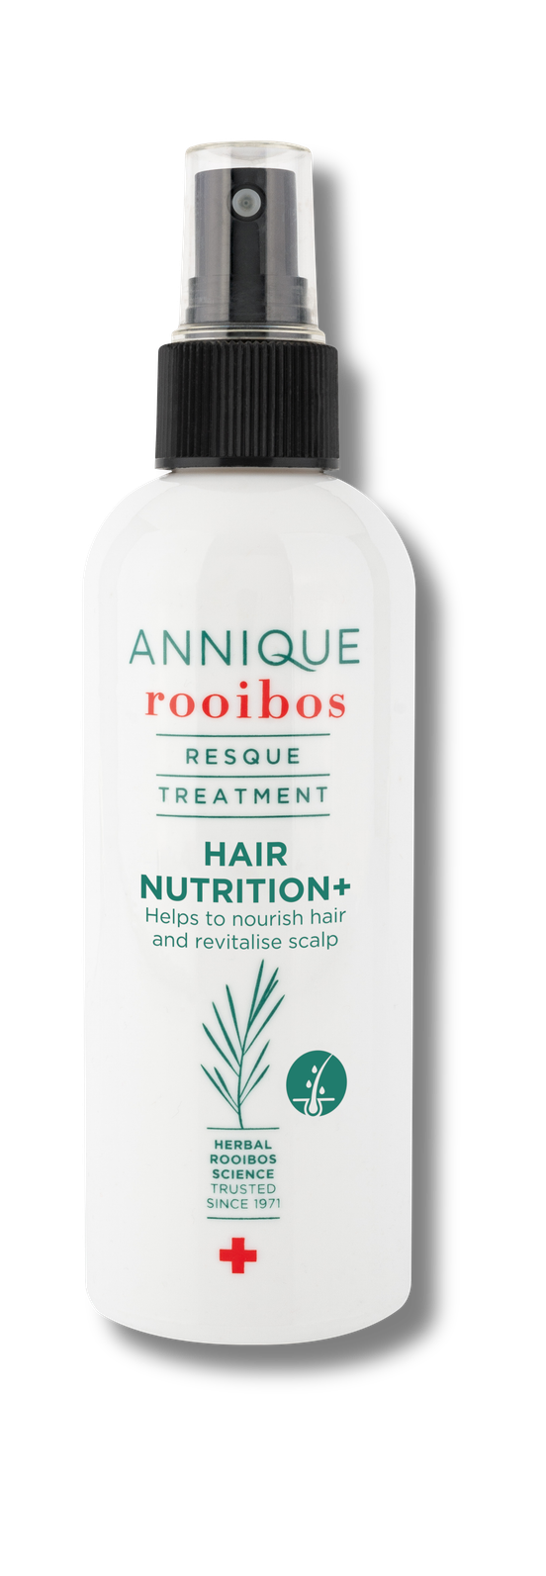
Question & Answer
Which Annique Rooibos Products can the new Consultant and Sponsor claim?
Any Annique Rooibos Products to the RSP Value as advertised
Example: Resque Hair Nutrition+ pricelist price = R 289
On Special Offer the price = R 179 (claim for this price)
Any Variable Discountable Products
Standard Line Products

Slide 24

New Consultants who joined from January 2026
Notes:
Kan ons hierdie foto’s aan die regterkant verander asb.

Slide 25
Question & Answer
How will it work for new Consultants who joined on the previous Fast Start Programme?
Month 1-4 :
Will fall away as from July 2026
Month 5-7 :
Will run until finished on previous Fast Start Programme

Slide 26
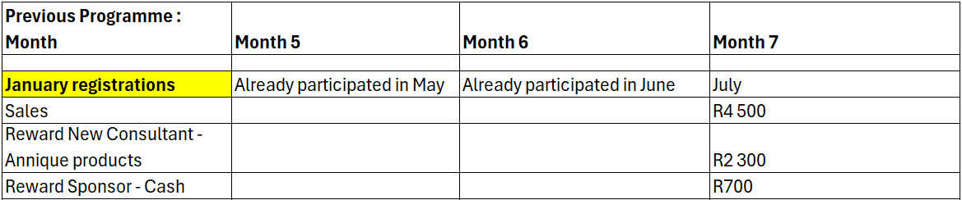
Example
Month 5-7 :
Consultants who joined from January 2026 until June 2026 will complete Fast Start Month 5-7 on previous Fast Start Programme:

Slide 27
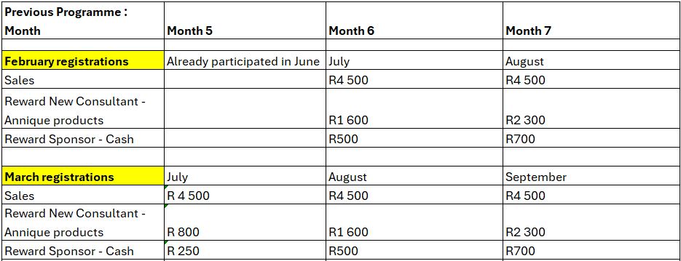
Example

Slide 28
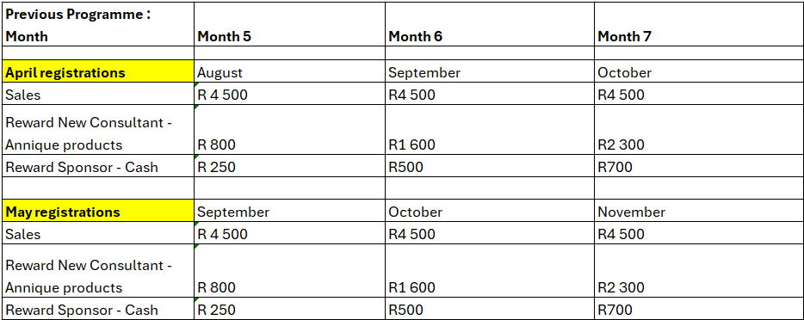
Example

Slide 29
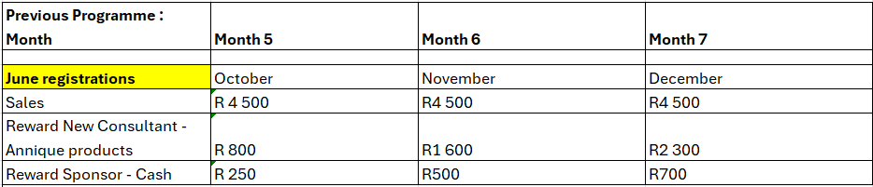
Example

Slide 30
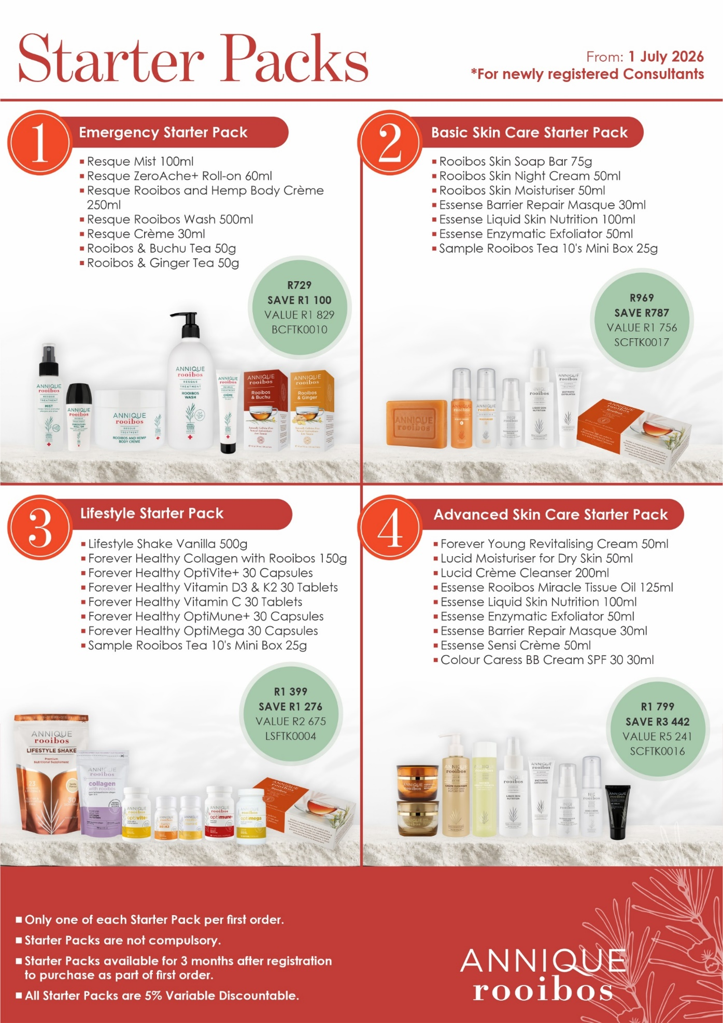

NEW STARTER PACKS
for New Consultants

Slide 31
New Starter Packs
New Starter Packs for newly registered Consultants from 1 July 2026
All Starter Packs are 5% Variable Discountable

Slide 32
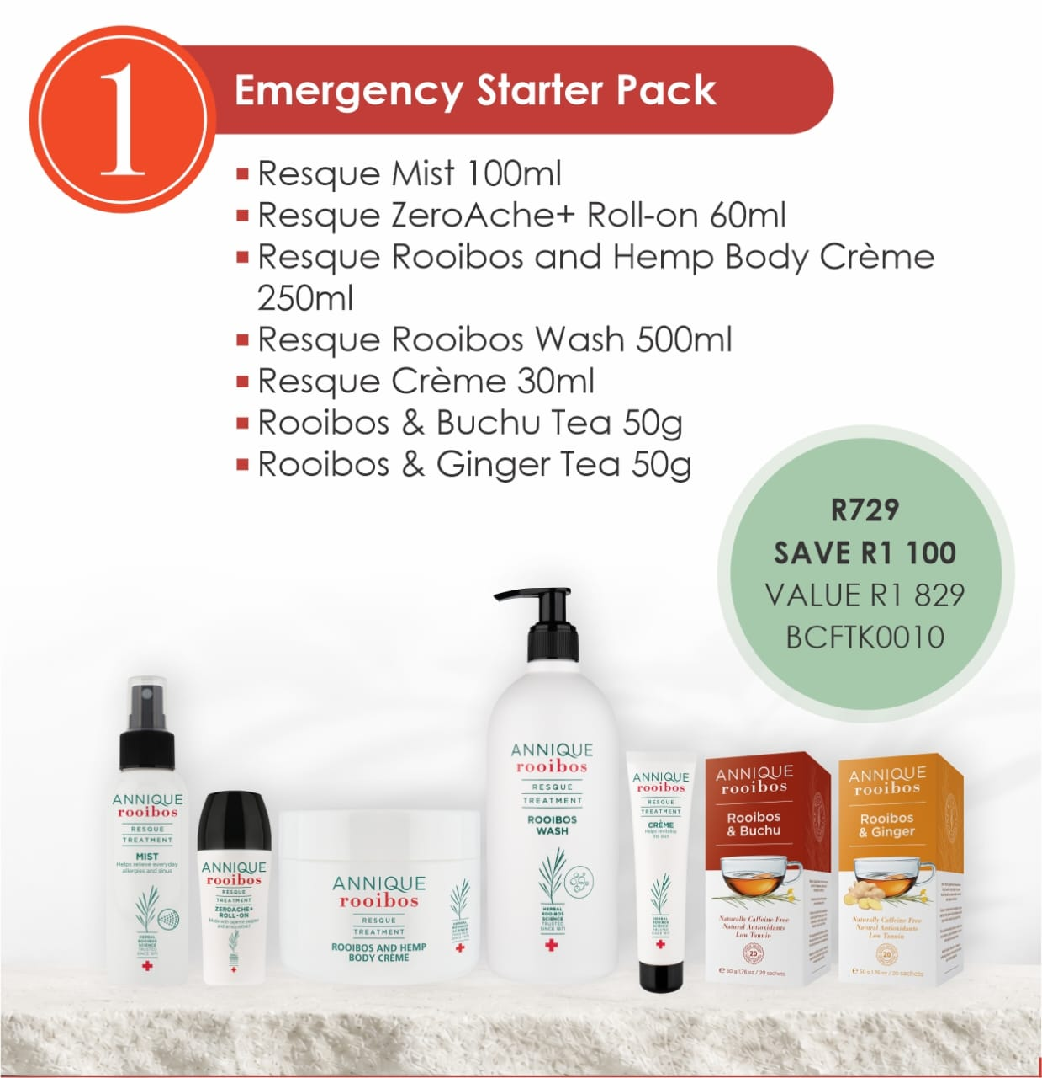
Emergency Starter Pack

Slide 33
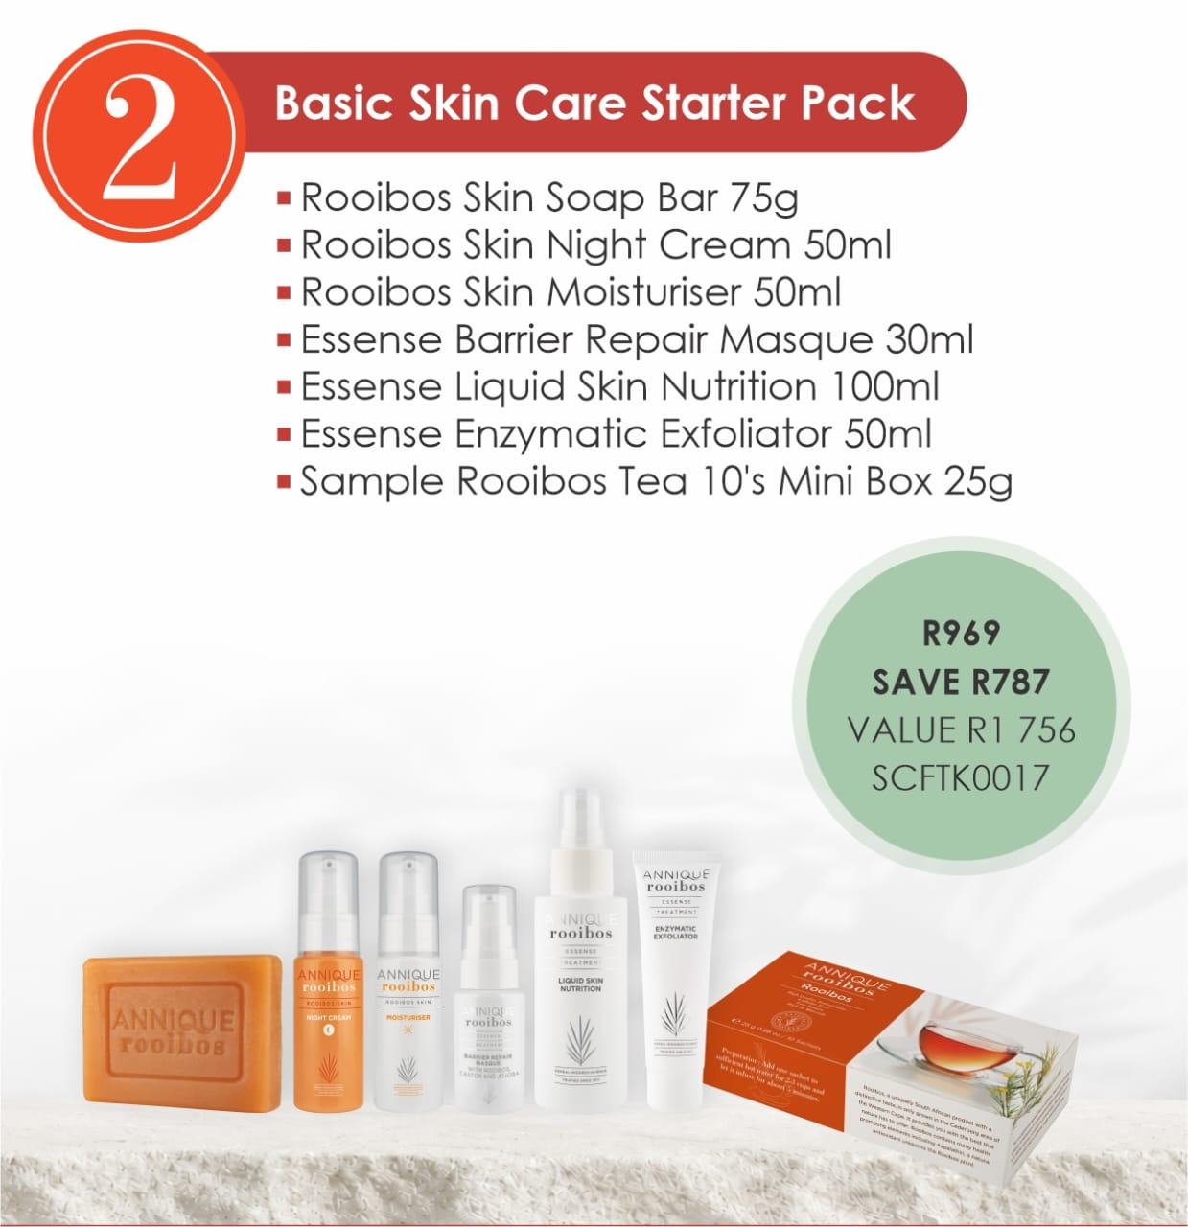
Basic Skin Care Starter Pack

Slide 34
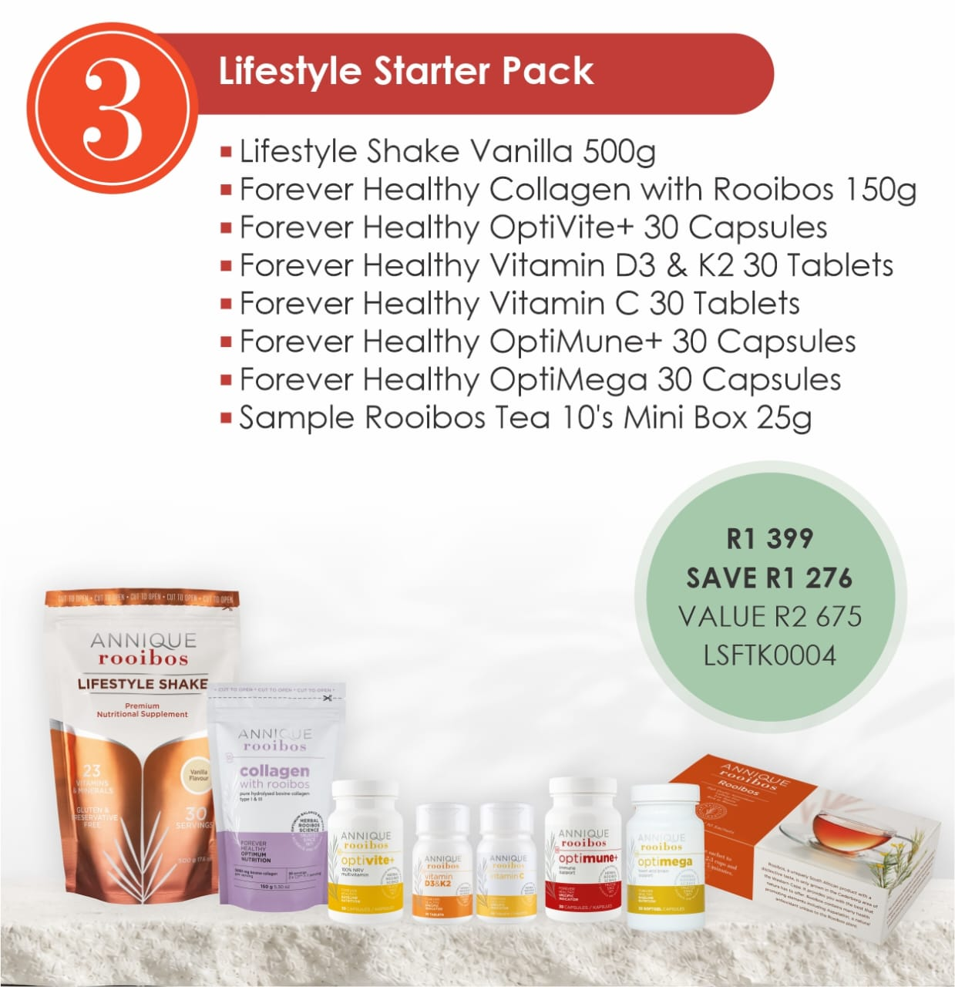
Lifestyle Starter Pack

Slide 35
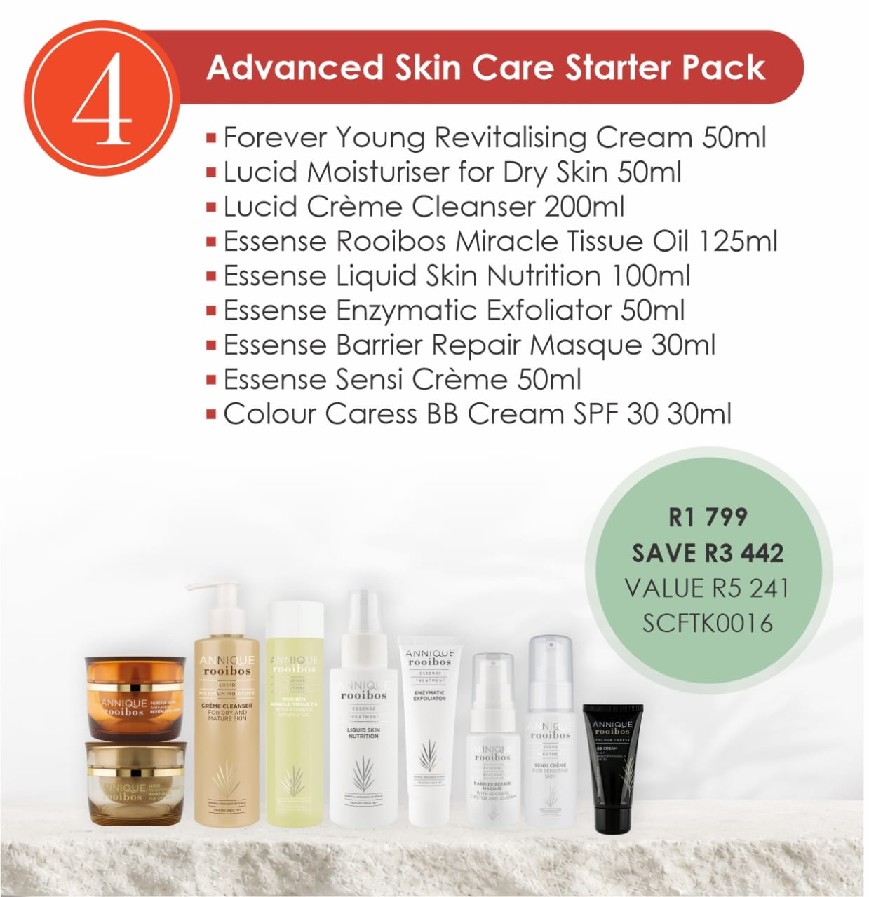
Advanced Skin Care Starter Pack

Slide 36
Starter Packs Information
Only one Starter Pack of each option per Consultant per first order - the packs are not compulsory.
Only available to newly registered Consultants.
Only available on first order.
New Consultants can order all four of the Starter Packs or just one, two, three or four with their first order.

Slide 37

REWARDS & RECOGNITION PROGRAMME
2026 / 2027
Total Rewards to the value of R 2.7 Million

Slide 38


Slide 39
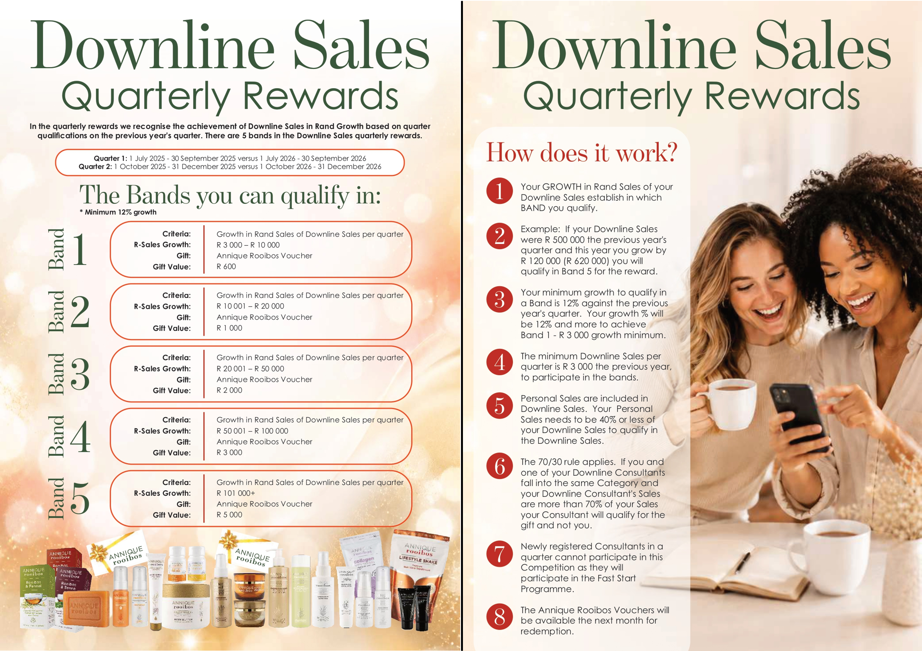

Slide 40
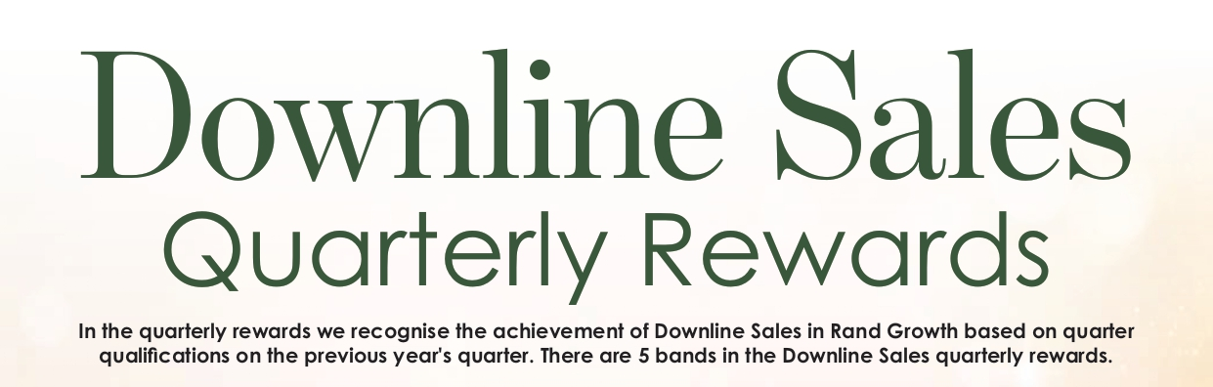
Quarter 1
3 Month-period
1 July 2026 - 30 September 2026
versus
1 July 2025 - 30 September 2025
Quarter 2
3 Month-period
1 October 2026 - 31 December 2026
versus
1 October 2025 - 31 December 2025

Slide 41
1
Band
Criteria:
R-Sales Growth:
Growth in Rand Sales of Downline Sales per quarter R 3 000 – R 10 000
Annique Rooibos Voucher
R 600
Gift:
Gift Value:
2
Band
Criteria:
R-Sales Growth:
Growth in Rand Sales of Downline Sales per quarter R 10 001 – R 20 000
Annique Rooibos Voucher
R 1 000
Gift:
Gift Value:
3
Band
Criteria:
R-Sales Growth:
Growth in Rand Sales of Downline Sales per quarter R 20 001 – R 50 000
Annique Rooibos Voucher
R 2 000
Gift:
Gift Value:
4
Band
Criteria:
R-Sales Growth:
Growth in Rand Sales of Downline Sales per quarter R 50 001 – R 100 000
Annique Rooibos Voucher
R 3 000
Gift:
Gift Value:
5
Band
Criteria:
R-Sales Growth:
Growth in Rand Sales of Downline Sales per quarter R 101 000+
Annique Rooibos Voucher
R 5 000
Gift:
Gift Value:

Slide 42
DOWNLINE SALES
Quarter 1 & 2 Rewards
R 600
Annique Rooibos Voucher
Band 1 GROWTH : R 3 000 - R 10 000 Sales
OR
Downline Sales Growth of between R 1 000 –
R 3 333 per month for 3 months
Note: Minimum 12% growth against LY Quarter

Slide 43
DOWNLINE SALES
Quarter 1 & 2 Rewards
R 1 000
Annique Rooibos Voucher
Band 2 GROWTH : R 10 001 - R 20 000 Sales
OR
R 3 334 - R 6 666 per month for 3 months
Note: Minimum 12% growth against LY Quarter

Slide 44
DOWNLINE SALES
Quarter 1 & 2 Rewards
R 2 000
Annique Rooibos Voucher
Band 3 GROWTH : R 20 001 - R 50 000 Sales
OR
Downline Growth of between R 6 667 - R 16 666 per month for 3 months
Note: Minimum 12% growth against LY Quarter

Slide 45
DOWNLINE SALES
Quarter 1 & 2 Rewards
R 3 000
Annique Rooibos Voucher
Band 4 GROWTH : R 50 001 - R 100 000 Sales
OR
Downline Sales growth of between R 16 667 - R 33 333 per month for 3 months
Note: Minimum 12% growth against LY Quarter

Slide 46
DOWNLINE SALES
Quarter 1 & 2 Rewards
R 5 000
Annique Rooibos Voucher
Band 5 GROWTH : R 101 000+ Sales
OR
Downline Sales growth of R 33 666+ per month for 3 months
Note: Minimum 12% growth against LY Quarter

Slide 47
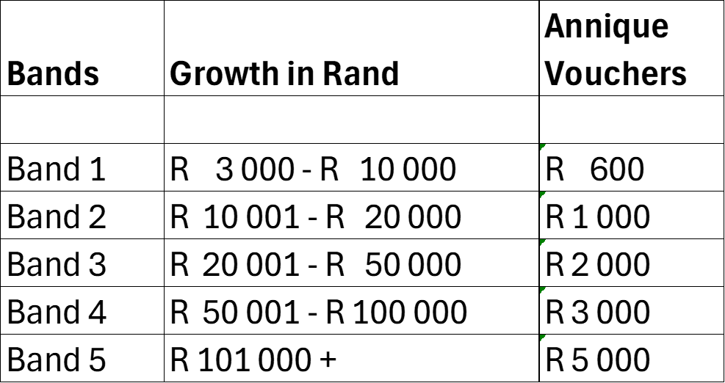
DOWNLINE SALES
Quarterly Rewards
Quarter 1 :
1 July - 30 September 2026
Quarter 2 :
1 October - 31 December 2026
Downline Sales
GROWTH R-sales

Slide 48

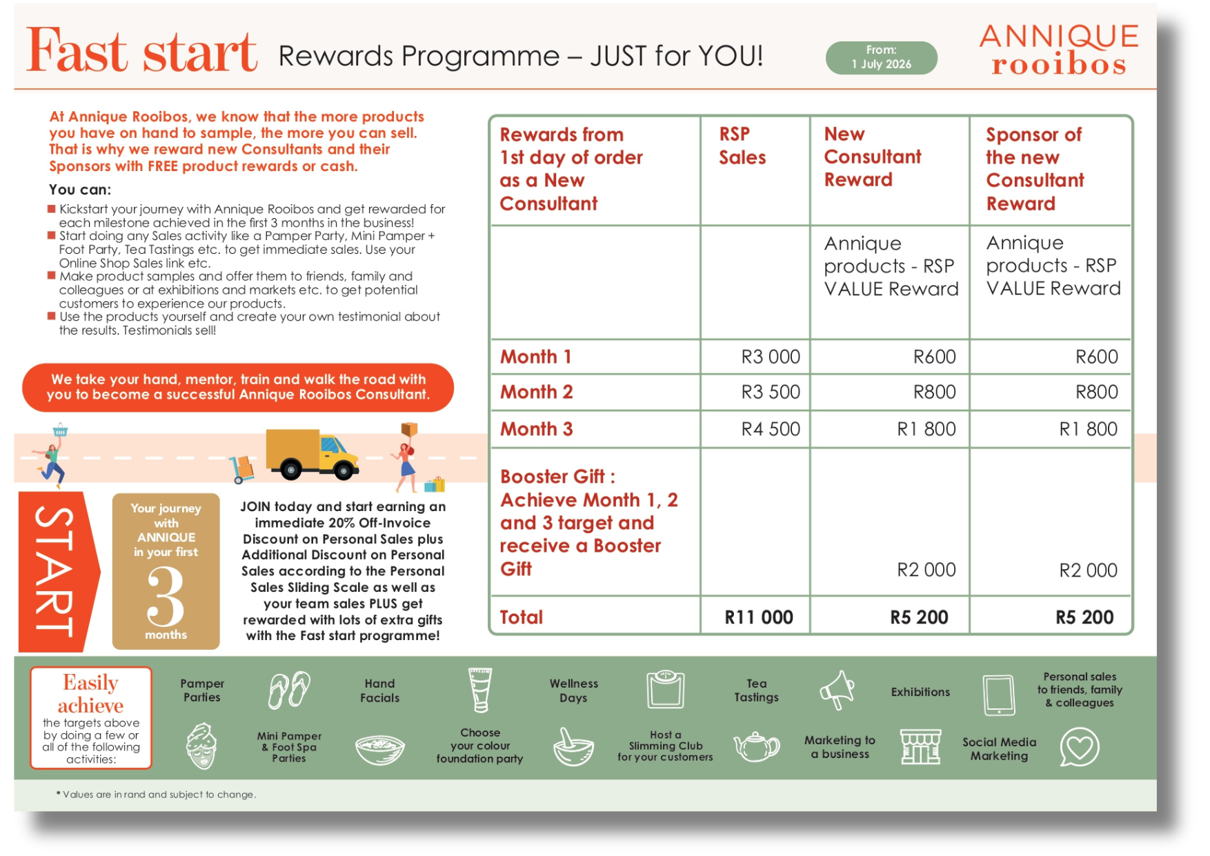
QUESTIONS & ANSWERS
Downline Sales – Quarterly Rewards
Is there a minimum Downline Sales to participate in the Rewards?
YES,
your minimum Downline Sales for the quarter last year must be R 3 000
Can a newly registered Consultant participate in the Downline Sales Rewards?
NO,
a newly registered Consultant in the quarter cannot participate as they will participate in the Fast Start Programme

Slide 49
QUESTIONS & ANSWERS
Downline Sales – Quarterly Rewards
What is the 70/30 rule?
If you and one of your Downline Consultants fall into the same band and your Downline Consultant's Sales are more than 70%
of your Sales, your Consultant will qualify for the gift and not you.
Example : Your sales growth = R 80 000 (Band 4)
Your Downline Consultant Sales Growth = R 60 000 (Band 4)
That is 75% of your Growth. Your Downline Consultant will qualify.

Slide 50
QUESTIONS & ANSWERS
Downline Sales – Quarterly Rewards
Is your Personal Sales included in your Downline Sales?
YES,
but your Personal Sales need to be less that 40% to qualify in the Downline Sales Rewards
Example:
Your Downline Sales after growth = R 100 000
Your Personal Sales = R 50 000
YOUR Personal Sales = 50% of Downline Sales
YOU DO NOT QUALIFY

Slide 51
QUESTIONS & ANSWERS
Downline Sales – Quarterly Rewards
What is the minimum growth to qualify in the Downline Sales Growth Bands?
12% growth against last year 's quarter 1

Slide 52
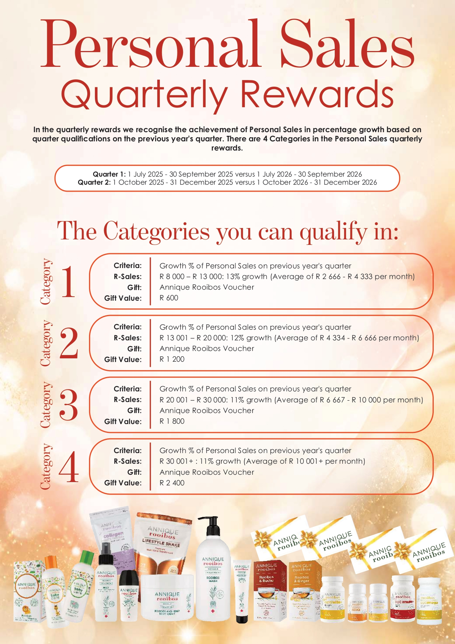



Slide 53
Achieve specific targets per Category
Quarter 1
3 Month-period
1 July 2026 - 30 September 2026
versus
1 July 2025 - 30 September 2025
Quarter 2
3 Month-period
1 October 2026 - 31 December 2026
versus
1 October 2025 - 31 December 2025

Slide 54

1
Criteria:
R-Sales Growth:
Growth in Rand Sales of Downline Sales per quarter R 3 000 – R 10 000
Annique Rooibos Voucher
R 600
Category
Gift:
Gift Value:
2
Criteria:
R-Sales Growth:
Growth in Rand Sales of Downline Sales per quarter R 10 001 – R 20 000
Annique Rooibos Voucher
R 1 000
Category
Gift:
Gift Value:
3
Criteria:
R-Sales Growth:
Growth in Rand Sales of Downline Sales per quarter R 20 001 – R 50 000
Annique Rooibos Voucher
R 2 000
Category
Gift:
Gift Value:
4
Criteria:
R-Sales Growth:
Growth in Rand Sales of Downline Sales per quarter R 50 001 – R 100 000
Annique Rooibos Voucher
R 3 000
Category
Gift:
Gift Value:

Slide 55
PERSONAL SALES
Quarter 1 & 2 Rewards
Personal Sales : Category 1
R 600
Annique Rooibos Voucher
Category 1 : R 8 000 - R 13 000 (LY sales)
Average sales of R 2 666 - R 4 333 per month (LY)
achieve 13%+ growth

Slide 56
PERSONAL SALES
Quarter 1 & 2 Rewards
Personal Sales : Category 2
R 1 200
Annique Rooibos Voucher
Category 2 : R 13 001 - R 20 000 (LY sales)
Average sales of R 4 334 - R 6 666 per month (LY)
achieve 12%+ growth

Slide 57
PERSONAL SALES
Quarter 1 & 2 Rewards
Personal Sales : Category 3
R 1 800
Annique Rooibos Voucher
Category 3 : R 20 001 - R 30 000 (LY sales)
Average sales of R 6 667 - R 10 000 per month (LY)
achieve 11%+ growth

Slide 58
PERSONAL SALES
Quarter 1 & 2
Personal Sales : Category 4
R 2 400
Annique Rooibos Voucher
Category 4 : R 30 001+ (LY sales)
Average sales of R 10 000+ per month (LY)
achieve 11%+ growth

Slide 59
PERSONAL SALES
Quarterly Rewards

Slide 60

QUESTIONS & ANSWERS
Personal Sales – Quarter 1 & 2 Rewards
Is there a minimum Personal Sales to participate in the Reward?
If your Personal Sales were less than R 8 000 (LY)
(Category : 1 R 8 000 - R 10 000). You can still qualify in any category this year. You must achieve the minimum growth of 30%
EXAMPLE
If your sales were R 7 500 last year, you would need to grow with R 2 250 – 30% growth.
That is a total of = R 9 750
You will qualify for Category 1 GIFT

Slide 61
QUESTIONS & ANSWERS
QUESTIONS & ANSWERS
Personal Sales
Personal Sales – Quarter 1 & 2 Rewards
Can a newly registered Consultant participate in the Personal Sales Reward?
NO,
a newly registered Consultant registered in the quarter cannot participate as they will participate in Fast Start

Slide 62
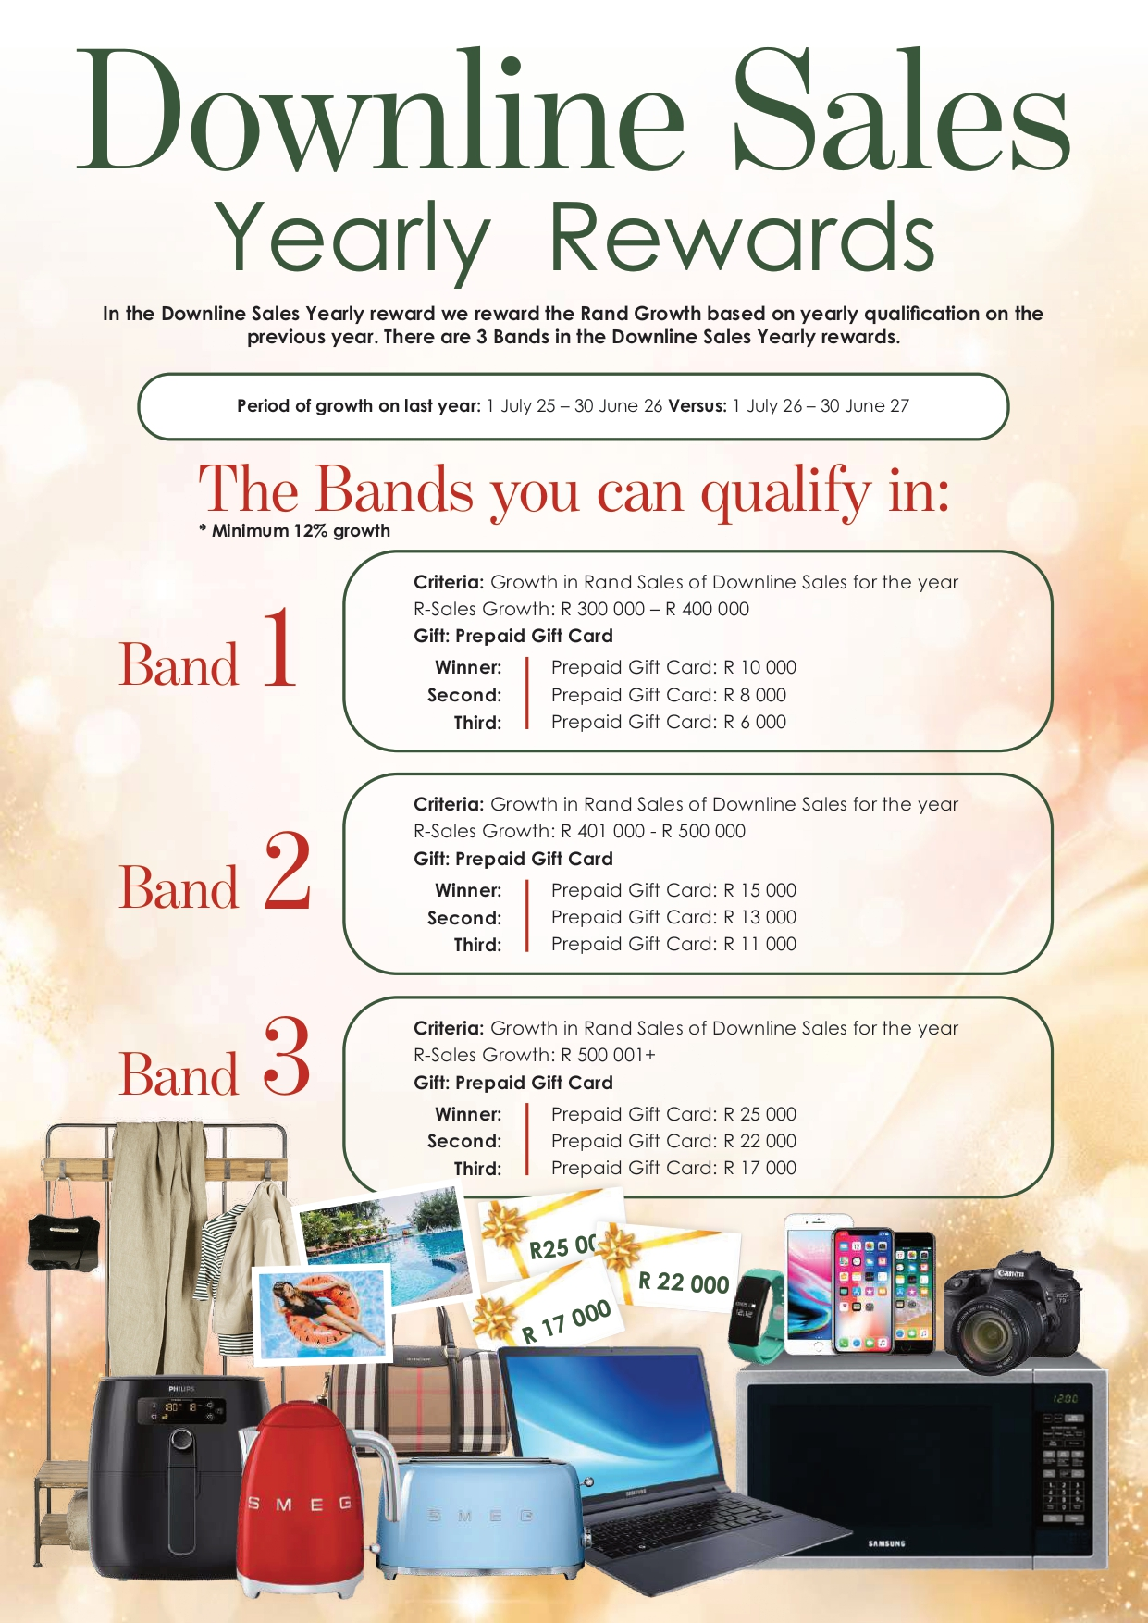
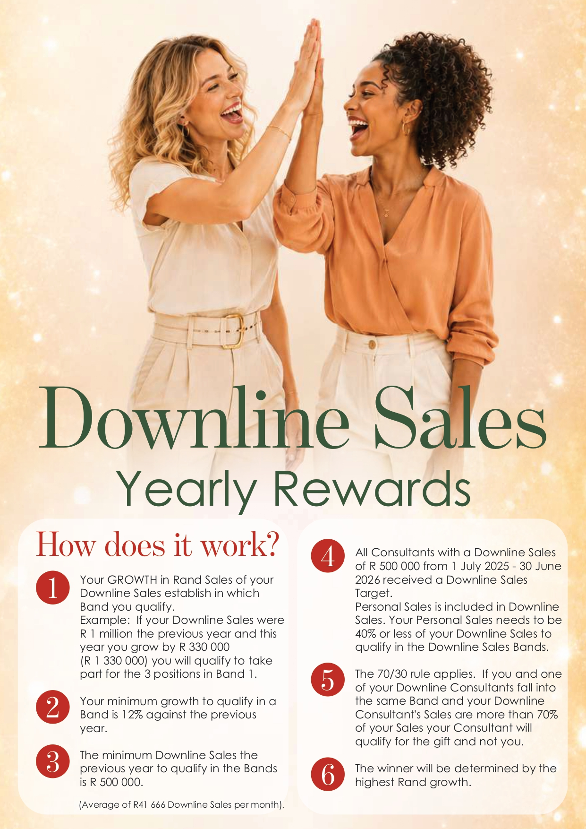
Category in
R-Growth
Bands
1 - 3

Slide 63
1
Criteria: Growth in Rand Sales of Downline Sales per year
R-Sales Growth: R 300 000 – R 400 000
Gift: Prepaid Gift Card
Band
Winner : Second :
Third:
Gift Value: R 10 000
Gift Value: R 8 000
Gift Value: R 6 000
2
Criteria: Growth in Rand Sales of Downline Sales per year R-Sales Growth: R 401 000 – R 500 000
Gift: Prepaid Gift Card
Band
Winner : Second :
Third:
Gift Value: R 15 000
Gift Value: R 13 000
Gift Value: R 11 000
3
Criteria: Growth in Rand Sales of Downline Sales per year R-Sales Growth: R 501 000+
Gift: Prepaid Gift Card
Band
Winner : Second :
Third:
Gift Value: R 25 000 Gift Value: R 22 000
Gift Value: R 17 000

Slide 64

12-month period :
1 July 2026 till 30 June 2027

Slide 65

INCOME OPPORTUNITIES
Why do I need to recruit?
Long Term Strategy
=
Increase Stable Income

Slide 66
INCOME OPPORTUNITIES
=
New L1 (39)
R 314 625
=
Income
R 33 744
=
R 2 812
per month extra
Average

Slide 67
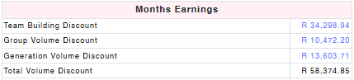
INCOME OPPORTUNITIES
Downline Sales R 1.5m
Ruby Director

Slide 68
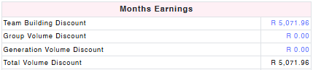
INCOME OPPORTUNITIES
Downline Sales R 128 260
Four-Star Consultant

Slide 69
Highest sales of Level 1 recruits

Slide 70
STAR BUSINESS BUILDER
Yearly Rewards
12-month period
1 July 2026 - 30 June 2027
WIN Prepaid GIFT Card
R 35 000 | R 30 000 | R 25 000
with your new Consultant’s Sales of
R 250 000+
Note : Minimum of 10+ New Level 1 Consultants

Slide 71
STAR BUSINESS BUILDER
Yearly Rewards
Third Place = R 25 000
Second Place = R 30 000
Winner = R 35 000
WIN Prepaid GIFT Card

Slide 72
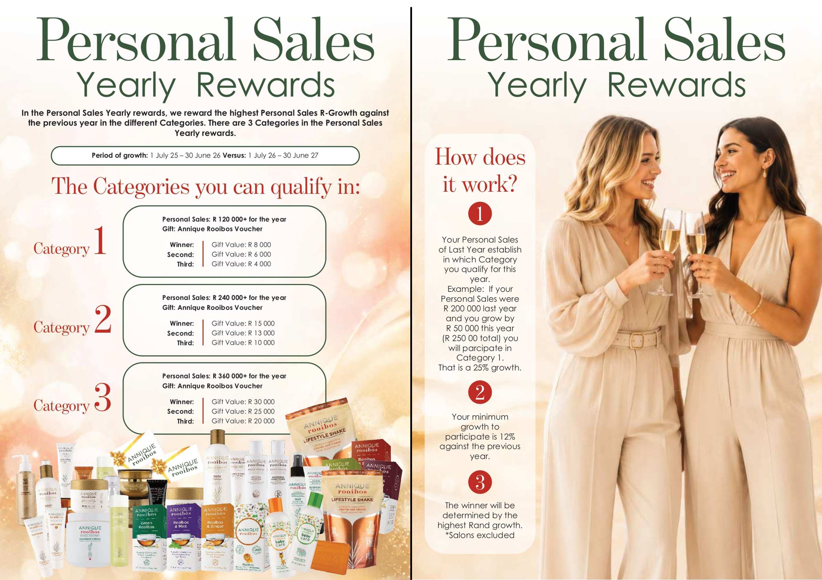
Category in
R-Growth
Category
1 - 3

Slide 73
1
Criteria: R 120 000+ for the year (12% growth)
Gift: Annique Rooibos Product Voucher
Category
Winner : Second :
Third:
Gift Value: R 8 000
Gift Value: R 6 000
Gift Value: R 4 000
2
Criteria: R 240 000+ for the year (12% growth)
Gift: Annique Rooibos Product Voucher
Category
Winner : Second :
Third:
Gift Value: R 15 000
Gift Value: R 13 000
Gift Value: R 10 000
3
Criteria: R 360 000+ for the year (12% growth)
Gift: Annique Rooibos Product Voucher
Category
Winner : Second :
Third:
Gift Value: R 30 000 Gift Value: R 25 000
Gift Value: R 20 000

Slide 74
Personal Sales
Your Personal Sales of Last Year establish in which Category you qualify for this year.
If your Personal Sales were R200 000 last year and you grow by R50 000 this year (R 250 000 total) you will participate in Category 1 because LY sales were R 200 000.
That is a 25% growth.

Slide 75
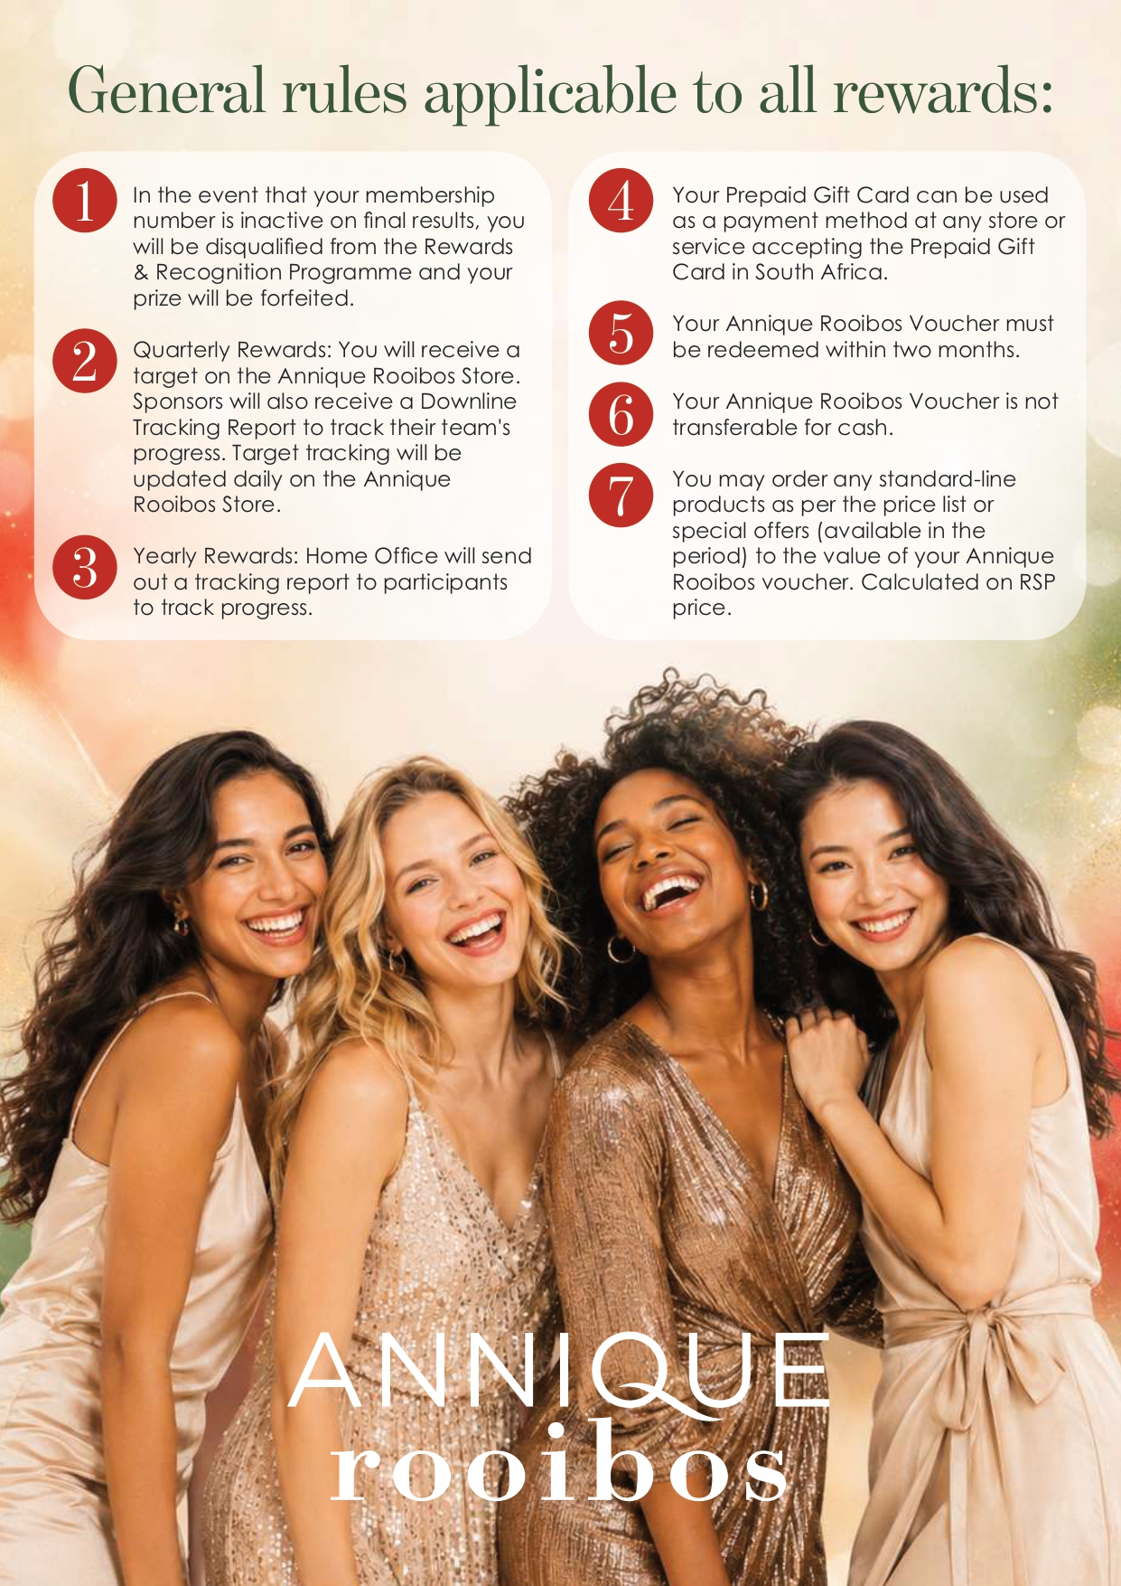
Applies to all Rewards & Recognition

Slide 76
QUARTERLY
Downline & Personal Sales Reward
Tracking Reports on the Annique Store
YEARLY
Downline & Personal Sales Reward
Monthly Tracking Reports to be sent to the Top 10 in each Category / Band Reward

Slide 77
RRI Document
Available today - Anews
Available on the Academy
PPT will be available on the Academy
Recording will be available on the Academy

Slide 78
THANK YOU
enjoy your evening

