Slide 1



QUARTERLY REWARDS
PERSONAL
SALES

Slide 2


PERSONAL SALES
CRITERIA
Top Personal Sellers
in Rand-growth
January to March
2024 vs 2025

Slide 3



PERSONAL SALES
3RD PLACE
Elsie Griesel
LY = R 169 218
CY = R 226 546
Growth : R 57 328
Growth p/m : R 19 109
Voucher to the Value of R6 000
Notes:
Voicenote

Slide 4

PERSONAL SALES
2ND PLACE
Alta Landman
LY = R 17 223
CY = R 104 804
Growth : R 87 581
Growth p/m : R 29 193
Voucher to the Value of R8 000

Slide 5

PERSONAL SALES
1ST PLACE
Adéle Goosen
LY = R 31 546
CY = R 184 814
Growth : R 153 268
Growth p/m : R 51 089
Voucher to the Value of R10 000

Slide 6
QUARTERLY REWARDS
DOWNLINE
SALES

Slide 7
DOWNLINE
SALES
CRITERIA
Top Downline Sales
(Current Business)
in Rand-growth
January - March
2024 vs 2025
LY Sales
Minimum R 400 000

Slide 8



DOWNLINE SALES
3RD PLACE
Elaine Opperman
Growth : R 111 222
LY = R 662 495
CY = R 733 717
Growth = R 71 222
Voucher to the Value of R4 000

Slide 9
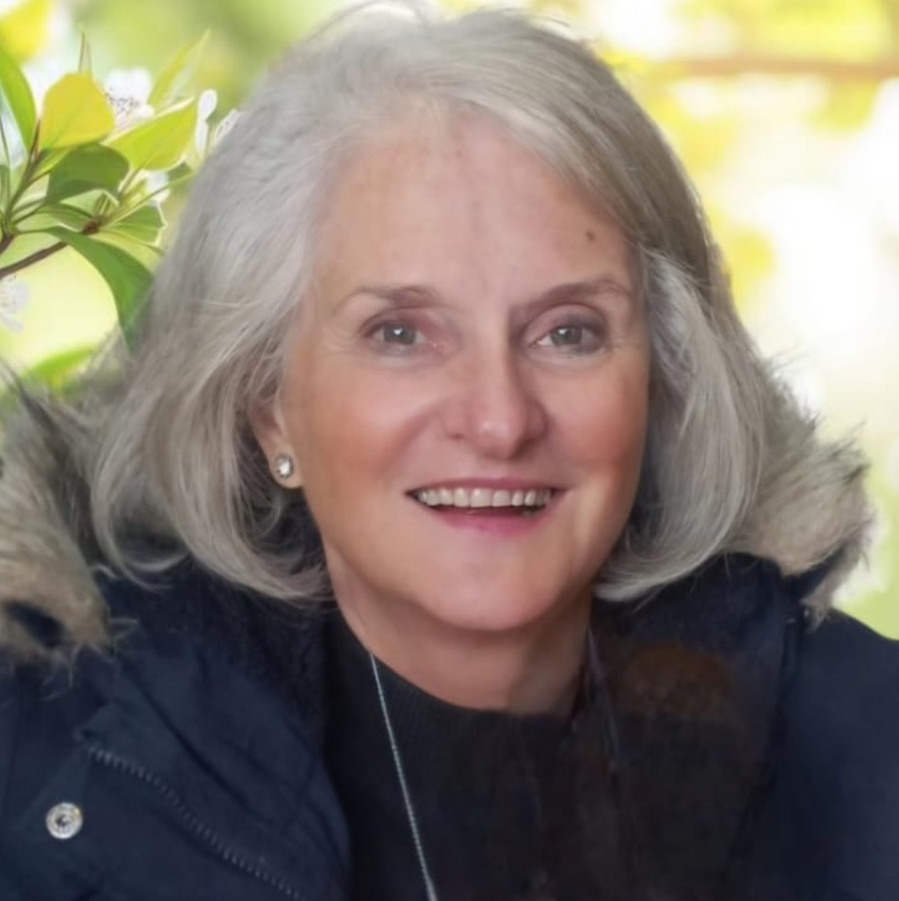
DOWNLINE SALES
2ND PLACE
Sandra Kruger
Growth : R 92 256
LY = R 480 555
CY = R 572 811
Voucher to the Value of R5 000

Slide 10

DOWNLINE SALES
1ST PLACE
Monika Basson
Growth : R 127 774
LY = R 884 841
CY = R 1 012 615
Voucher to the Value of R6 000
Notes:
Will be speaking LIVE

Slide 11
QUARTERLY REWARDS
STAR
RECRUITER

Slide 12
STAR
RECRUITER
CRITERIA
Top STAR Recruiter
January to March - 2024
*Level 1 Consultants Sales (Growth on LY)

Slide 13

TOP RECRUITER
5TH PLACE
Annemarie Smuts
LY = 3 x L1
(Sales R 7 773)
CY = 7 x L1
Sales = R 20 897
Voucher to the Value of R2 000

Slide 14
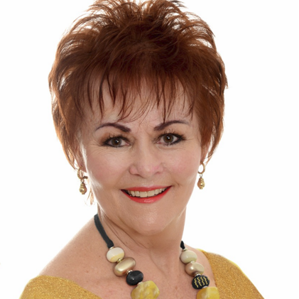
TOP RECRUITER
4TH PLACE
Leslie Grobler
LY = 3 x L1
(Sales = R 5 213)
CY = 4 x L1
Sales = R 21 871
Voucher to the Value of R3 000

Slide 15

TOP RECRUITER
3RD PLACE
Henriëtte Badenhorst
LY = 11 x L1
(Sales = R 11 890)
CY = 5 x L1
Sales = R 32 882
Voucher to the Value of R4 000

Slide 16
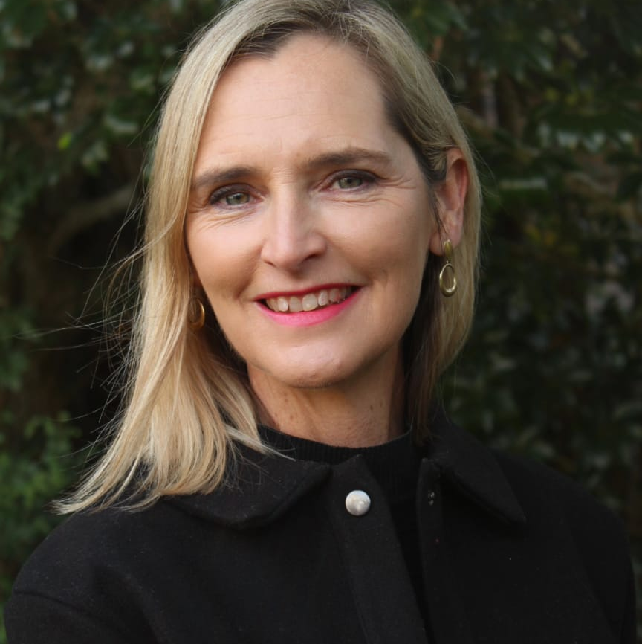
TOP RECRUITER
2ND PLACE
Petro Venter
LY = 6 x L1
(Sales = R 5 332)
CY = 7 x L1
Sales = R 38 789
Voucher to the Value of R5 000
Notes:
Petro will be speaking LIVE

Slide 17

TOP RECRUITER
1ST PLACE
Amanda Brugman
LY = 4 x L1
(Sales = R 5 464)
CY = 4 x L1
Sales = R 40 452
Voucher to the Value of R6 000

