Slide 2
Vitamin C Benefits
Antioxidant
Supports the immune system
Supports collagen building
Helps reduce chronic disease
Supports the wound healing
Enhances iron absorption
Notes:
Vitamin C is an essential nutrient that plays numerous important roles in the human body. Scientific studies have demonstrated several benefits associated with adequate intake of vitamin C:
Antioxidant properties: Vitamin C is a potent antioxidant, meaning it helps protect cells from damage caused by free radicals. This may reduce the risk of chronic diseases such as heart disease, cancer, and arthritis.
Immune system support: Vitamin C is well-known for its role in supporting the immune system. It helps stimulate the production of white blood cells, which are key to fighting infections. Adequate vitamin C intake may reduce the severity and duration of common colds and allergies
Collagen synthesis: Vitamin C is essential for the synthesis of collagen, a protein that is important for skin health, wound healing, and the structure of bones, muscles, and blood vessels.
Reduced risk of cardiovascular disease: Some studies suggest that adequate intake of vitamin C may help reduce the risk of cardiovascular disease by improving endothelial function, lowering blood pressure, and reducing inflammation.
Wound healing: Due to its role in collagen synthesis and its antioxidant properties, vitamin C is important for wound healing. It helps the body repair damaged tissue and promotes the formation of scar tissue.
Iron Absorption: Vitamin C can enhance the absorption of non-heme iron from plant-based foods, which is particularly important for individuals who follow vegetarian or vegan diets.

Slide 3
Vitamin C = Workers in a Fortress
Defense Army: Immune support
Chief engineer repairs breaches
Fortified defense against disease
Shield against free radical attack
Builds strong walls (collagen)
Notes:
Imagine your body is like a fortress, constantly under attack from invaders (like bacteria and viruses) and facing threats from environmental elements (like pollution and UV radiation). Now, think of vitamin C as the loyal guards and repair workers within this fortress, tirelessly defending and maintaining its integrity.
Immune System Support - The Defensive Army: Vitamin C acts like the commander of your body's immune system, rallying the troops (white blood cells) to fight off invaders. Just as a strong army can repel attacks, adequate vitamin C intake strengthens your body's defenses against common colds and infections, helping you stay healthy and resilient.
Antioxidant Properties - Shield Against Enemies: Picture vitamin C as a shield, protecting your fortress from the constant bombardment of free radicals - unstable molecules that can damage cells and DNA. By neutralizing these free radicals, vitamin C helps prevent oxidative stress, reducing the risk of chronic diseases like heart disease and cancer.
Collagen Synthesis - Building Strong Walls: Imagine your body's tissues, like skin, bones, and blood vessels, as the walls and structures of your fortress. Vitamin C plays a crucial role in building and repairing these structures by aiding in collagen synthesis. Think of it as the mason who ensures that the fortress remains sturdy and resilient, promoting wound healing and maintaining healthy skin and connective tissues.
Wound Healing - Repairing Breaches: When your fortress sustains damage, whether from injury or illness, vitamin C steps in as the chief engineer, orchestrating the repair efforts. It accelerates wound healing by promoting tissue regeneration and forming scar tissue, ensuring that any breaches in the fortress are swiftly repaired.
Reduced Risk of Disease - Fortifying Defenses: By supporting immune function, combating oxidative stress, and promoting overall health, vitamin C helps fortify your body's defenses against a range of diseases, from cardiovascular conditions to age-related macular degeneration. Just as a well-fortified fortress is less vulnerable to attacks, a body with adequate vitamin C levels is better equipped to fend off health threats.

Slide 4
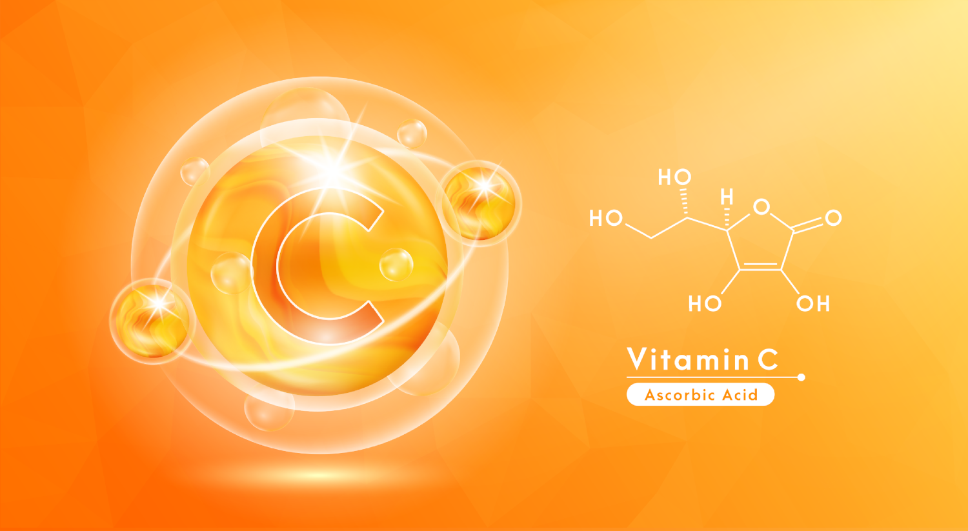
Vitamin C: Why Supplement Every Day?
Water soluble
Inefficient dietary intake
Some medications, like aspirin, oral contraceptives, and corticosteroids, may interfere with absorption

Slide 5
People at Risk of Vitamin C Inadequacy
Smokers
People with limited food variety
People with less optimal digestive systems
Elderly
People who drink alcohol regularly
Those with certain chronic diseases like diabetes
Those under severe stress
Notes:
Smokers: Smoking increases the body's demand for vitamin C. The harmful chemicals in tobacco smoke can also deplete vitamin C levels in the body.
People with Poor Diets: Those who do not consume enough fruits and vegetables rich in vitamin C are at risk. This could include individuals with limited access to fresh produce or those who have poor dietary habits.
People with challenged digestive systems: Individuals with malabsorption syndromes, such as Crohn's disease or celiac disease, may have difficulty absorbing enough vitamin C from their diet. Additionally, individuals undergoing dialysis may be at risk of vitamin C deficiency.
Elderly Individuals: Older adults may have reduced intake of vitamin C due to changes in appetite, reduced food intake, or difficulties in food preparation. Aging can also affect the body's ability to absorb and utilize nutrients efficiently.
People who drink alcohol regulary: Excessive alcohol consumption can interfere with the absorption and utilization of vitamin C in the body, leading to deficiency over time.
6. People with Certain Chronic Diseases: Individuals with certain chronic diseases, such as diabetes or certain types of cancer, may have increased requirements for vitamin C or may be at higher risk of deficiency due to factors related to their disease or treatment.

Slide 6
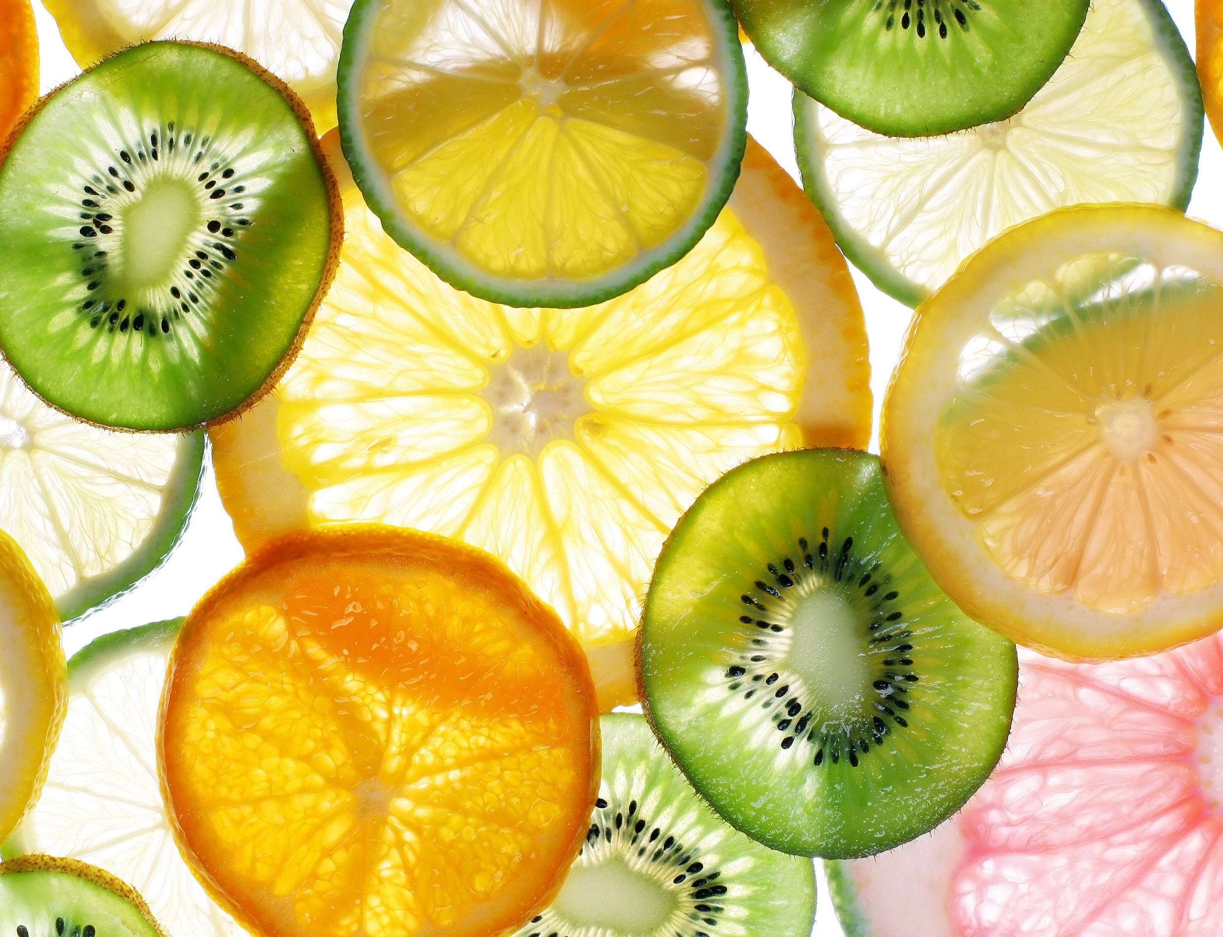
Buffered Vitamin C
Buffered Vitamin C
Non-Buffered Vitamin C
Calcium Ascorbate
Ascorbic Acid
Gentle on the stomach - less likely to cause digestive issues
Can cause stomach discomfort due to high acidity

Slide 7
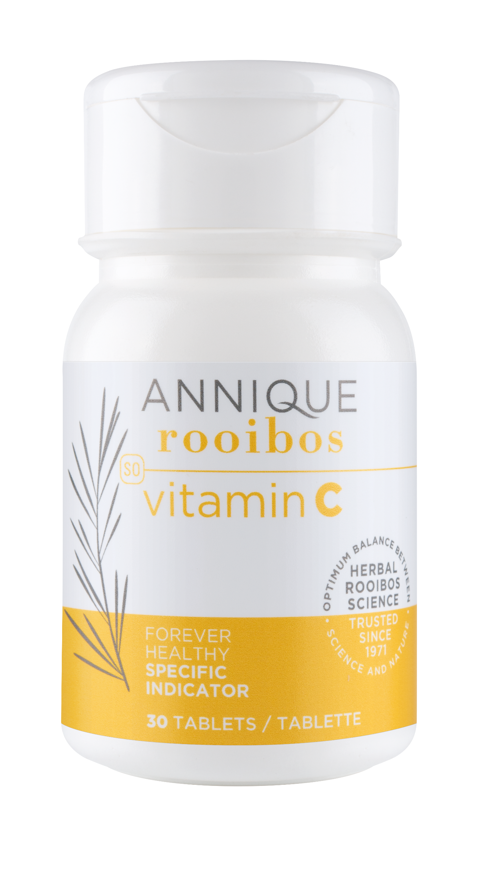
NEW Vitamin C Tablets
NEW
Buffered Vitamin C
Green Rooibos

Slide 8
NEW Vitamin C vs OptiC
NEW Vitamin C 30 Tablets
OptiC 30 Capsules
Calcium Ascorbate 500mg
Green Rooibos
Calcium Ascorbate 300mg
Selenium
Zinc
Green Rooibos
67% more vitamin C
R139
R239
Notes:
Comparing the new vitamin C with the OptiC:
Both contains buffered vitamin C
The new Vitamin C tablets contain 67% vitamin C: 500mg vs 300mg
We have the Selenium and Zinc
Selling price is R100 or 40% less than OptiC, so you are getting more bang for your buck.
If you take our daily multivitamin, OptiVite, or some people take OptiDerm as a multivatmin, those contain zinc and selenium, so you don’t miss out if you feel it is important to supplement these.

Slide 9
Vitamin C Directions of Use
Adults:
1 to 2 in the morning with breakfast
Kids:
4-8 years old:
1 in the morning with breakfast
9+ years:
1 to 2 in the morning with breakfast
Suitable for pregnant and breastfeeding women

Slide 10
Vitamin C Directions of Use
Immune Booster Combo:
Take 1 of each of the following tablets in the morning with breakfast:
- Vitamin C
- Vitamin D3 & K2
- Zinc
OptiBoost
Notes:
Also, if you are looking for additional immune boosting benefits, try adding our Zinc and or Vitamin K2&D3 tablets, especially in winter months.

