Slide 1
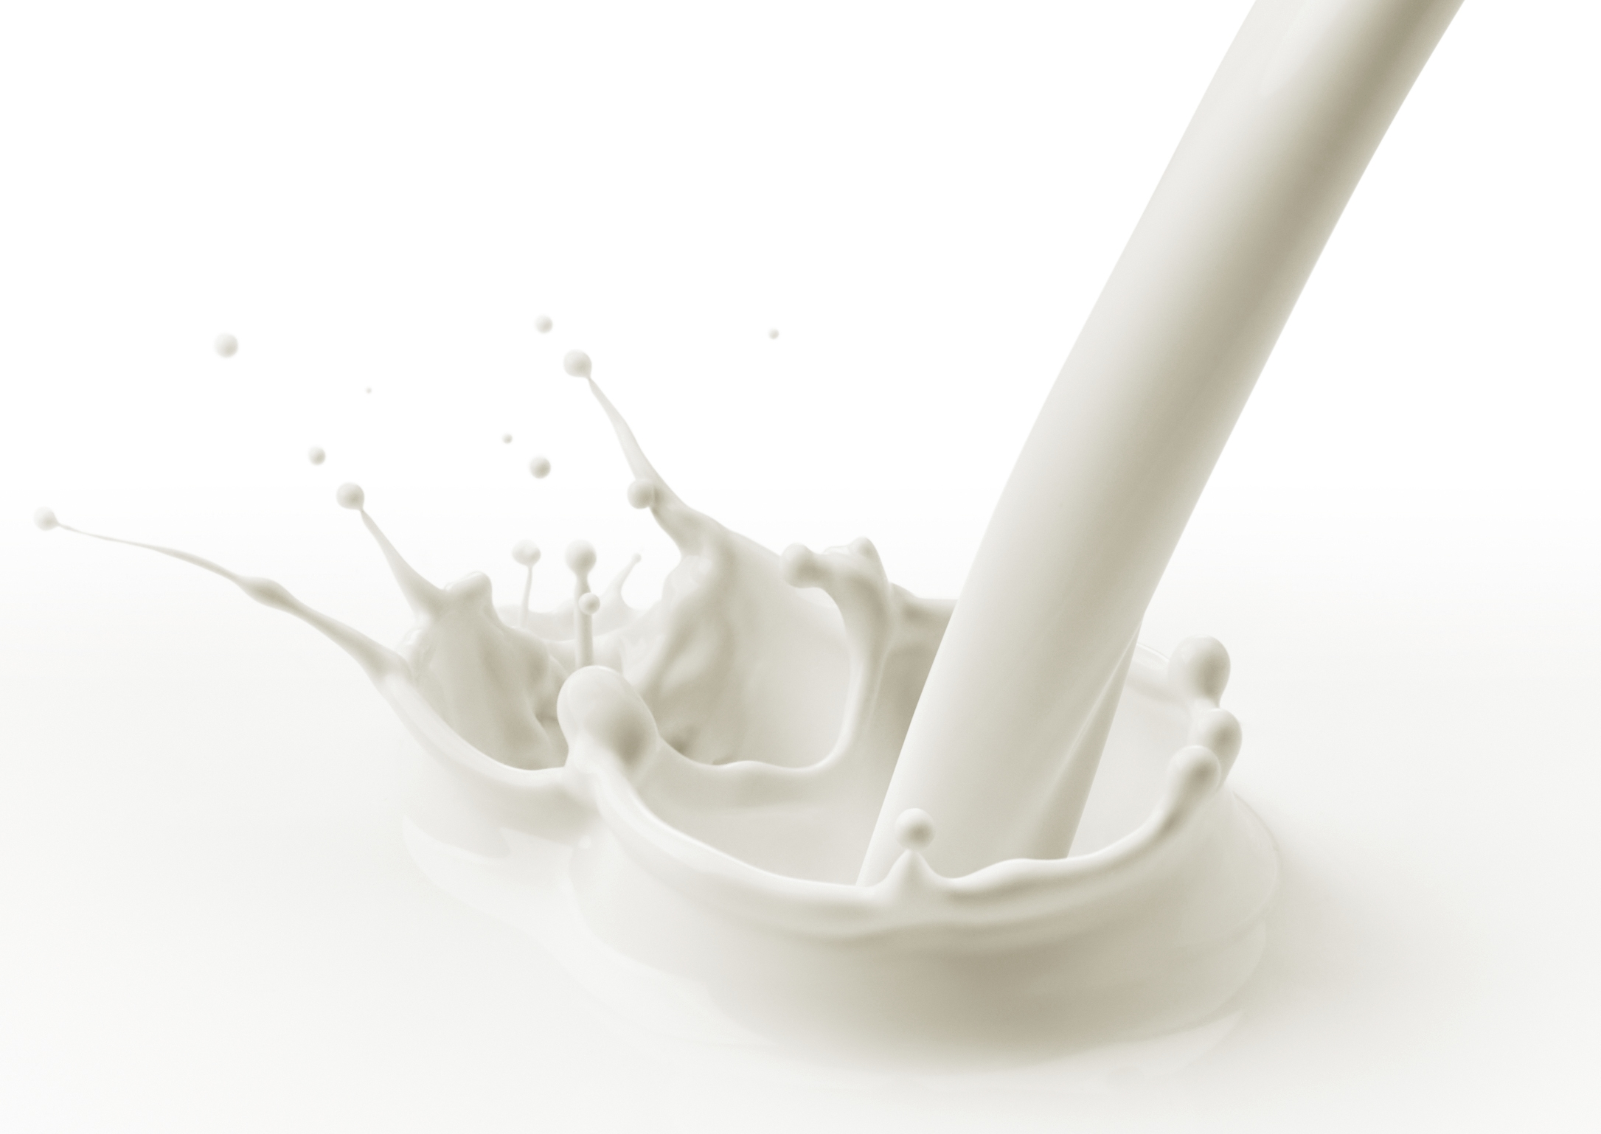
NEW
Rooibos Lifestyle Shake
July 2023

Slide 2
Rooibos Lifestyle Shake
First product launched in 1971
Countless testimonials
Healthy weight loss
A healthy snack for growing kids
Helps the elderly and others to recover from illness
Packed vitamin and minerals
Notes:
Annique’s Rooibos Lifestyle Shake is a firm favourite amongst thousands of Consultants and Clients. Did you know it was the very first product Annique launched back in 1971 when the business started? And until today it is one of our top sellers.
We have received countless testimonials over the years on how the Lifestyle Shake has improved people’s lives for the better, from healthy weight loss, a healthy snack for growing kids and how it has helped the elderly and others to recover from illness.
There have been several new developments and technological advancements in the health supplement space in recent years, paving the way for the development of a new, improved Annique Rooibos Lifestyle Shake. The South African Health Products Regulatory Authority (SAHPRA) also established new rules with recommendations for the minimum and maximum dosages for ingredients providing the opportunity to include more of some essential ingredients in the new formula.

Slide 3
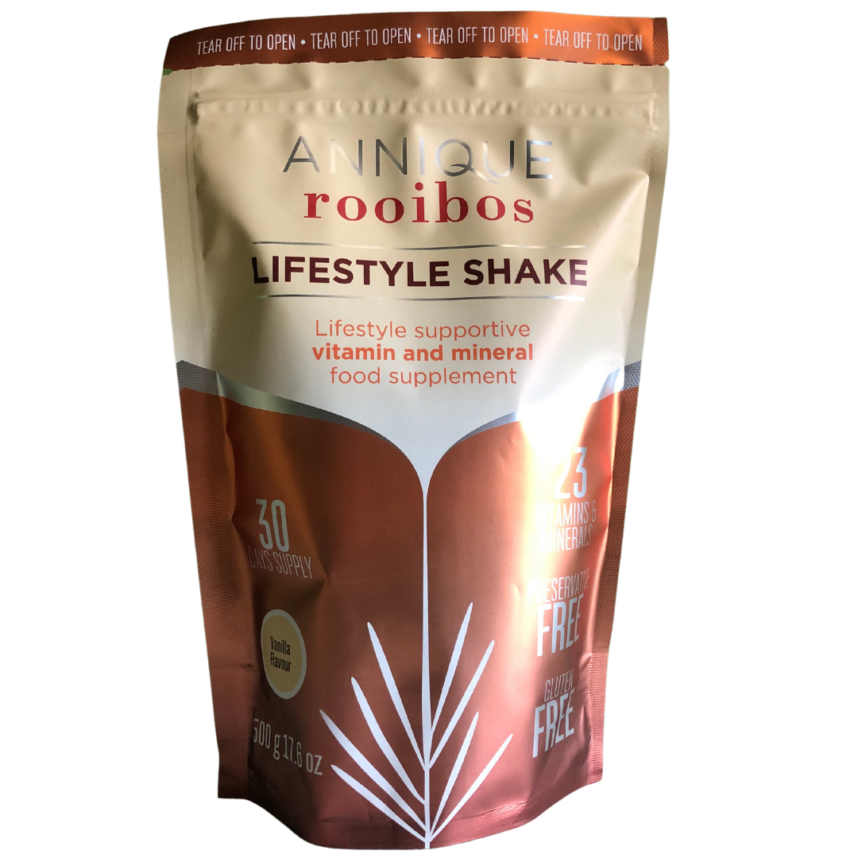
Rooibos Lifestyle Shake
NEW
NEW formula and packaging
54% less carbohydrates
31% more protein
More good fats, for sustainable energy
More vitamins and minerals to support good health
One month supply (33 servings)
Notes:
Annique’s new and improved Rooibos Lifestyle Shake is a premium supplement that has a special blend of components to help replace and maintain your body's nutrient levels.
This incredible new formulation now contains:
54% less carbohydrates
More protein and good fats, for sustainable energy
More vitamins and minerals to support good health
One month supply (33 servings)

Slide 4
Rooibos Lifestyle Shake
 | New Shake Formula | Previous Formula
 | New and improved formula
SAHPRA | SAHPRA compliant | Not SAHPRA compliant
Macro nutrient (carbohydrates, proteins and fats) comparison | More good fats added (from responsibly sourced palm oil, which is naturally rich in vitamin E, essential to improve mental and heart health) Protein increased by 31% Carbohydrates reduced by 54% More sustainable energy and improved maintenance of blood sugar levels
Vitamins and minerals | 20 out of the 23 vitamins and minerals increased
Fibre | Contains inulin, a soluble fibre that aids digestion, helps to relieve constipation, and even aids in the body's absorption of calcium and magnesium. | Contains apple fibre
Notes:
SAHPRA (South African Health Products Regulatory Authority) compliant with the Complementary Medicines (Quality, Safety and Efficacy) act.
More good fats added (from responsibly sourced palm oil, which is naturally rich in vitamin E, essential to improve mental and heart health)
Protein increased by 31%
Carbohydrates reduced by 54%
The effect is more sustainable energy and improved maintenance of blood sugar levels
The vitamin and mineral content has been upgraded. 20 out of the 23 vitamins and minerals have been increased in the new formula.
The new Shake contains inulin, a soluble fibre that aids digestion, helps to relieve constipation, and even aids in the body's absorption of calcium and magnesium.

Slide 5
Rooibos Lifestyle Shake
 | New Formula | Previous Formula
Taste | Contains a slightly different, yet still creamy and delicious taste
Size of pack | Now available in a 500g, one-month supply pack | Available in 300g, less than one month supply
Servings per pack | 33 servings | 20 servings
Packaging | Now in a convenient pouch, that is more sustainable and uses less plastic. | Plastic jar
Both formulas contain: | Skim and full cream milk Rooibos extract Stevia (sweetener) Vitamins and minerals
Notes:
Contains a slightly different, yet still creamy and delicious taste
Now available in a 500g, one-month supply pack
33 servings
The packaging has also been updated to be a convenient pouch, that is more sustainable and uses less plastic. It is also more flexible and lightweight and is produced with significantly less carbon emissions.
Both formulas contain:
Skim and full cream milk
Rooibos extract
Stevia (sweetener) Stevia is one of the best low glycemic sweeteners around. It is derived from the leaves of the stevia plant and is 40 times sweeter than sugar. It is a highly effective alternative for a healthy lifestyle.
Vitamins and minerals

Slide 6
Rooibos Lifestyle Shake
Benefits:
Convenient
Delicious
Contains less carbs for sustained energy
Fibre may help to keep you regular
Helps to:
Build and maintain strong bones
Reduce fatigue and exhaustion

Slide 7
Rooibos Lifestyle Shake
Supports:
A healthy nervous system and brain
A heathy metabolism
The body's cell maintenance and production
Weight loss
Healthy blood sugar levels

Slide 8
Rooibos Lifestyle Shake
Unique Selling Points:
Free from
Nuts
Gluten
Potentially harmful artificial sweeteners
MSG
Trans fats
Preservatives
No added sugar
Halaal

Slide 9
Rooibos Lifestyle Shake
Directions of Use:
Mix 2 scoops (15g) with 250ml full cream milk, yogurt, water or Rooibos and shake or mix well.
Suitable for pregnant and breastfeeding women, but it is advised to consult your health care practitioner before using this product.
Recommended from 4 years.
Before starting using the product or any other weight loss program, it is advisable that certain people, like children, insulin-dependent diabetics, and those with damaged renal function, consult with their doctors.

Slide 10
Rooibos Lifestyle Shake
Notes:
Frequently Asked Questions:
Q: What is the difference between the new and previous Shake formulas?
A: The new Shake formula contains:
Less carbs and more protein and healthy fats
500g/33 day’s supply
Q: Why does the new Shake label and ingredient list differ from the old?
A: With the new improved formula, we have updated the label with the correct format and information. As the formula has been improved, the new label will not correspond with the old label and there will be more detail on the new label.
Q: Why did we change the size of the Shake from 300g to 500g
A: We have received overwhelming feedback that customers prefer to buy a one-month supply of the Shake. Hence we have reverted back to a 500g and 33 serving size for your convenience.
Q: Is the Lifestyle Shake a meal replacement?
A: The product was formulated to supplement your nutritional intake of vitamins and minerals. It is not a meal replacement.

