Slide 1



ABC Plan + FAST START PROGRAMME
1 August 2023

Slide 2

Agenda points
Price increase : 1 August 2023
ABC Success Plan : New criteria – 1 August 2023
Fast Start Programme : GOOD NEWS changes – 1 August
Online Shop Sales
Discount terminology : DISCOUNTABLES / NON-DISCOUNTABLES / VARIABLE DISCOUNTABLES

Slide 3
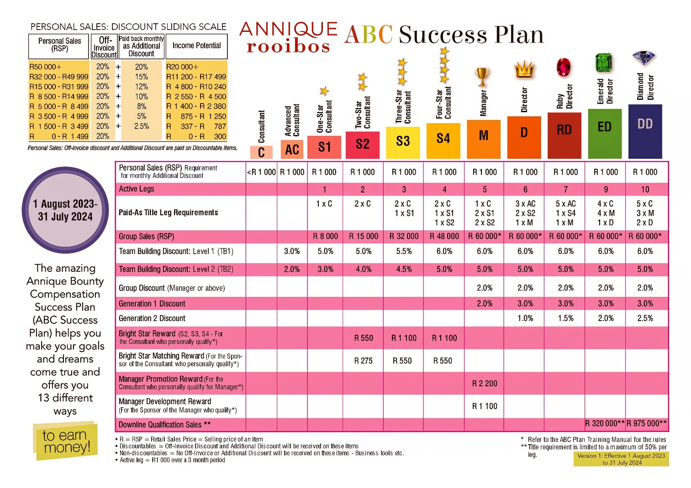
ABC SUCCESS Plan – 1 August 2023

Slide 4
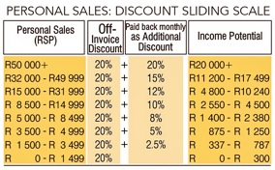
WHAT will change?
ABC SUCCESS Plan
Personal Sales Sliding Scale : More Levels = 7 in total
Start earning from R 1 500 : Earn 2.5% extra

Slide 5
WHAT will change?
ONLINE SHOP SALES
What is Online Shop Sales?
Each Annique Consultant has a personalised link that you can share with your customers. They may order via the link on the Annique Online Shop and sales will count towards your Personal Sales.
2022/23 criteria for Online Shop Sales :
A consultant received an Annique voucher according to the Online Shop Sliding Scale of the Rand Sales Value of the order. This will not be applicable anymore in 2023/24.
2023/24 NEW criteria for Online Shop Sales :
A consultant will now earn the Additional Personal Sales Sliding Scale discount according to the qualifying level (2.5% - 20%) on Personal Sales. The upline consultants will also receive Team Building, Group and Generation discounts, according to the Additional Discount Qualification criteria.

Slide 6
definitions?
Discountable products
You get 20% off-invoice on these products
Non-discountable products
No off-invoice discount on specific products like Starter Packs / Beautès / Replique’s / Samples etc
Variable discountable products NEW from 1 August
Home Office will identify products from time to time and give a 5 / 8 / 10% discount. Can be promotional items. Will earn additional discount according to the Personal Sales Sliding Scale.

Slide 7
Personal sales sliding scale
(Example of calculations = R 5 500 sales)

Slide 8
2022/2023 vs 2023/2024

Slide 9

WHAT will change?
ABC SUCCESS Plan
Additional Discount Qualified amount for your Personal Sales to earn on your team :
  2022/2023 - R 900
  2023/2024 – R 1 000
Additional Discount Qualified amount to earn Sliding Scale on your Online Shop Sales your own Personal Sales must be R 1 000.

Slide 10

Rule to be additional discount qualified to earn on your team
Personal Sales = R 1 000 RSP
Include
  Discountable products
  Non-discountable products
  Variable discountable products
Exclude
  Online Shop Sales
VDS Statement will show Variable discountable products

Slide 11
WHAT will change?
ABC SUCCESS Plan
Group Sales RSP for titles :
S1 = R 8000 / S2 = R 15 000 / S3 = R 32 000 / S4 =
R 48 000 / Manager = R 60 000
Bright Star Reward : R 550 / R 1 100
Bright Star Matching Reward : R 275 / R 550
Manager Promotion Reward : R 2 200
Manager Development Reward : R 1 100
Downline Qualification Sales

Slide 12
Additional Discount earnings on Team Sales – Including / excluding
Team Building 1 / 2 : Group : Generation
You earn on the Personal Sales of your downline
Including in the earnings
  Discountable
  Variable discountables
  Online Shop Sales
Excluding in the earnings
  Non-discountables

Slide 13
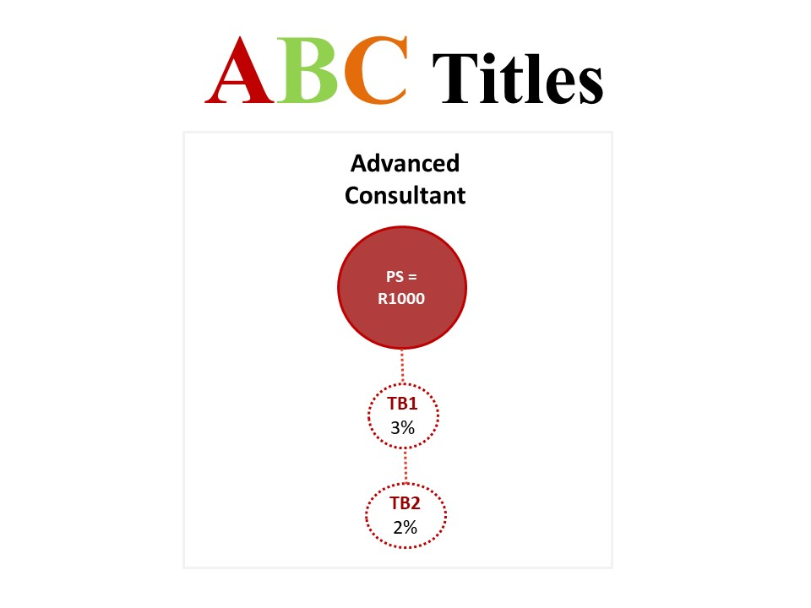
EARNINGS structure

Slide 14
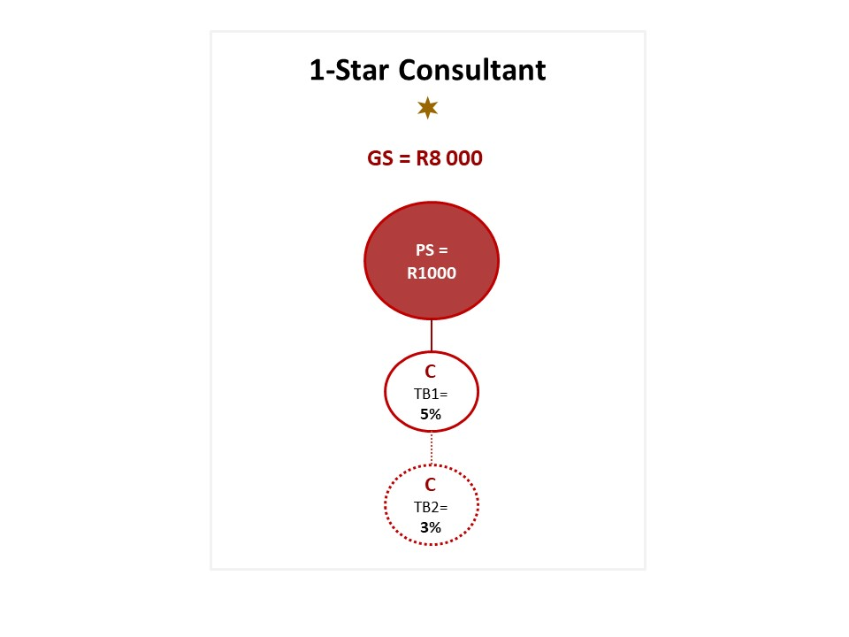
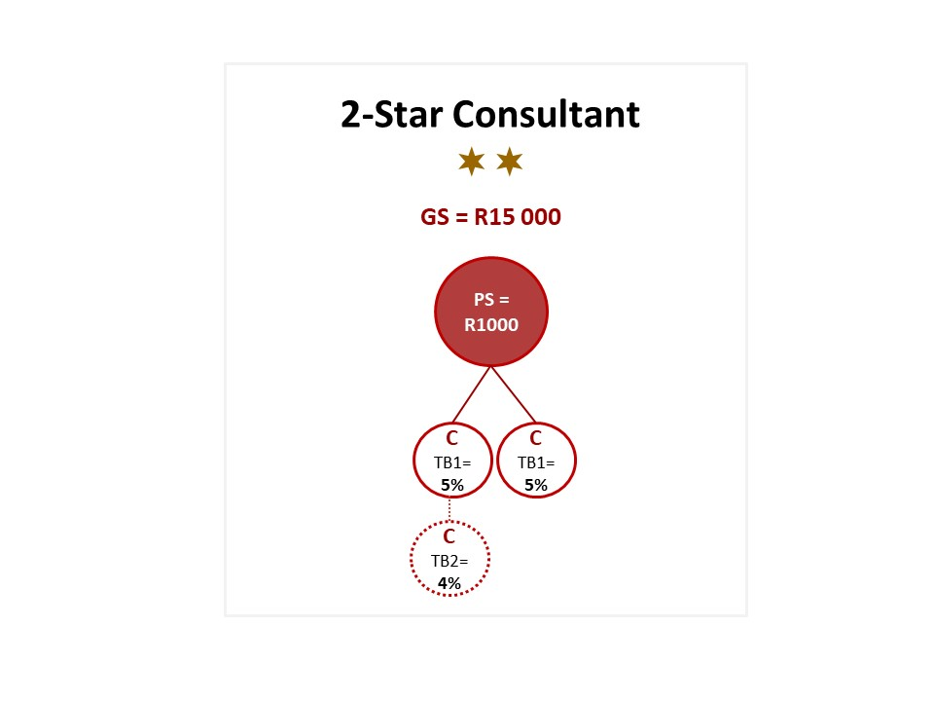
POTENTIAL EARNINGS

Slide 15
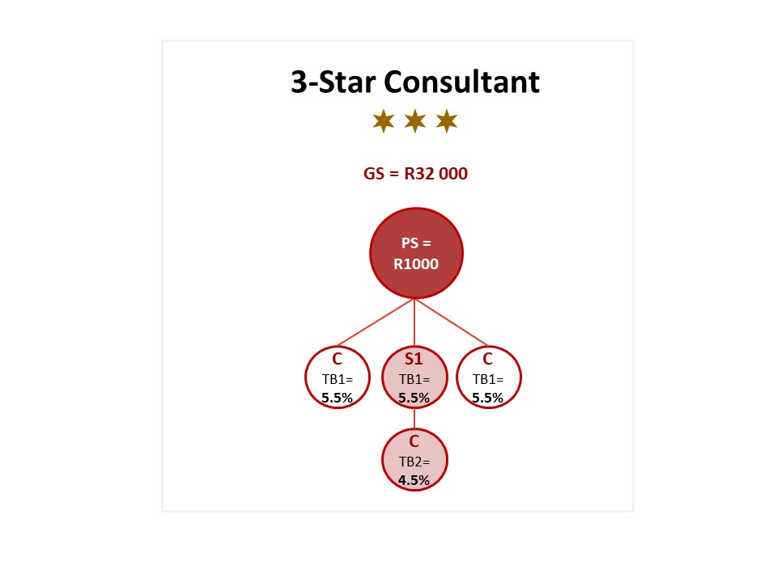
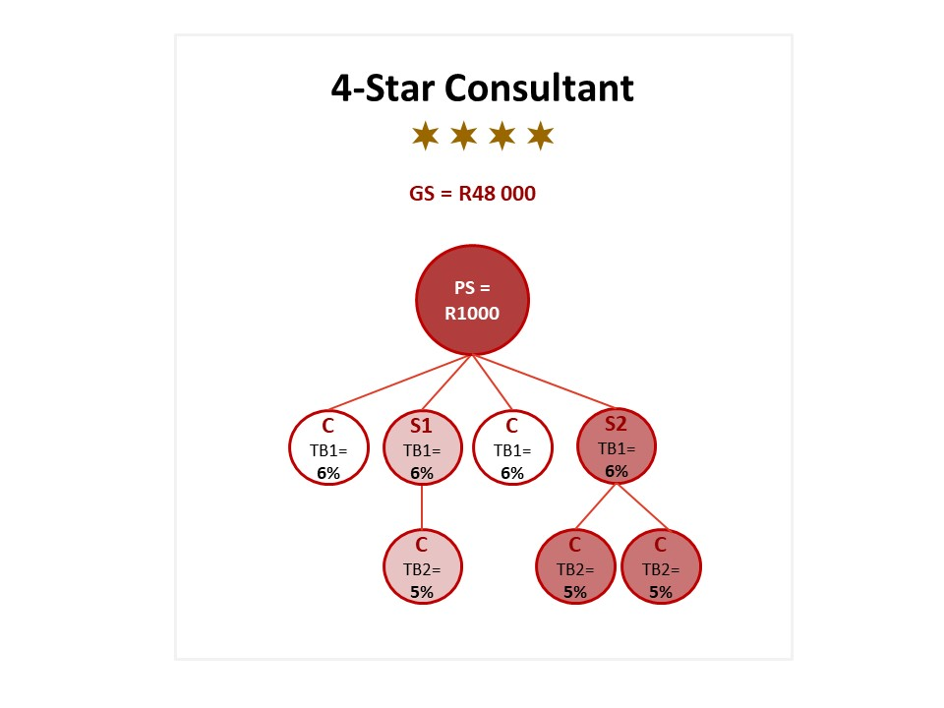
POTENTIAL EARNINGS

Slide 16
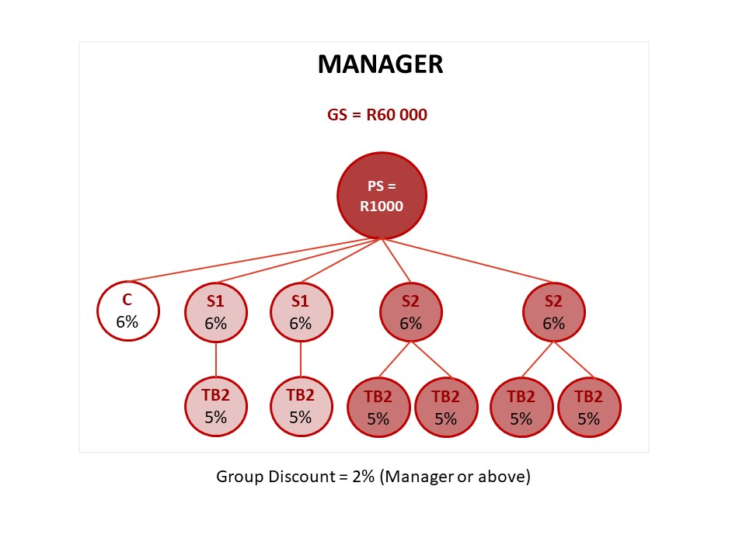
POTENTIAL EARNINGS
Generation 1 = 2 %

Slide 17
WHAT IS THE FAST START PROGRAMME?
A Rewards Programme for new consultants and sponsors

Slide 18
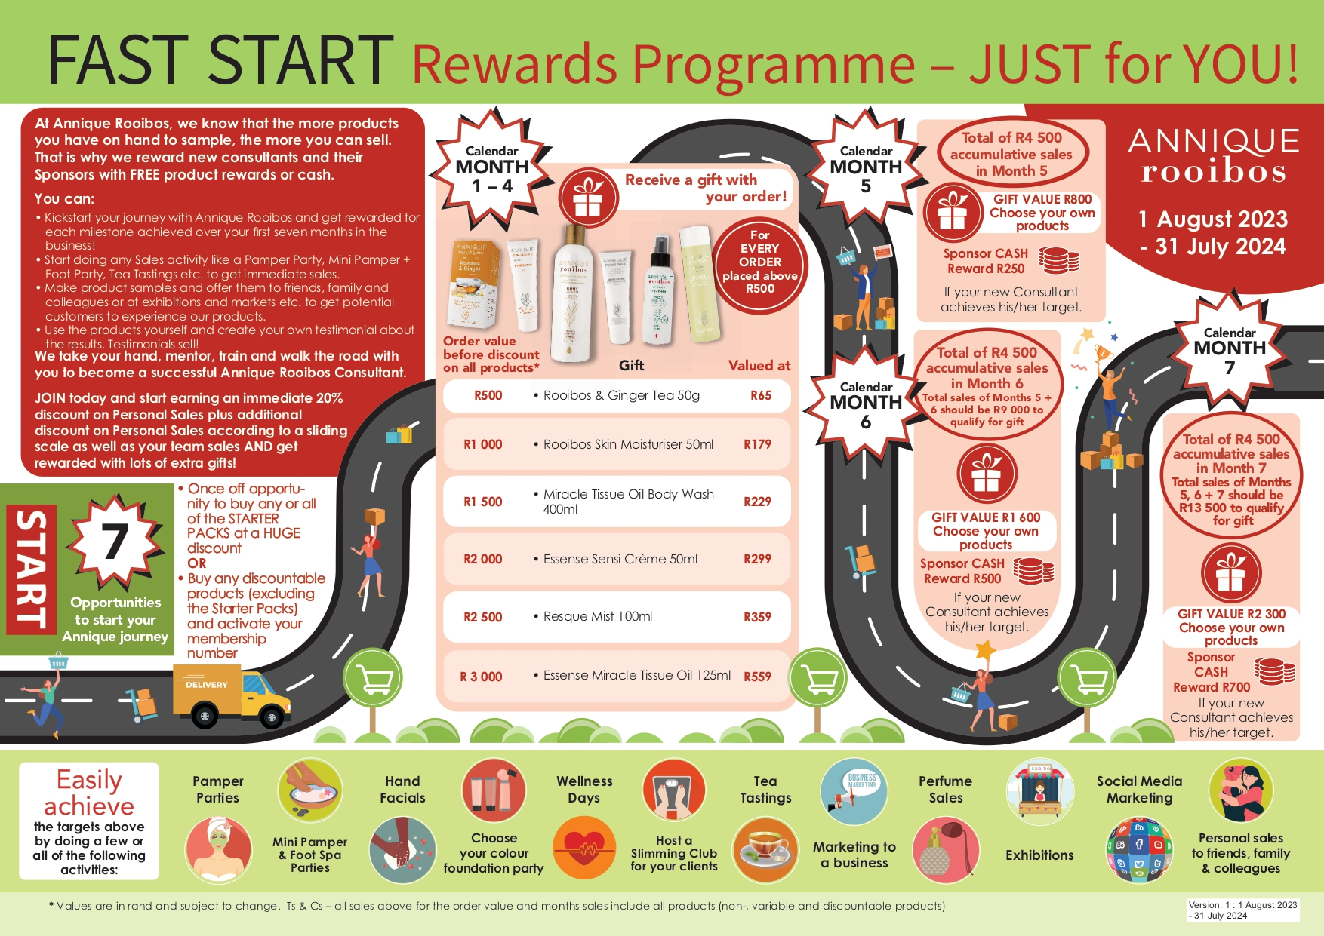
THE FAST START PROGRAMME

Slide 19
Objective of the fast start programme?
Kickstart the new consultant Rooibos journey and get rewarded from day 1 of first order placed?
Earn an income immediately and faster
Fast Start Reward with products :
  Use them yourself
  Use your own testimonials to sell
  Sample the products
    Sell to customers / consultants to experience the products
    Upsell to customers
    Give to your consultants at Team meetings to experience
  Sell the products in your Starter Packs
  Use the products to train your team

Slide 20
TIME period of programme?
Month 1 to 7 of a new consultant’s career
Note: Calendar months (Example: 1 – 31 July)
First order place = First month of career
Subject to the same cut-off dates as per the monthly communication

Slide 21
WHAT will change? Fast start programme
Month 1 – 4 : Gifts of the orders / The value of order stayed the same
Months 5 – 7 : Total accumulative sales R 4 500 / R 9 000 / R 13 500
Months 5 – 7 : Gifts consultants receive : Value has increased : R 800 / R 1 600 / R 2 300 – Fast Start Reward
Cash reward for sponsors increased : R 250 / R 500 / R 700
All products : Discountable, non & variable discountables count - Month 1 - 7
Online Shop Sales count for Month 5 - 7
Online Shop Sales count for Month 5 – 7 sales : If your customer order on the Online Shop you or the customer will not receive the Order Value Gift (Ginger Tea, Rooibos Skin Moisturiser etc.)
NEW Starter Packs – 5 in total : FOCUS = Skin Care

Slide 22
THE FAST START PROGRAMME

Slide 23
Starter packs offer
For new consultants
One Starter Pack of each option
  1x Basic Rooibos Skin Care (4 products)
  1x Resque & Miracle Tissue Oil (Foot Party) (5 products)
  1x Essense Skin Care (Hand Pamper) (5 products)
  1x Skin Care (Pamper Party) (8 products)
  1x Mega (Pamper Party) (9 products)
Not compulsory
Can buy all 5 starter packs (1 of each) OR just one of the 5 or 2/3/4
Only available to buy with your FIRST order
Newly registered consultants have 3 MONTHS to place first order
  Home Office will clear system
  Register again – old/new sponsor

Slide 24
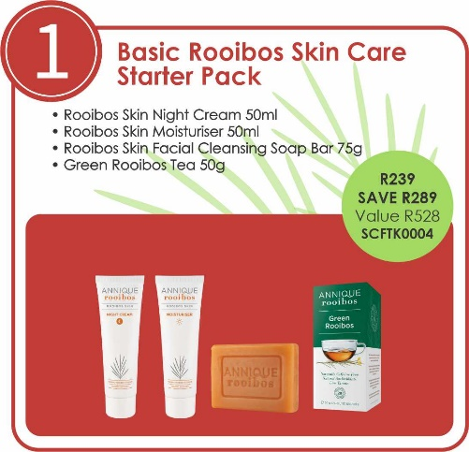
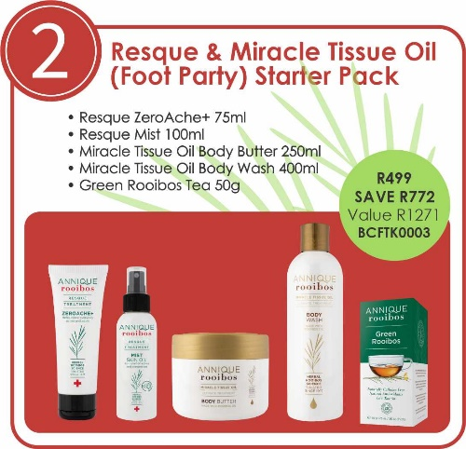
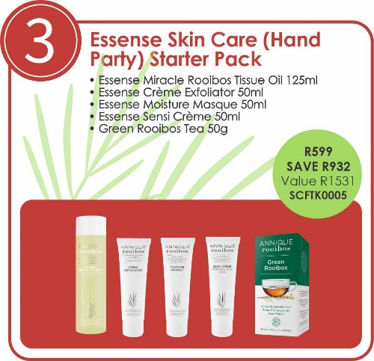
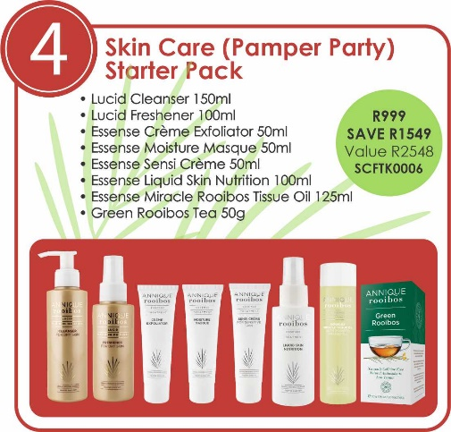
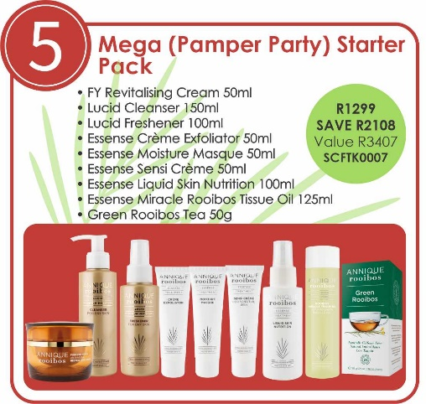
Starter packs
5 Starter
Packs
to choose
from!
Opportunity
to purchase
with 1st order

Slide 25


Slide 26


Slide 27
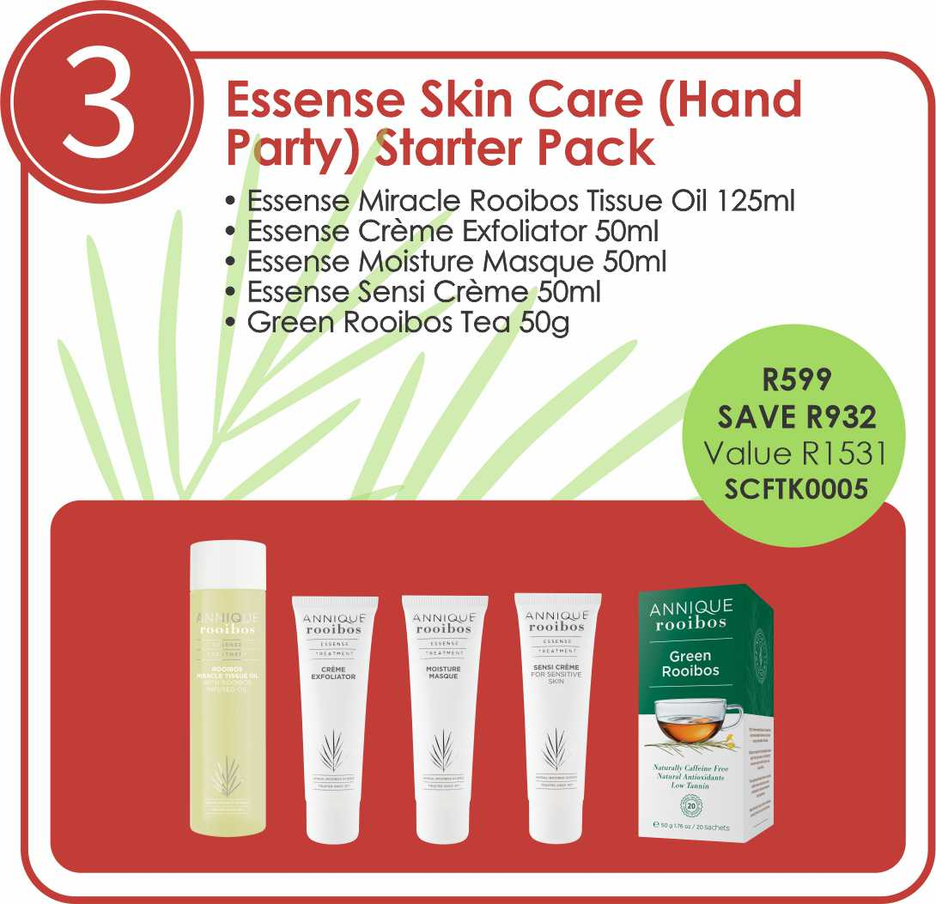

Slide 28


Slide 29


Slide 30
Starter packs
Buy all 5 Starter Packs
Value: R9 285
Pay: R3 635
EARN: R5 650
Investment to start your own business!

Slide 31
Starter packs questions
If my first order contains a Starter Pack plus normal products, will I qualify for a gift according to the order value?
No
If my first order only contains Starter Packs, will I qualify for a gift according to the order value?
No

Slide 32
Starter packs questions
If my first order is a normal order, can I order the Starter Pack(s) with my second order?
No, you can only order Starter Packs with your first order
Can I order any of the Starter Packs later, one in July, one in August etc?
No, you can only order it with your first order
If my order is only a normal order without any Starter Packs, will I qualify for a gift according to the order value?
YES!

Slide 34

Fast start journey
Registration of new consultant
Month 1 = The month the 1st order is placed
Example 1
Register -> 27 July
1st Order invoice -> 1 August
Month 1 - August
Month 2 - September
Month 3 - October
Example 2
Register -> 27 July
1st Order invoice -> 28 July
Month 1 - July
Month 2 - August
Month 3 - September

Slide 35
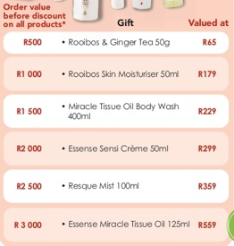
Months 1 - 4
Qualify for a gift with each order
GOOD NEWS!
Gift will be in
your parcel
together with all
other products
Order value:
Include
Discountable, Non &
variable discountables
Before 20% off-invoice discount

Slide 36


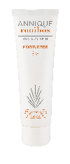



FAST START PROGRAMME
month 1 - 4
Free gifts per order
R 500 Order
Rooibos & Ginger Tea 50g
Valued at R65
R 2 000 Order
Essence Sensi Crème
Valued at R299
R 1 000 Order
Rooibos Skin Moisturiser 50ml
Valued at R179
R 2 500 Order
Resque Mist 100ml
Valued at R359
R 1 500 Order
Miracle Tissue Oil Body Wash 400ml
Valued at R229
R 3 000 Order
Essence Miracle Tissue Oil 125ml
Valued at R559

Slide 37
Months 1 – 4 Questions
Can I qualify for more than one gift in month 1-4?
Yes, with every order above R500 you qualify for a gift. 1 Gift per order.
How?
Each order value has a gift, for example:
10 August -> Order value = R500
Gift = Ginger Tea (R65)
13 August -> Order value = R500
Gift = Ginger Tea (R65)
* Will receive a Ginger Tea again
15 August -> Order value = R1 000
Gift = Rooibos Skin Moisturiser (R179)
25 August -> Order value = R2 500
Gift = Resque Mist (R359)

Slide 38
FAST START Months 5 - 7
Accumulative Orders
Online Shop Sales included
Non-Discountables included
Variable Discountables Included
FAST START REWARDS :
Choose your own Products
Specials included
MONTH 5
R4 500 Personal Sales
MONTH 6
R4 500 Personal Sales
MONTH 7
R4 500 Personal Sales
MONTH 5
Consultant Fast Start Reward
= R800
Sponsor = R250
MONTH 6
Consultant Fast Start Reward
= R1600
Sponsor = R500
MONTH 7
Consultant Fast Start Reward
= R2300
Sponsor = R700
Month 5 = Total Sales of month 5 should be R4500 to qualify for Fast Start Reward of R800
Month 6 = Total Sales of month 5 and 6 together (accumulative) should be R9000 to qualify for Fast Start Reward of R1600
Month 7 = Total Sales of month 5,6 and 7 together (accumulative) should be R13 500 to qualify for the Fast Start Reward of R2300
Sponsor must be Additional Discount Qualified (R1 000 Personal Sales) to qualify to earn the Sponsor Cash Rewards

Slide 39
Months 5 - 7
Calendar month 5 6 7
Accumulative orders
Sales = R4 500
Includes Online Shop sales
Includes non & variable discountables
Fast Start Reward = R800 R1 600 R 2 300
Choose your own Annique products
Specials included
Sponsor of Consultant reaching R4 500 R250 cash R500 cash R700 cash
Paid into bank account on 20th of next month with Additional Discounts
Sponsor must be Additional Discount Qualified (R1000 Personal Sales) to qualify to earn the Sponsor Cash Rewards

Slide 40
Months 5 – 7 Questions
If I achieve R9 000+ sales in month 5, will I only qualify for the R800 gift?
No, you will qualify for month 5 & 6’s gift = R800 + R1 600 gift
If I achieve R4 500 in month 5, R0 sales in month 6, can I still work for month 7 gift?
YES! Only month 7 gift – Your accumulative sales for Month 5, 6 and 7 must be R 13 500 – GIFT R 2 300

Slide 41
Months 5 – 7 Questions
If I do R0 sales in month 5, R0 sales in month 6, can I still work for the gift in month 7?
YES! Only month 7 gift – Total sales must be R 13 500 in Month 7
If I do R0 sales in month 5 and R0 in month 6 and R13 500 in month 7, can I qualify for month 5/6 gift?
No, you can only qualify for the R2 300 gift of month 7

Slide 42
Months 5 – 7 Questions
Do I receive months 5-7’s gift with the order I place automatically?
No, you need to choose your own products for months 5-7. You can claim them with your normal order by using the Fast Start Reward amount of the gift you qualified for..
(Distribution costs as per normal rules.)
Your reward will only be available the day after you qualify.
When does month 5 of the programme start?
1st Calendar day of month 5

Slide 43
Months 5 – 7 Questions
If I reach all 3 months’ target of R13 500 in month 5, can I still work for month 6 and 7?
No, you have qualified for all 3 gifts. You are now finished with your Fast Start journey
When must I claim my Fast Start Reward?
Within 90 Days after you qualified

Slide 44
Months 5 – 7 Questions
If I am a sponsor of a new consultant, when do I receive my cash reward?
1st : Sponsors need to be Additional Discount Qualified (R1000 Personal
Sales)
2nd : On the 20th of the next month

Slide 45
Months 5 - 7
Example:
Month | 5 – Scenario 1 | 5 – Scenario 2 | 5 – Scenario 3 | 5 – Scenario 4
Sales | R3 500 | R4 500+ | R9 000+ | R13 500+
Gifts | No gift | R 800 (Fast Start Reward) | R 800 + R1 600 Fast Start Reward | R 800 + R1 600 + R2 300 gift
Notes | The gifts from month 5 does not work on order value. Must be R4 500+ accumulative orders. | You did your R4 500+ accumulative orders. CONGRATULATIONS! You have qualified | Month 5 + 6 target can be reached in one month | Month 5 + 6 + 7 target can be reached in one month. You are now finished with the programme

Slide 46
EXAMPLE of fast start : Gifts - month 5 - 7

Slide 47
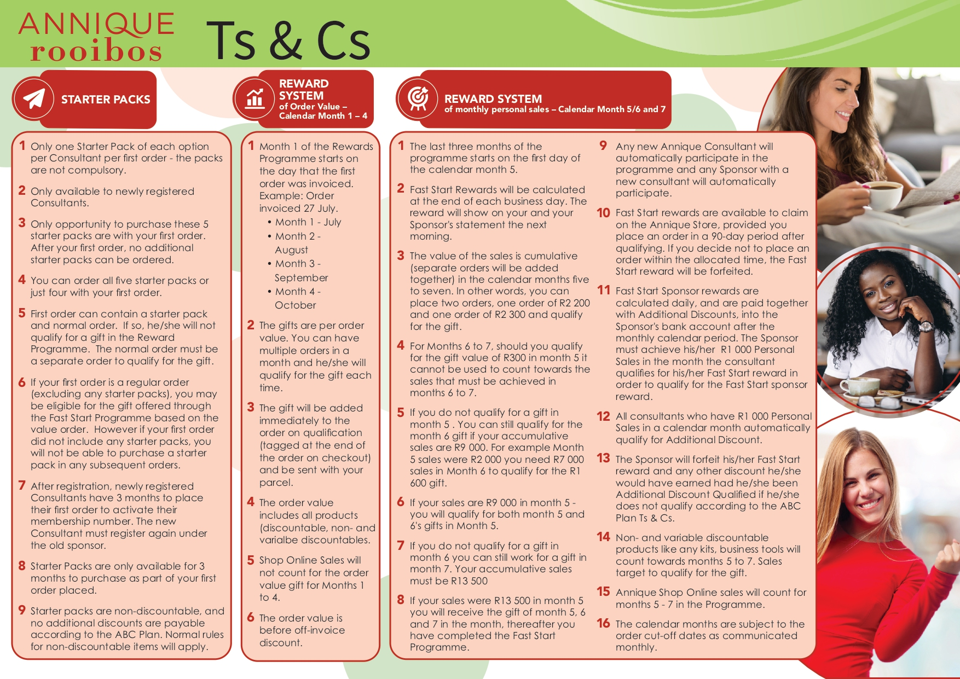
Replace with new one from Jackie

Slide 48
DISTRIBUTION COSTS
DISTRIBUTION COSTS : South Africa = R 72 (Courier)
DISTRIBUTION COSTS : South Africa = R 60 (PostNet / Skynet – PEP Stores)
DISTRIBUTION COSTS : Namibia (Windhoek) = R 53 (Courier)
DISTRIBUTION COSTS : Namibia (Outside Windhoek) = R 115 (Courier)
Orders of R6 000+ will qualify for free delivery

Slide 49
COMMUNICATION TO FIELD – A-NEWS
* Price List – Effective 1 August 2023
* ABC Plan - GRID
* Fast Start Programme : Road Map + Starter Packs + T’s & C’s
* The Power Point
* The link of the training of today

Slide 50


Slide 51
2022/2023 vs 2023/2024

