Slide 1
Introduction to Resque Gifting 2022 Range

Slide 2
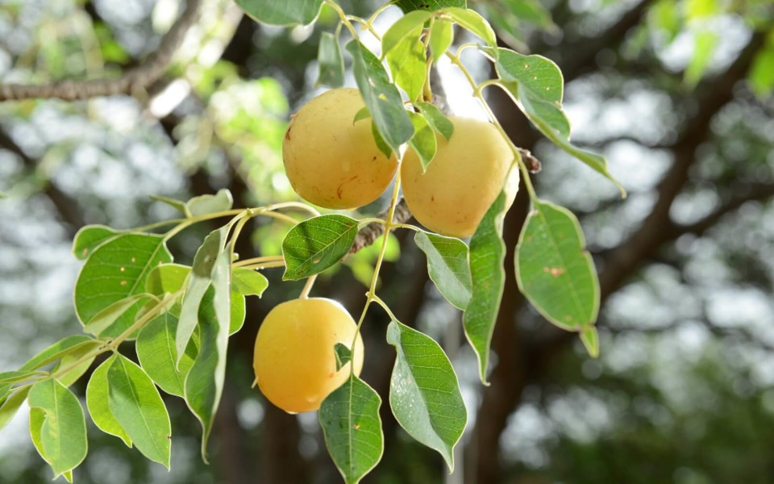
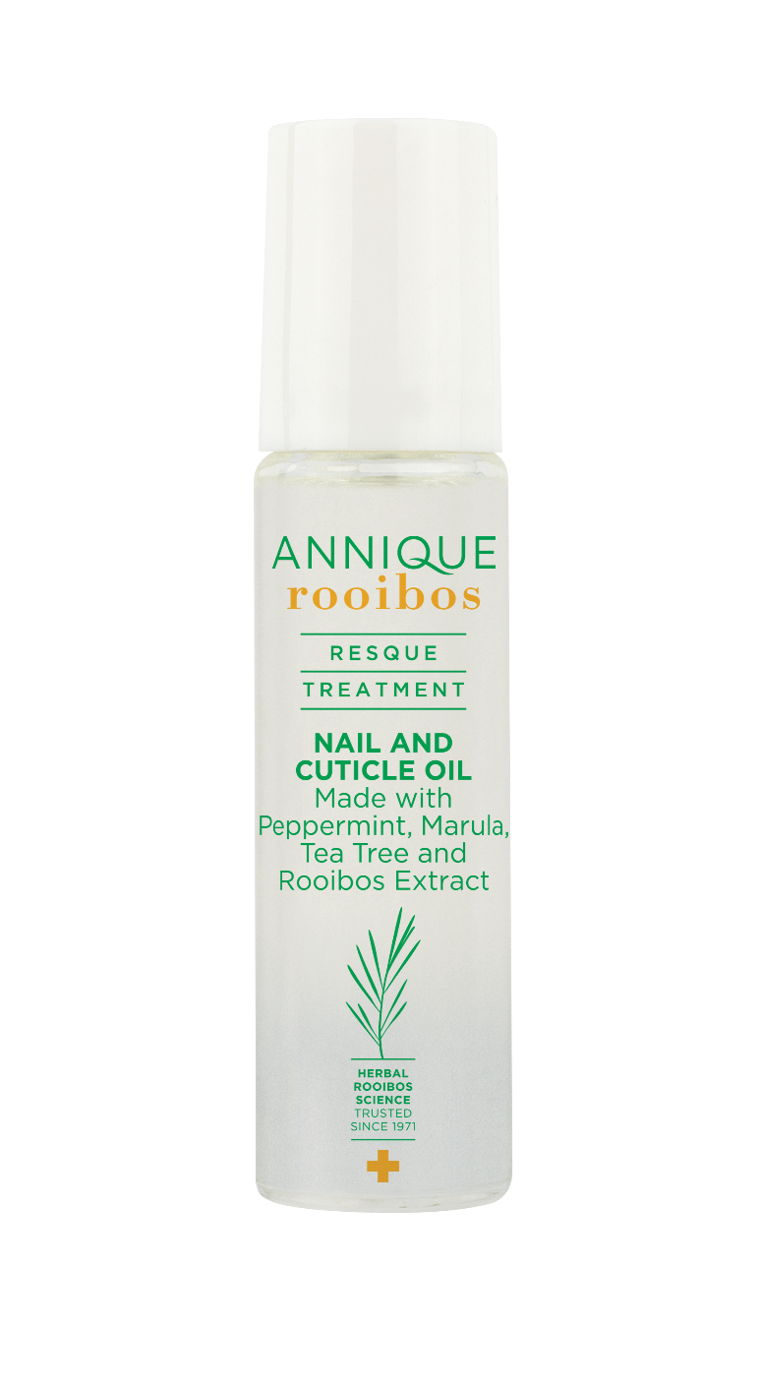
Resque Nail and Cuticle Oil 10ml

Slide 3
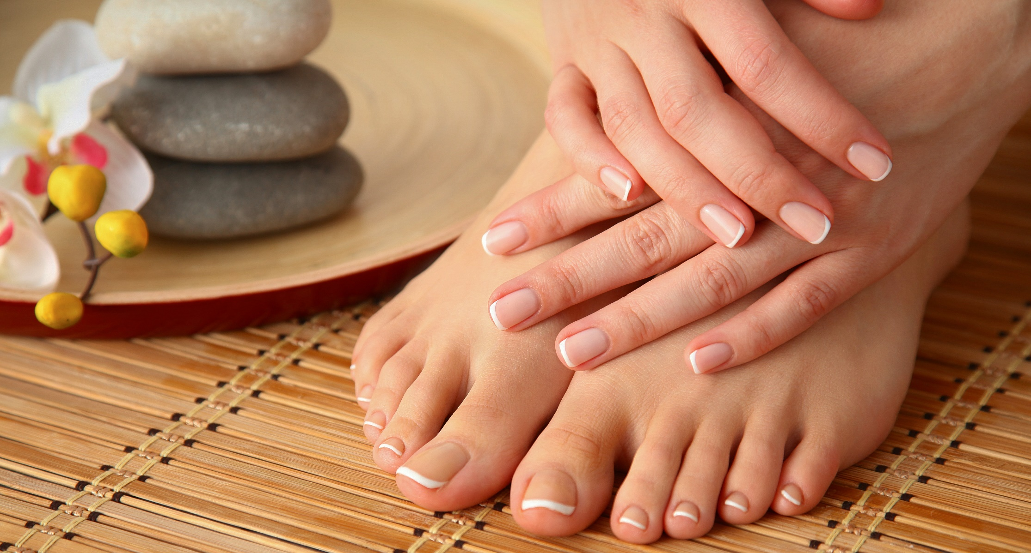
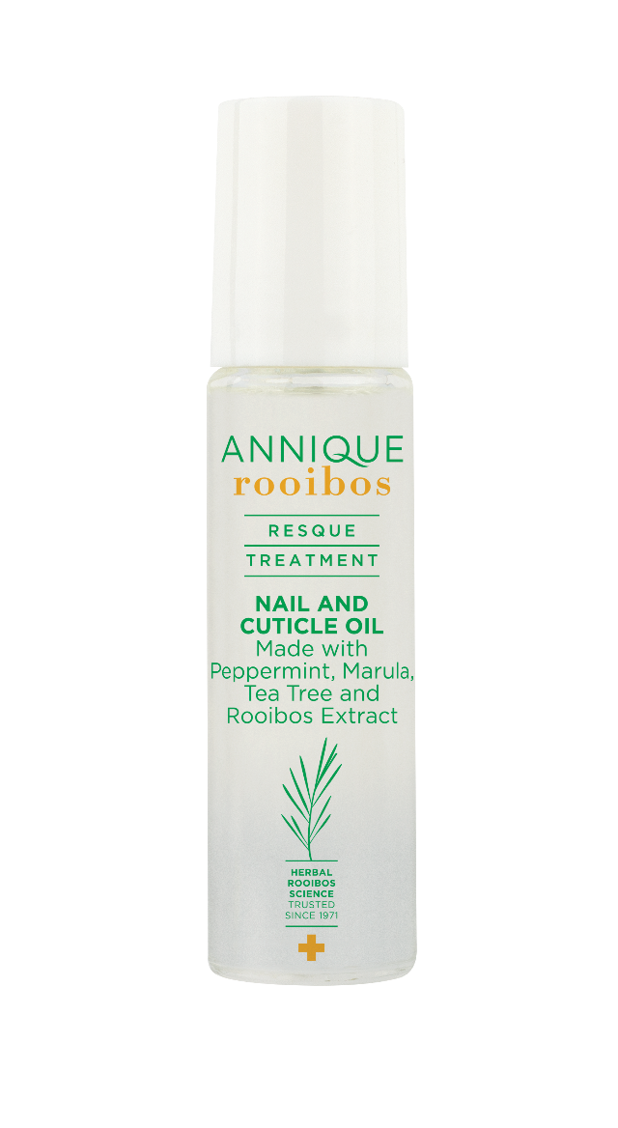
Resque Nail and Cuticle Oil
10ml
A blend of herbal oils that nourish and treat your nails and cuticles
May prevent and reduce fungal growth

Slide 4
Resque Nail and Cuticle Oil
10ml
Product Benefits
Made with a combination peppermint, marula and tea tree oil
Soothes and protects sore and torn cuticles
Moisturises and hydrates cuticles and nail bed
Prevents and protects nail from fungal growth
Comes in an easy to apply roller ball applicator

Slide 5
Resque Nail and Cuticle Oil
10ml
Product Application
Apply the oil to the nail and cuticle area with the roller
Massage until absorbed
If you suspect that your nail has fungal growth, use an earbud and apply liquid to the affected area

Slide 6
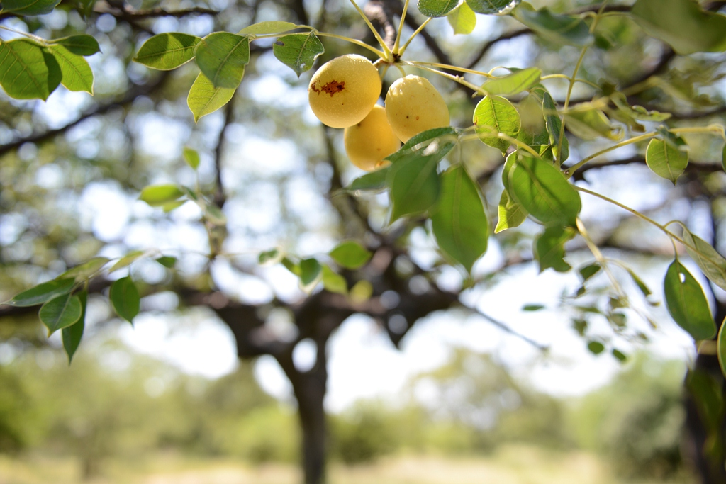
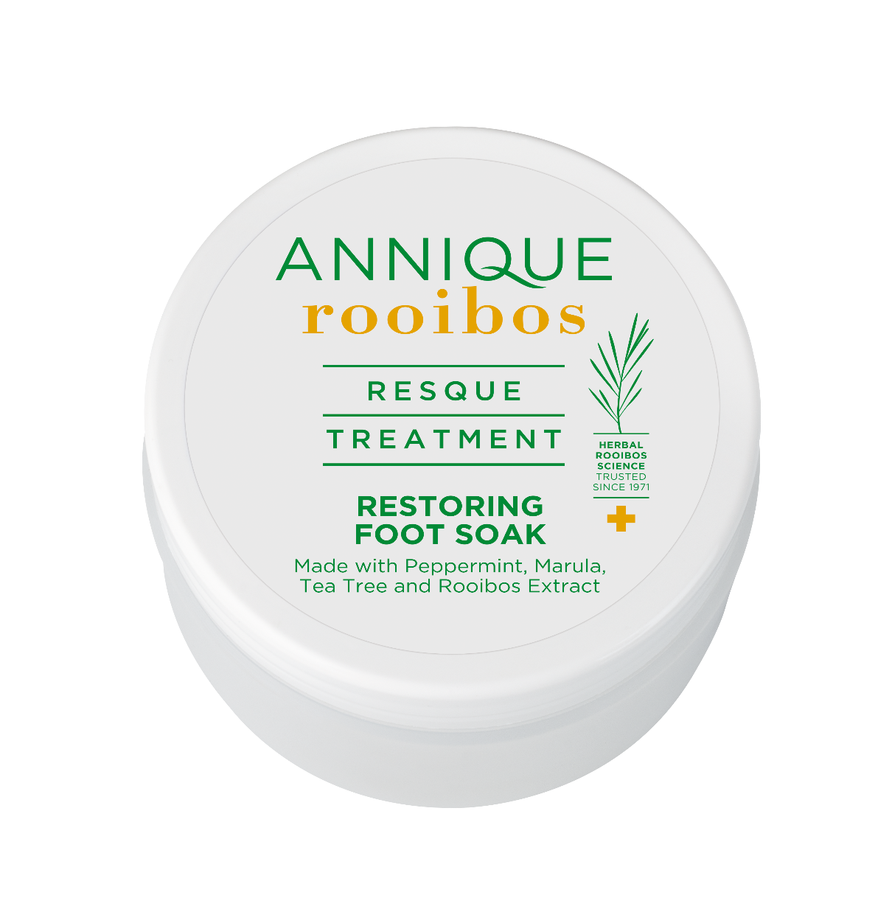
Resque Restoring Foot Soak 300g

Slide 7
Resque Restoring Foot Soak 300g
Soothing and restoring foot soak
Made with a unique blend of essential oils and magnesium salts

Slide 8
Resque Restoring Foot Soak 300g
Product Benefits
Relieves aching and swollen feet
Has antifungal and antiseptic properties
Soothes and restores tired feet
Notes:
Helps to reduce the symptoms of colds, flu, sinusitis and bronchitis.
It is excellent for neck and muscle pain, headaches, sinus and hay fever and is also a great mood-lifter during stressful moments when you need to be calm.

Slide 9
Resque Restoring Foot Soak 300g
Product Application
Sprinkle 2 tablespoons in warm Rooibos- infused water
Leave feet to soak for 5-10 minutes

Slide 10
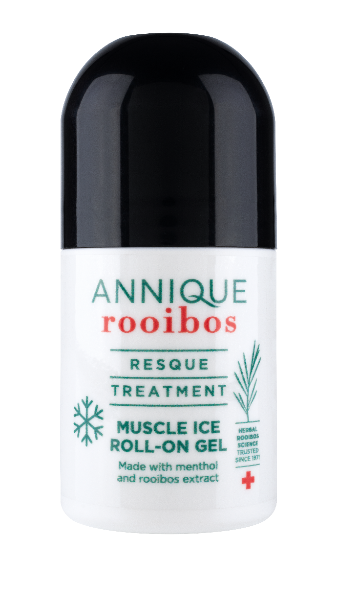
Resque Muscle Ice Roll-on Gel 60ml

Slide 11
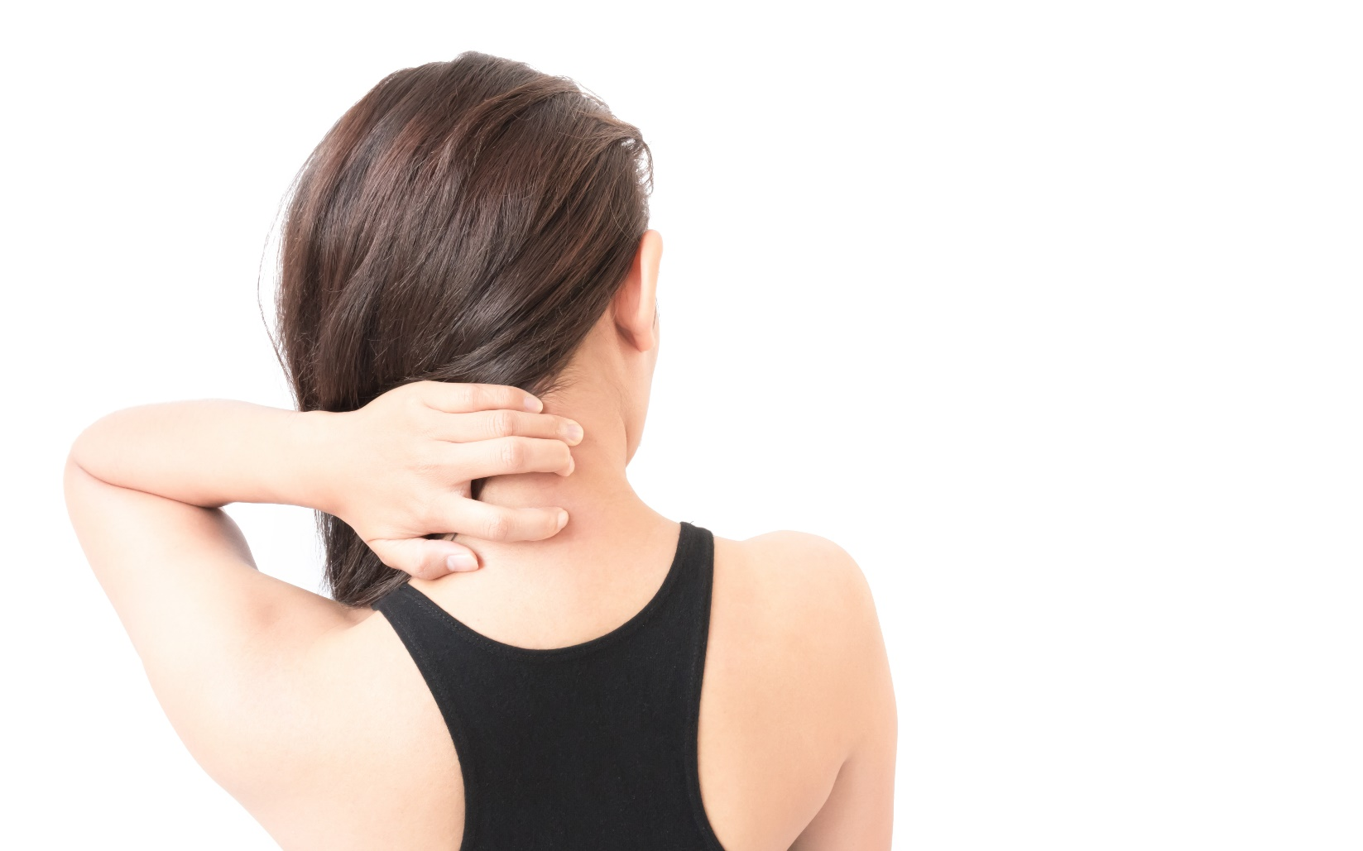
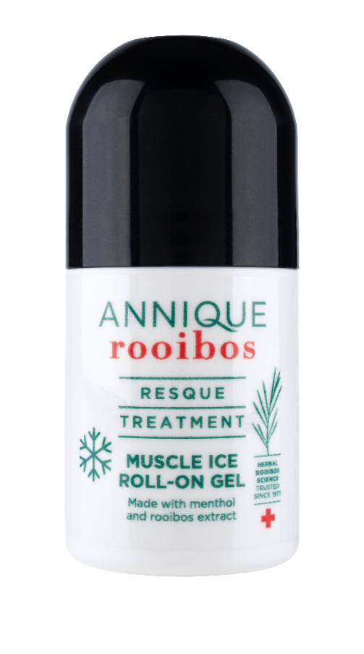
Resque Muscle Ice Roll-on
Gel 60ml
Lightweight liquid gel that is designed to provide targeted relief
This product forms part of cold therapy as its has a cooling pain relief action
The roller applicator makes it easy and convenient to help treat targeted areas

Slide 12
Resque Muscle Ice Roll-on
Gel 60ml
Product Benefits
Provides targeted cooling pain relief to overworked muscles and joints
Reduces inflammation
Easy and convenient to apply

Slide 13
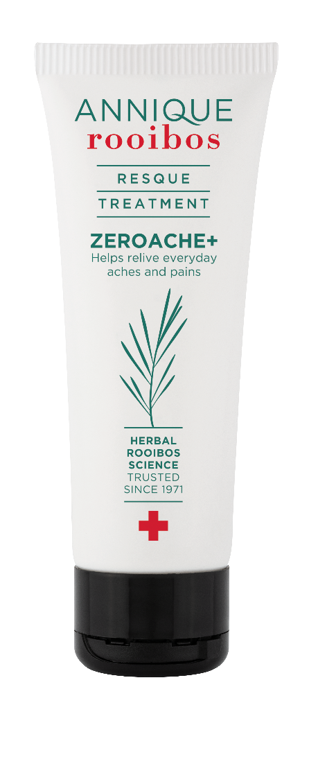
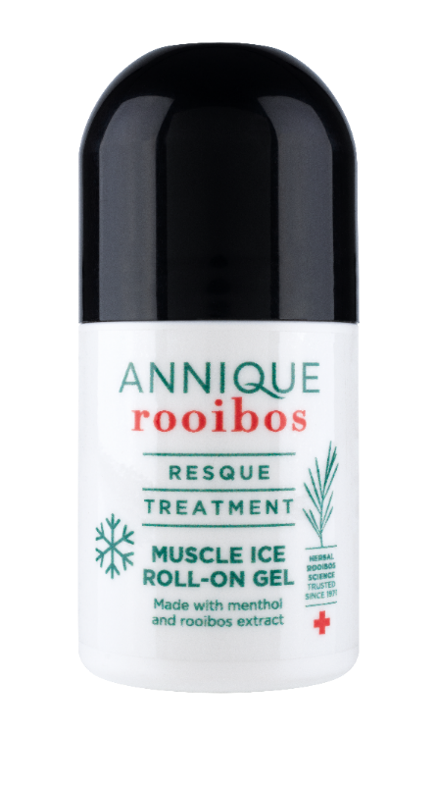
Resque Muscle Ice Roll-on
Gel 60ml
Differences between:
Resque Muscle Ice Roll-on Gel 60ml | Resque ZeroAche+ 75ml
Cold slows blood flow, reducing swelling and pain. | Heat boosts the flow of blood and nutrients to an area of the body.
For short-term pain, like that from a sprain or a strain. | For morning stiffness or to warm up muscles before activity.
Cold treatment reduces inflammation by decreasing blood flow. Apply within 48 hours after an injury. | Heat treatment promotes blood flow and helps muscles relax. Use for chronic pain.

Slide 14
Resque Muscle Ice Roll-on
Gel 60ml
Product Application
Remove the cap and roll the gel directly onto the affected area, immediately after injury, to reduce inflammation
For relief of tense muscles, increase pressure while rolling

Slide 15
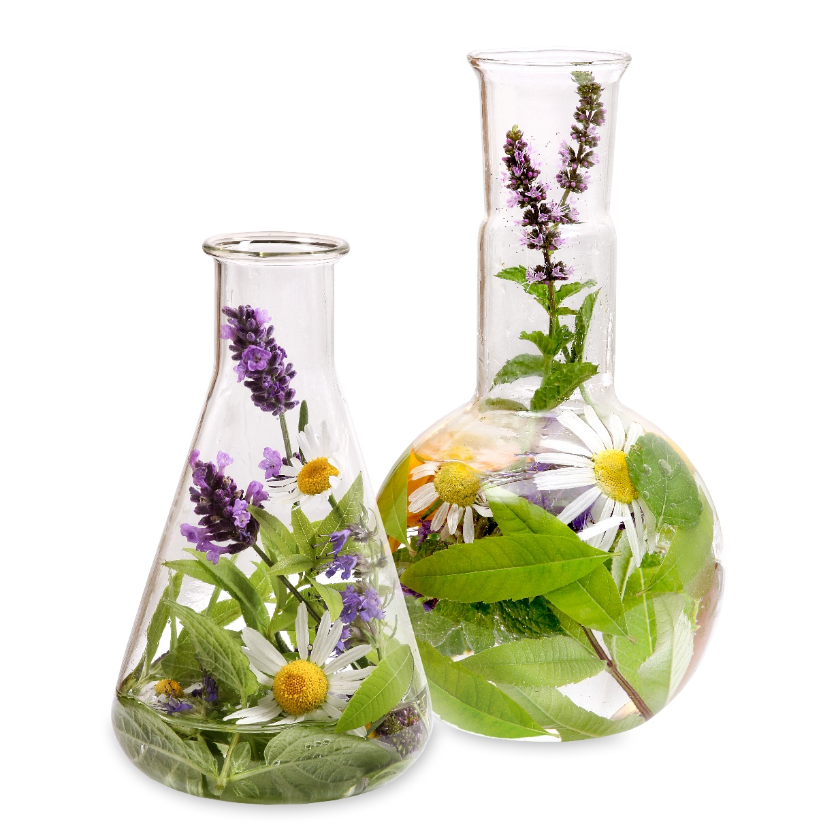
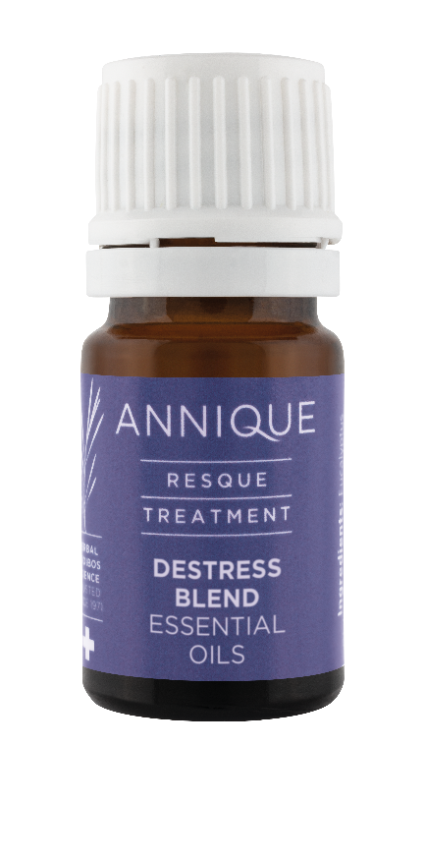
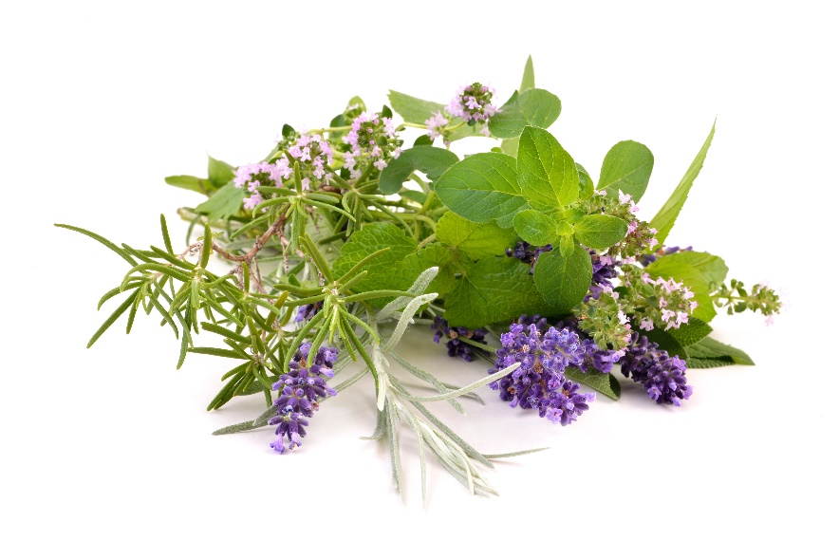
Resque Destress Blend
Essential Oils 5ml

Slide 16
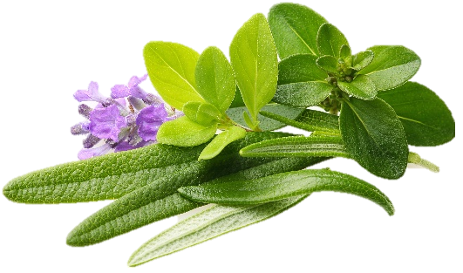
Resque Destress Blend
Essential Oils 5ml
Leave all the stress behind and unwind with this wonderful blend of essential oils.
Infused with cedarwood, rose geranium, lavender, peppermint, and marjoram essential oils.
Ideal blend to use in a diffuser, making use of the hand cupping method or to make your own room spray.
Safety during pregnancy has not been established.
Suitable for children from the age of 5 and older. When used near and or around children, make sure that the aroma is not too strong.

Slide 17
Resque Destress Blend
Essential Oils 5ml
Product Benefits
100% essential oil blend
Helps to uplift mood
Stress and anxiety relief
Better sleep
Promotes relaxation

Slide 18
Resque Destress Blend
Essential Oils 5ml
How to use :
The Resque Destress Blend Essential Oil can not be used as part of your facial routine, but can be used in the following ways.
Electronic Diffuser
Drip 3-5 drops into the diffuser water (filtered/distilled) and switch on.
Hand Cupping
Drip 1-2 drops of the Essential Oil Destress Blend into one hand. Rub your hands together, bring your cupped hands over your nose and mouth and breathe in and out slowly.
Cotton Make-up Pads:
Drip 2-3 drops of the Essential Oil Destress Blend onto a cotton make-up pad and place this in your shoes; in your car when you are driving; or clip the cotton pad onto a clothing peg and attach it to your car's air vent or in your home.

Slide 19
Resque Destress Blend
Essential Oils 5ml
Make Your Own Spray
Fill a spray bottle with filtered/distilled water and add 5-10 drops of the Essential Oil Destress Blend (depending how strong you would like the aroma). Shake it up and spray.
Wooden Laundry Peg
Drop 2-3 drops of the Essential Oil Destress Blend onto a wooden laundry peg. The oils will absorb into the wood and diffuse. You can place these pegs anywhere.
Favourite Toy or Blanket
You can add a few drops of the Essential Oil Destress Blend onto your child's favourite toy or blanket before bedtime. The aroma will help calm and relax your child. Suitable for children aged three years and older.

Slide 20
End

