Slide 1
Daily Skin Care for Sensitive skin: Sensitìv 2022

Slide 2
Sensitìv

Slide 3
Why is a Skin Care Routine Important?
Your skin is the largest organ your body has, and it works hard every day to protect our bodies from harmful elements.
Taking care of your skin and developing a skin care routine is important, because it can help this organ do its job better and longer.
A proper skin care routine helps to keep our outermost surface layer of skin intact.
This layer maintains skin’s overall hydration and serves as our primary defence against the environment, so keeping it strong and healthy is critical.

Slide 4
The 6 Unique Annique Differences
1: Cleanse only once a day - in the evenings
2: Press cream onto face – don’t rub
3: Moisturising several times throughout the day
4: Apply Sun protection everyday
5: Use Annique Freshener throughout the day
6: Annique’s Foundation has skin care benefits that
cares for your skin

Slide 5
How do I know if I have sensitive or sensitised skin?
Symptoms of sensitive skin:
Red and/ or dry patches
Certain foods make you flush
Tight, itchy or burning skin
Tendency to sunburn easily
Easily irritated
Symptoms of sensitised skin:
Dehydration
Acne
Rashy appearance
Redness and broken capillaries
A "sunburn" sensation
Tightness after washing face
Weather or traveling can trigger sensitised skin
Notes:
Sensitive vs Sensitised
Sensitised skin is the wolf in sheep's clothing in the skin care world; it pretends to be something it is not. The hard part of distinguishing between the sensitive and sensitised skin is that they have similar symptoms and appearances.
Both conditions can cause the client to experience dehydration, burning, itching, swelling, uneven texture, facial redness, rashes, breakouts, and discomfort. Knowing that a client is merely temporarily sensitised allows you as the consultant to stop, slow down, and repair the broken-down barrier in order to return the client's skin to its normal, functioning state.
Once this reversal occurs and this condition resolves, the professional can determine their client's true skin type and create a customised treatment plan.
Sensitive skin runs much deeper than that of skin that simply reacts to products and treatments. This skin type has a true genetic makeup and those that have sensitive skin tend to come from a long line of family members that also have sensitive skin.
Clients with this skin type also tend to suffer from non-related skin sensitivities such as allergies, asthma, and flushing or blushing of the skin. They are typically also accustomed to experiencing other forms of skin rashes on the body such as eczema, rosacea, and other forms of dermatitis.
Sensitive skin types tend to have less pigment in their skin and a thinner epidermis, thus causing them to have less of a protective barrier for the skin, which opens it up to factors that lead to impaired barrier function.
Sensitive skin is not something that can ever truly be fixed as it is genetic. Fortunately, it can be helped.
Sensitised skin, on the other hand, has a weakened barrier because of internal and external factors from one's immediate environment and habits that have caused the barrier to become temporarily impaired over time.
Sensitised skin tends to look lustreless, blotchy, dry, and visibly irritated. It also typically suffers from either an overproduction of oil or a lack of thereof. This skin also develops an assortment of dermatitis reactions that can be managed once the trigger(s) are determined.
Typically, sensitised skin can be contributed to one or more of the following internal and external factors: internal and external pro-inflammatory aggressors, overuse of chemical and manual exfoliants, changes in medication use, alcohol consumption, dehydration, poor diet, inadequate water intake, overexposure to the sun and extreme weather conditions, stress and use of the improper products for the skin.
It is the consultant’s responsibility to ask both lifestyle- and beauty-related questions to determine what might be causing changes in the client's skin that is leading to sensitisation.
Fifty percent of the population believes they have sensitive skin, yet the majority of them are really experiencing sensitised skin due the increase of pollution, lifestyle, diet, medications, over-exfoliation, incorrect product use, and excess sun exposure.
The easiest way to conclude whether a client has sensitised or sensitive skin is to ask numerous questions during the consultation.
Symptoms of sensitive skin:
Red and/ or dry patches, a dry skin type or chapped skin
Certain foods make you flush - alcohol, coffee or spicy foods
Tight, itchy or burning skin
Tendency to sunburn easily
Easily irritated by soaps, laundry detergent, perfume etc.
Symptoms of sensitised skin:
Dehydration
Acne
Rashy appearance to skin, small bumps that aren't quite acne
Redness and broken capillaries
A "sunburn" sensation
Tightness after washing face
Weather or traveling can trigger sensitised skin

Slide 6
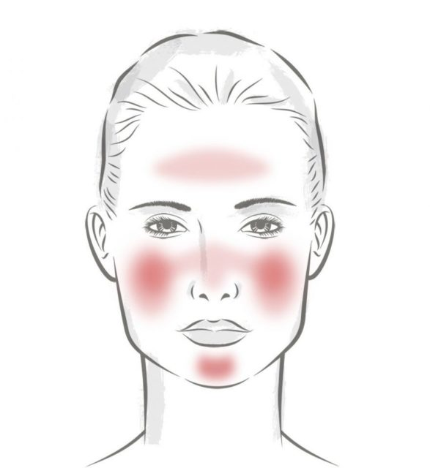
Sensitive skin
Definition:
A complex condition that:
Is characterised by subject sensitivity
Can present with or without clinical symptoms
Can appear alone or with other skin conditions
Has considerable impact on health-related quality of life

Slide 7
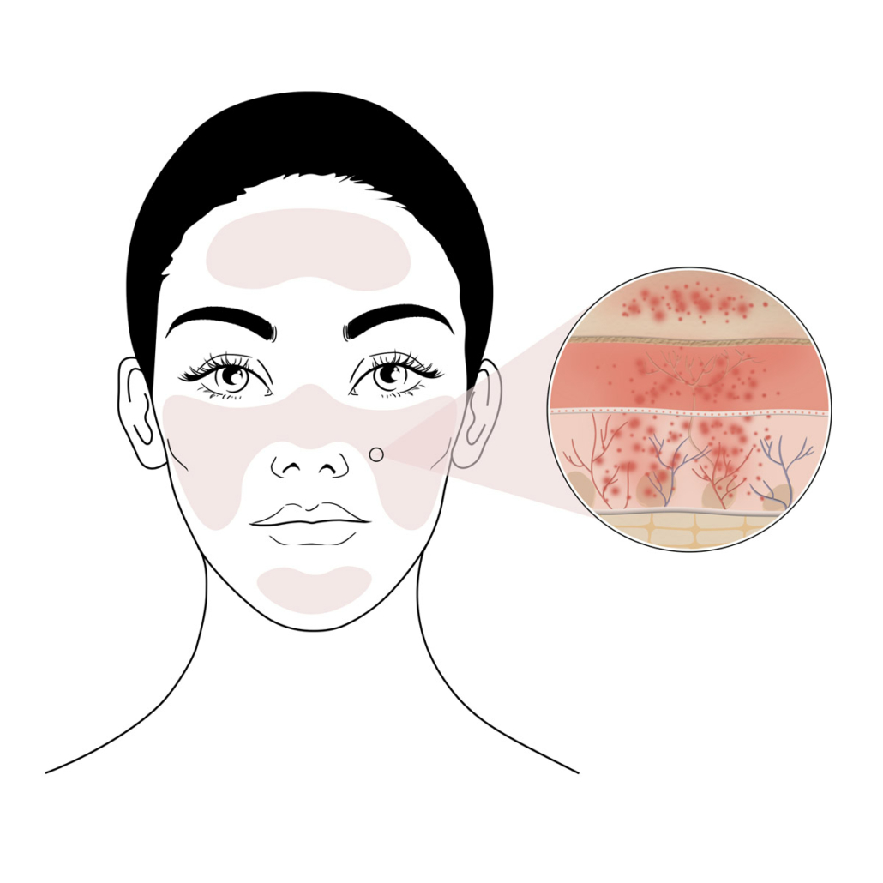
Sensitive skin
Symptoms:
Tightness
Redness
Stinging
Itchiness
Burning
Dehydration
Notes:
Men perceived less severe reactions on their face.
Men and women noted different causes for their condition:
15% women & 11% men link condition to irritation due to cosmetic products
9% men and 4% women link condition to friction or rubbing

Slide 8
Forest Stewardship Council
Notes:
Aligned with two of our missions, to do our bit to save the environment and sustainability, the material for the Sensitìv unit cartons are also responsibly sourced.
You will see a logo on the bottom of the cartons from the Forest Stewardship Council (FSC). As the original pioneers of forest certification, FSC has 25 years of experience in sustainable forest management.
They use their expertise to promote the responsible management of the world’s forests, bringing together experts from the environmental, economic and social spheres.
Simply put: by choosing products with the FSC logo, you are helping to take care of the world’s forests. Our new unit cartons are made using materials from FSC certified forests.
This ensures that the materials that are used for making the paper are sourced from responsibly managed forests that do not practice illegal logging, or deforestation and don’t violate human and traditional rights.
ADD FSC logo here
Our stunning Sensitìv jar is also more environmentally friendly! This jar contain 33% less plastic and use 60% less energy to manufacture than the previous jar.

Slide 9
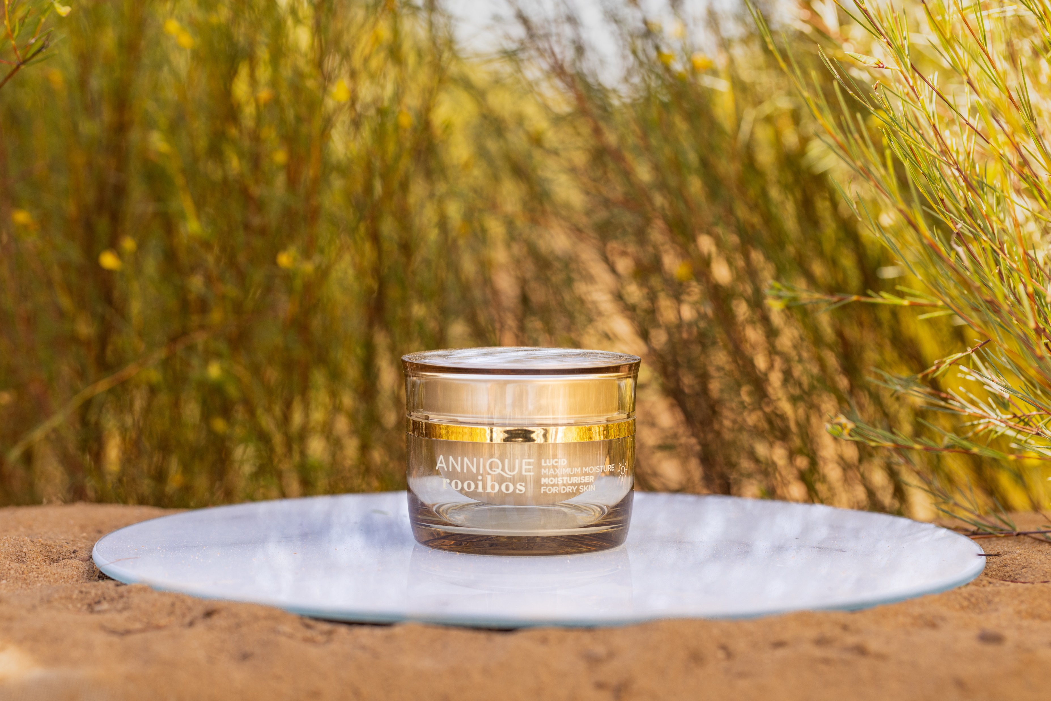
Sensitìv
Moisturiser

Slide 10
Sensitìv Moisturiser 50ml
A rich, caring formula
Developed specifically for sensitive skin
Reduce itchiness, tightness and inflammation

Slide 11
Sensitìv Moisturiser 50ml
Key active ingredients:
Rooibos Extract
Macadamia Nut Oil

Slide 12
Sensitìv Moisturiser 50ml
Benefits:
Helps to repair skin’s outer protective layer
Water in oil emulsion
Fragrance free
Dermatologically tested

Slide 13
Sensitìv Moisturiser 50ml
Product application:
Press gently onto skin regularly throughout the day.
During the day, the moisturiser may be applied over your foundation.
For best results, use in conjunction with the serums best suited to your skin type followed by Skin Detox and Revitalising Cream for a higher degree of intense moisture and suppleness.

Slide 14
TESTIMONIAL: Sensitìv Moisturiser
“I have a dry, sensitive skin and have been using Sensitìv for the past five years as this moisturiser gives my dry skin amazing relief.
I live in the Free State and due to this area’s climate, it is necessary to apply moisturiser more than once a day.
I even apply Sensitìv over my make-up and it makes a huge difference.”
– Annemarie Cronje

Slide 15
TESTIMONIAL: Sensitìv Moisturiser
“I just love Sensitìv feeding my skin with richness and moisture.
It feels as if the moisture creeps into every dehydrated spot and just gives it new life.
For me moisturiser is the key to a healthy skin. Sensitìv gives me that and more.”
– Annalize du Plessis

Slide 16
TESTIMONIAL: Sensitìv Moisturiser
“I am never further than one meter away from my Sensitìv moisturiser.
Having a sensitive skin can be quite problematic in the sun, air-conditioned buildings, wind, cold, etc.
Sensitìv calms my skin immediately and gives enough moisture to take the tightness away.”
– Lizette Labuschagne

Slide 17
TESTIMONIAL: Sensitìv Moisturiser
“I have always suffered from a very sensitive skin that is easily irritated, prone to getting inflamed, very dry and with redness on my cheeks.
Sensitìv Moisturiser makes it so easy to calm my skin.
Since I started using Sensitìv, I rarely suffer from an irritated skin and when I do, Sensitìv gives me instant relief and takes away the discomfort.”
– Adele Dercksen

