Slide 1
FAST START PROGRAMME
1 July 2022

Slide 2
WHAT IS THE FAST START PROGRAMME?
A rewards programme for new consultants and sponsors

Slide 3
Objective of the fast start programme?
Kickstart your journey and get rewarded from day 1
Make money immediately and faster
Experience the products you will receive as GIFTS:
Use them yourself
Use your own testimonials to sell
Sample the products
Sell to clients / consultants to experience the products
Give to clients for upselling
Give to your consultants
Sell the products in your starter packs
Use the products to train your team

Slide 4
TIME period of programme?
Month 1 to 7 of a new consultant’s career
Note: Calendar months (Example: 1 – 31 July)
Subject to the same cut-off dates as per the monthly communication

Slide 5
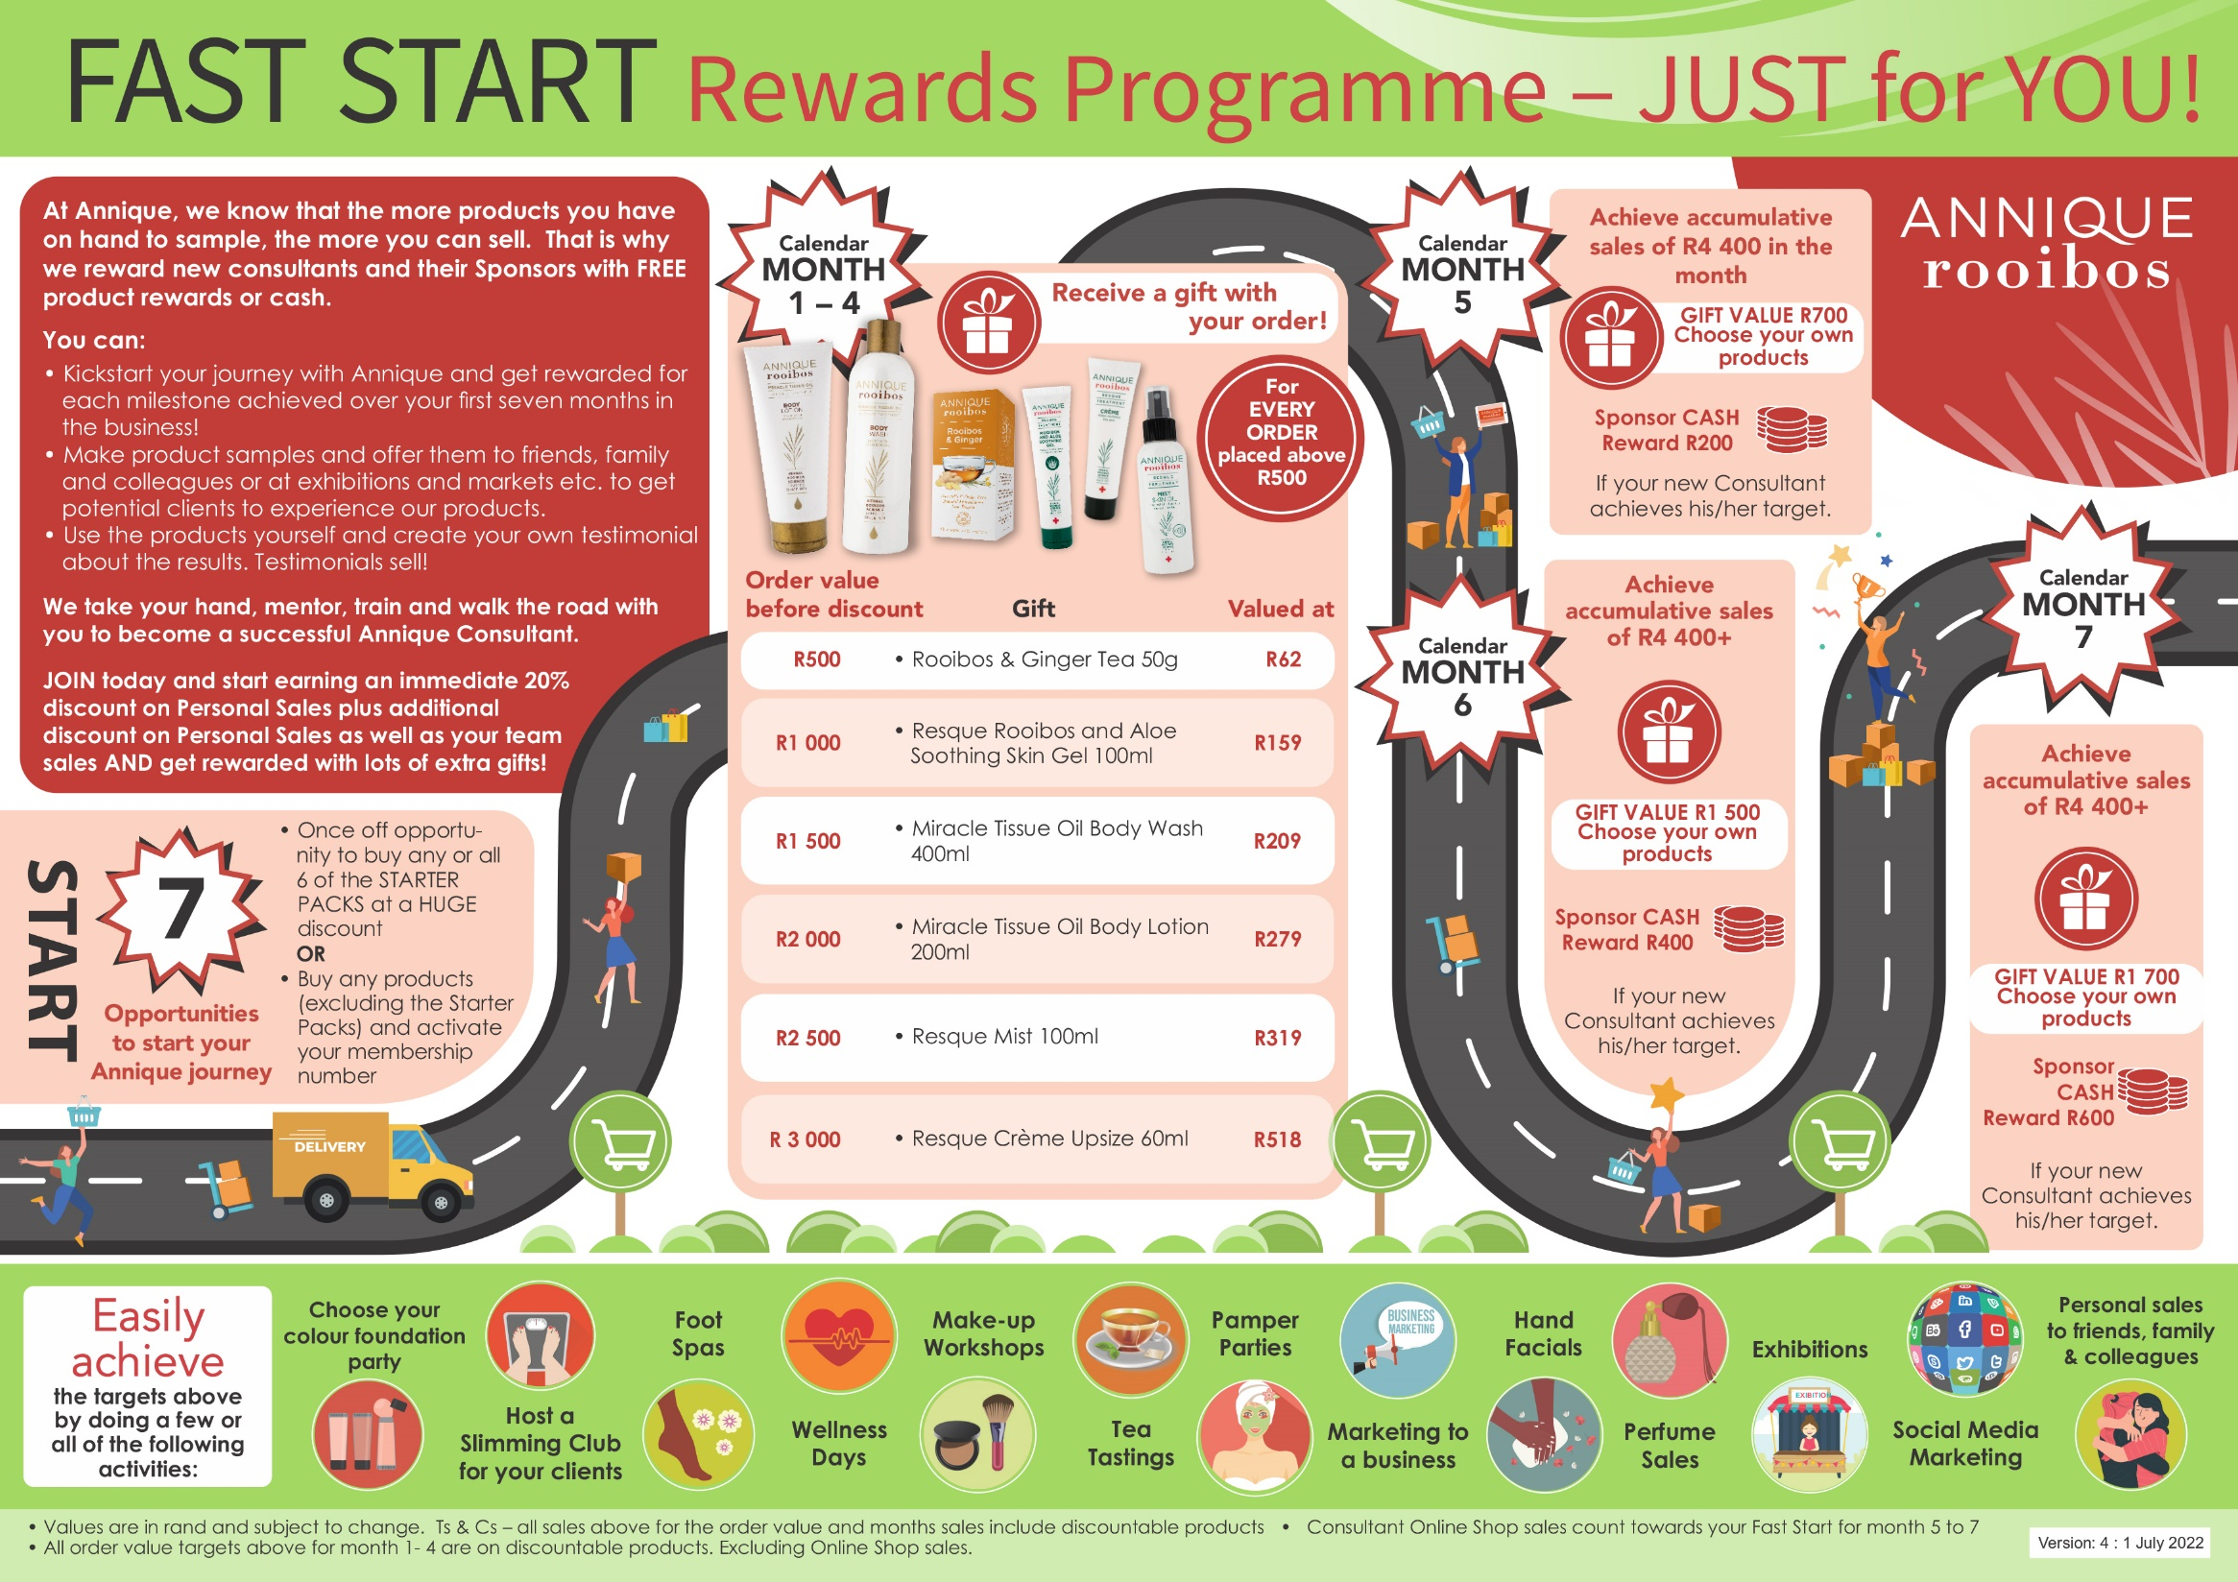

Slide 6
Fast start journey
Registration of new consultant
Month 1 = The month the 1st order is placed
Example 1
Register -> 27 July
1st Order invoice -> 1 August
Month 1 - August
Month 2 - September
Month 3 - October
Example 2
Register -> 27 July
1st Order invoice -> 28 July
Month 1 - July
Month 2 - August
Month 3 - September

Slide 7
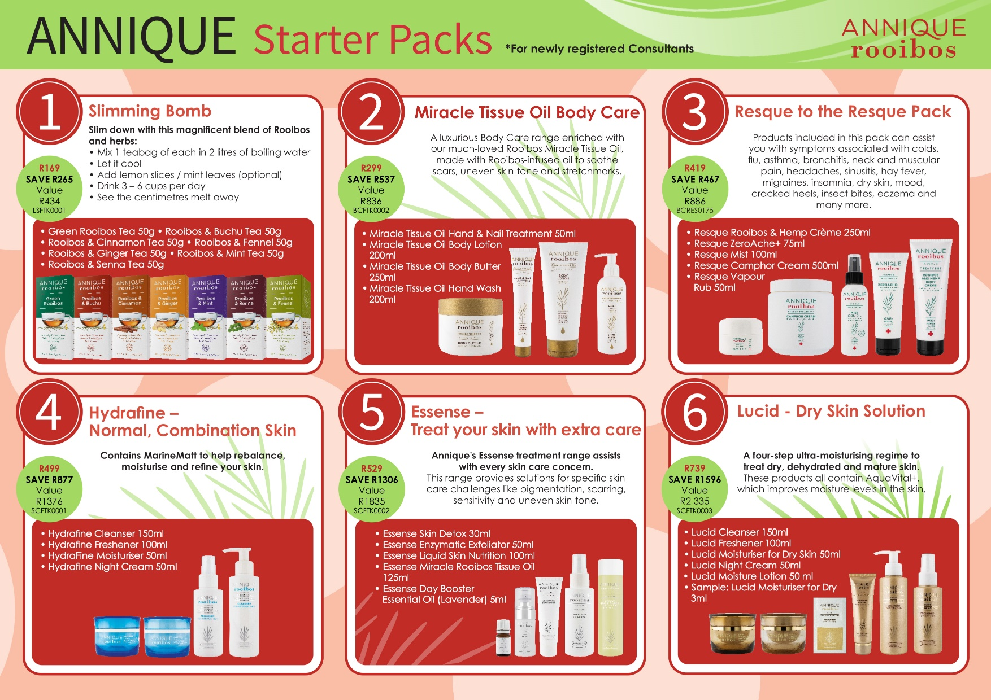
Starter packs
6 Starter
Packs
to choose
from!
Opportunity
to purchase
with 1st order

Slide 8
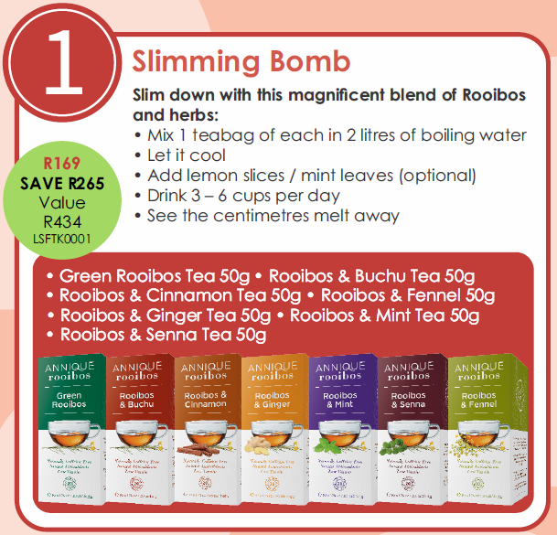

Slide 10
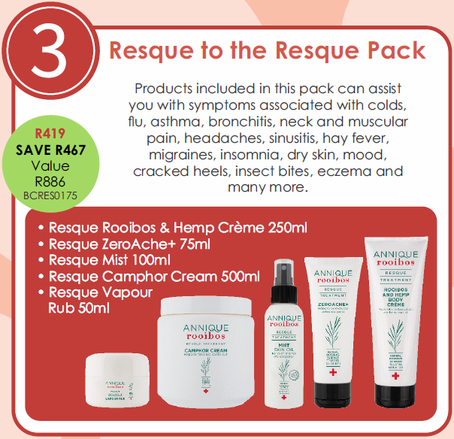

Slide 11
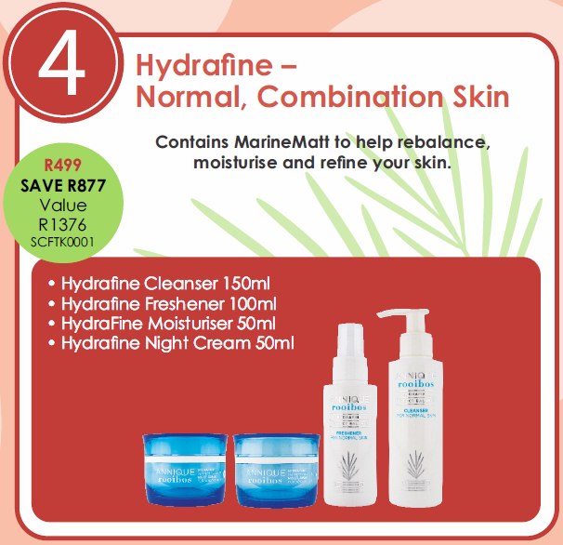

Slide 12
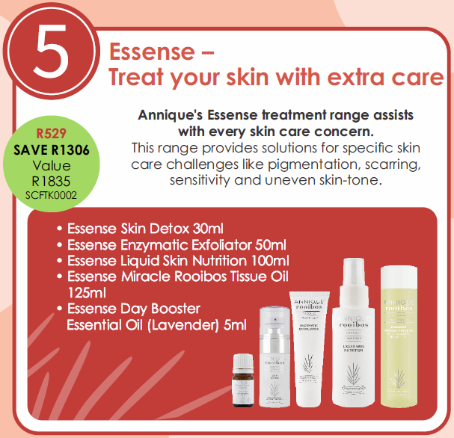

Slide 13
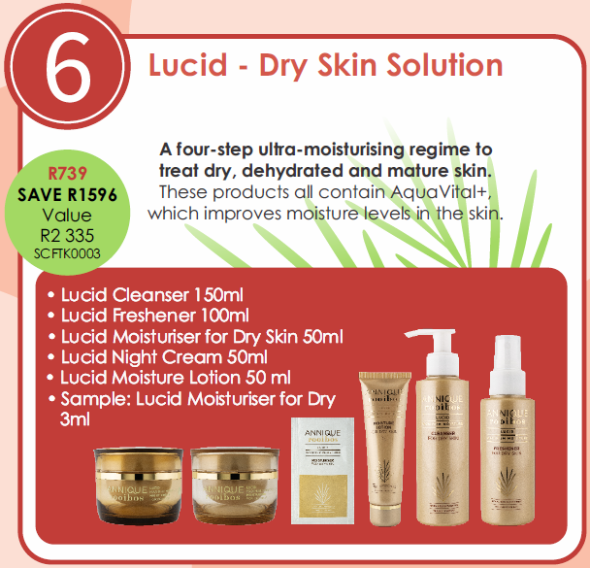

Slide 14
Starter packs
Buy all 6 Starter Packs
Value: R7 702
Pay: R2 654
EARN: R5 048
Investment to start your own business!

Slide 15
Starter packs offer
For new consultants
One pack of each option
1x Slimming Bomb (7 herbal teas)
1x Miracle Tissue Oil Body Care (4 products)
1x Resque to the Resque pack (5 products)
1x Hydrafine (4 products)
1x Essense (5 products)
1x Lucid (5 products)
Not compulsory
Can buy all 6 starter packs OR just one of the 6 or 2/3/4/5
Only available to buy with your FIRST order
Newly registered consultants have 3 MONTHS to place first order
Home Office will clean system
Register again – old/new sponsor

Slide 16
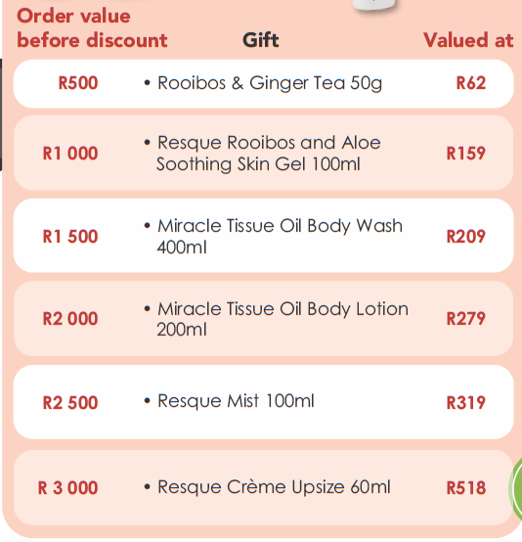
Months 1 - 4
Qualify for a gift with each order
GOOD NEWS!
Gift will be in
your parcel
together with all
other products
Order value:
Excludes
non-discountables
Before 20% off-invoice discount

Slide 17
Starter packs questions
If my first order contains a starter pack plus normal products, will I qualify for a gift according to the order value?
No
If my first order only contains starter packs, will I qualify for a gift according to the order value?
No

Slide 18
Starter packs questions
If my first order is a normal order, can I order the starter pack(s) with my second order?
No, you can only order starter packs with your first order
Can I order any of the starter packs later, like one in July, one in August etc?
No, you can only order it with your first order
If my order is only a normal order without any starter packs, will I qualify for a gift?
YES!

Slide 19
Months 1 – 4 Questions
Can I qualify for more than one gift in month 1-4?
Yes, with every order above R500 you qualify for a gift. 1 Gift per order.
How?
Each order value has a gift, for example:
10 August -> Order value = R500
Gift = Ginger Tea (R62)
13 August -> Order value = R500
Gift = Ginger Tea (R62)
* Will receive a Ginger Tea again
15 August -> Order value = R1 000
Gift = Aloe Soothing Gel (R159)
25 August -> Order value = R2 500
Gift = Resque Mist (R319)

Slide 20
Months 5 - 7
Calendar month 5 6 7
Accumulative orders
Sales = R4 400
Includes Online Shop sales
Excludes non-discountables
Gift = R700 R1 500 R1 700
Choose your own products
Specials included
Sponsor of Consultant reaching R4 400 R200 cash R400 cash R600 cash
Paid into bank account on 20th of next month with Additional Discounts
Sponsor must be Additional Discount Qualified (R900 Personal Sales) to qualify to earn the Sponsor Cash Rewards

Slide 21
Months 5 – 7 Questions
If I achieve R8 800+ sales in month 5, will I only qualify for the R700 gift?
No, you will qualify for month 5 & 6’s gift = R700 + R1 500 gift
If I achieve R4 400 in month 5, R0 sales in month 6, can I still work for month 7 gift?
YES! Only month 7 gift

Slide 22
Months 5 – 7 Questions
If I do R0 sales in month 5, R0 sales in month 6, can I still work for the gift in month 7?
YES! Only month 7 gift
If I do R0 sales in month 5 and R0 in month 6 and R13 200 in month 7, can I qualify for month 5/6 gift?
No, you can only qualify for the R1 700 gift of month 7

Slide 23
Months 5 – 7 Questions
Do I receive months 5-7’s gift with the order I place automatically?
No, you need to choose your own products for months 5-7. You can claim them with your normal order. (Distribution costs as per normal rules.)
Your reward will only be available the day after you qualify.
When does month 5 of the programme start?
1st Calendar day of month 5

Slide 24
Months 5 – 7 Questions
If I reach all 3 months’ target of R13 200 in month 5, can I still work for month 6 and 7?
No, you have qualified for all 3 gifts. You are now finished with your Fast Start journey
When must I claim my Fast Start Gifts?
Within 90 Days after you qualified

Slide 25
Months 5 – 7 Questions
If I am a sponsor of a new consultant, when do I receive my cash reward?
1st : Sponsors need to be Additional Discount Qualified (R900 Personal
Sales)
2nd : On the 20th of the next month

Slide 26
Months 5 - 7
Example:
Month | 5 | 5 | 5 | 5
Sales | R3 500 | R4 400+ | R8 800+ | R13 200+
Gifts | No gift | R700 | R 700 + R1 500 gift | R 700 + R1 500 + R1 700 gift
Notes | The gifts from month 5 does not work on order value. Must be R4 400+ accumulative orders. | You did your R4 400+ accumulative orders. CONGRATULATIONS! You have qualified | Month 5 + 6 target can be reached in one month | Month 5 + 6 + 7 target can be reached in one month. You are now finished with the programme

Slide 27
Old fast start vs new fast start
April ’22 | May ’22 | June ’22 |  | July ’22 | Aug ’22 | Sept ’22 | Oct ’22 | Nov ’22 | Dec ’22
Month 1 | Month 2 | Month 3 |  | Month 4 | Month 5 | Month 6 | Month 7
Consultant registered and placed 1st order in April |  | Can still qualify for old Fast Start programme when registered in April |  | Can take part in order value gifts | Can take part again in last 3 months of the new Fast Start programme R4 400 – Gift R700 | Can take part again in last 3 months of the new Fast Start programme R4 400 – Gift R1 500 | Can take part again in last 3 months of the new Fast Start programme R4 400 – Gift R1 700
 | Month 1 | Month 2 |  | Month 3 | Month 4 | Month 5 | Month 6 | Month 7
 | Consultant registered and placed 1st order in May | Can qualify for 40-day Fast Start when started in May |  | Can take part in order value gifts | Can take part in order value gifts | Can take part again in last 3 months of the Fast Start programme R4 400 – Gift R700 | Can take part again in last 3 months of the Fast Start programme R4 400 – Gift R1 500 | Can take part again in last 3 months of the Fast Start programme R4 400 – Gift R1 700
 |  | Month 1 |  | Month 2 | Month 3 | Month 4 | Month 5 | Month 6 | Month 7
 |  | Consultant registered and placed 1st order in June. 3 Kits to choose from. Can work for Fast Start in month 5/6/7. |  | Can take part in order value gifts | Can take part in order value gifts | Can take part in order value gifts | Can take part again in last 3 months of the Fast Start programme R4 400 – Gift R700 | Can take part again in last 3 months of the Fast Start programme R4 400 – Gift R1 500 | Can take part again in last 3 months of the Fast Start programme R4 400 – Gift R1 700

