Slide 1
NEW Product Launch for May 2022

Slide 2
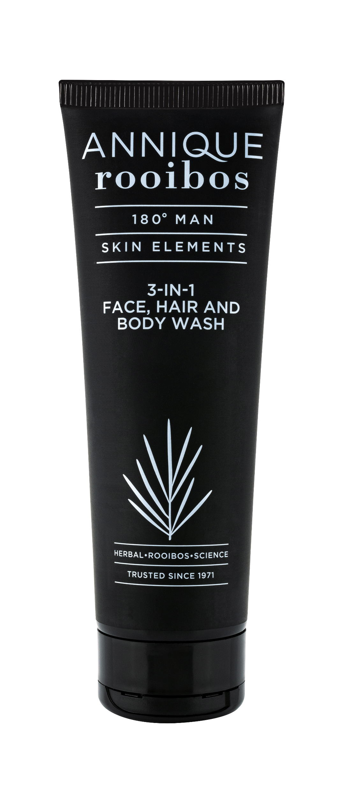
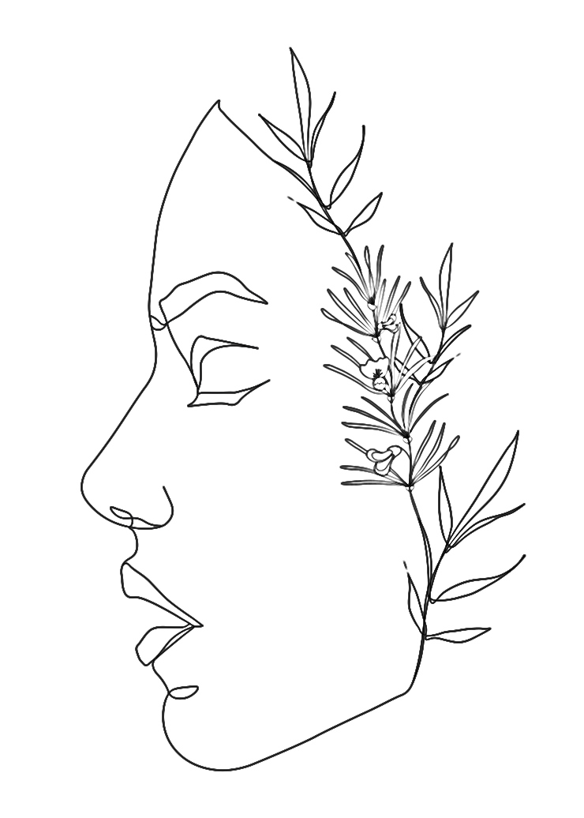
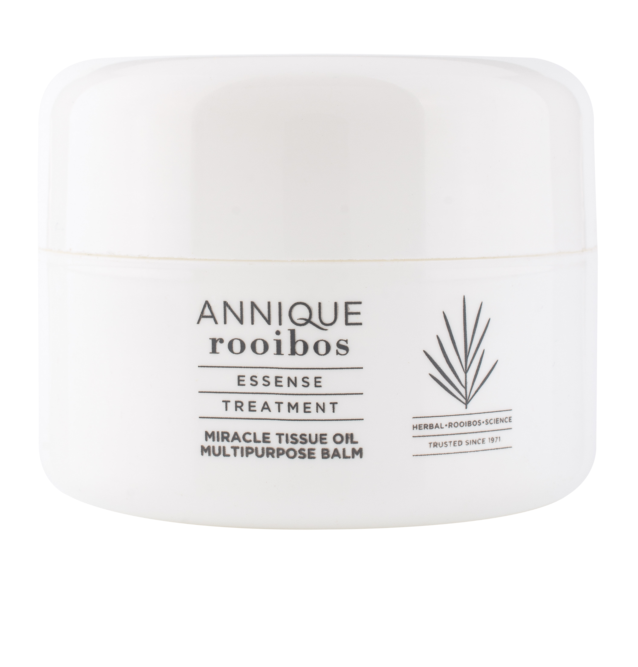

Slide 3
Essense Miracle Tissue Oil Multipurpose Balm 50ml
A convenient, on-the-go, dry skin remedy balm for everyday use infused with Rooibos Extract.
It is rich in antioxidants and infused with a blend of moisturising ingredients to help provide skin with deep, targeted moisture.

Slide 4
Essense Miracle Tissue Oil Multipurpose Balm 50ml
Key active ingredients:
Shea Butter
moisturises dry skin
reduces skin inflammation
healing properties
Avocado Oil
calm itchy skin
heal chapped skin
replenish dry skin

Slide 5
Essense Miracle Tissue Oil Multipurpose Balm 50ml
Key active ingredients:
Coconut Oil
smooths skin
hydrates
calms temporary redness
Sweet Almond Oil
reduces the appearance of scars
treats dry skin
improves complexion

Slide 6
Essense Miracle Tissue Oil Multipurpose Balm 50ml
Key active ingredients:
Rooibos Extract
full of antioxidants
multiple skin care benefits
soothing
Rosehip Oil
reduce inflammation
moisturises
protect and hydrate skin

Slide 7
Essense Miracle Tissue Oil Multipurpose Balm 50ml
Directions for use:
Can be applied on all areas.
Suitable for everyday use.
Apply as often as needed.

Slide 8
180° Men: 3-in-1 Face, Hair & Body Wash 250ml
An effective multi-tasking formula
Formulated to gently cleanse face, body and hair
Won’t strip skin, or hair of natural oils

Slide 9
180° Men: 3-in-1 Face, Hair & Body Wash 250ml
Key active ingredients:
Rooibos Extract
full of antioxidants
multiple skin care benefits
soothing
Notes:
Key active ingredients:
Silt lends a calming and balancing feel to the complexion, skin looks toned and soothed, appears healthier and more youthful.
Sweet Almond Oil is an extremely nourishing natural oil. It is rich in fatty acids, vitamins A and E, proteins, potassium and zinc.
Rooibos Extract, with all its antioxidants, helps fight free radicals in the skin and repairs damage brought on by the elements.

Slide 10
180° Men: 3-in-1 Face, Hair & Body Wash 250ml
Directions for use:
Use daily as an all-over wash.
Generously lather on face, body and hair and rinse with clean water.

