Slide 2
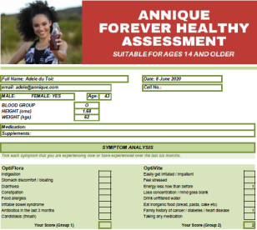
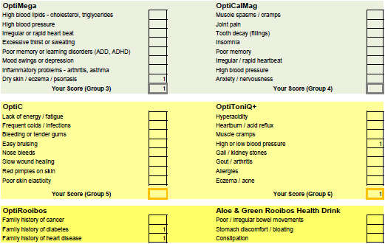
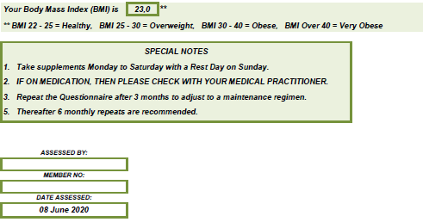
Question Sheet
Answer Sheet

Slide 4
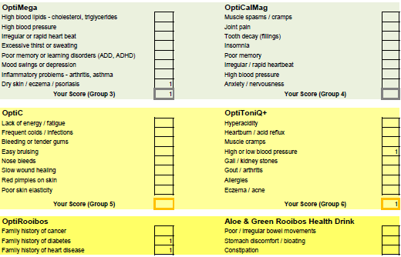
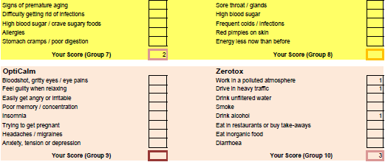

Slide 5
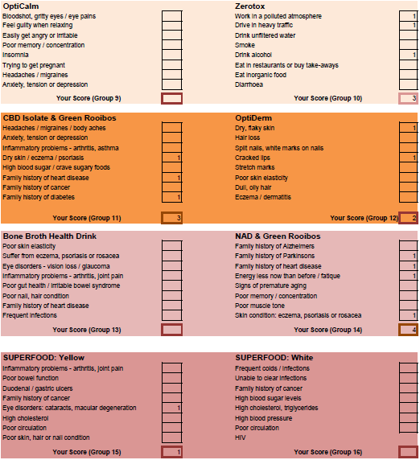

Slide 6
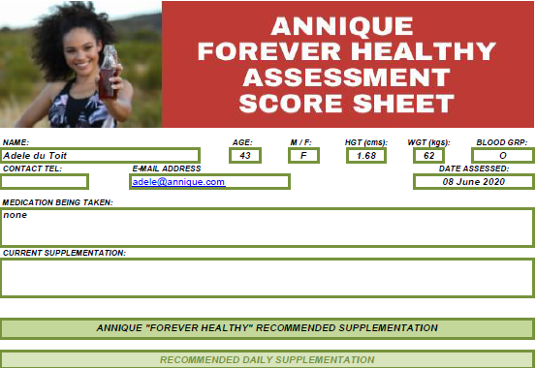

Slide 7
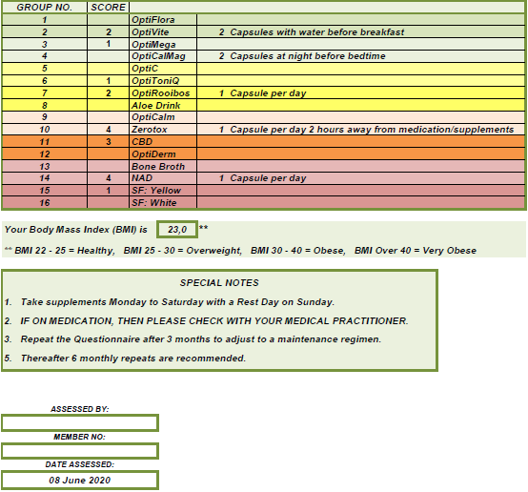

Slide 8
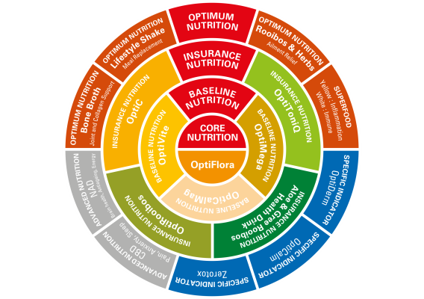
RANGE COMPOSITION
Notes:
Explain range strategy and how it all fits together
Annique's Forever Healthy Philosophy:
Annique’s Forever Healthy range of vitamin and mineral supplements has been created by nutritional experts to provide the optimum balance between science and nature.
Advanced, complex scientific formulas, combined with the best nature has to offer, has produced a range that will help to improve and preserve your health and wellbeing.
The range was compiled to be easy to use, simple to understand and to make the choice of supplements most beneficial to your individual needs.
The optimum balance between science and nature. The range allows for easy recommendations to be made with the composition of different segments:
Core Nutrition with OptiFlora forms the nucleus of Forever Healthy. Great health starts in the digestive system, where nutrients from food and supplements are broken down, absorbed and distributed to the rest of the body. An unhealthy or damaged digestive tract and diseased organs will starve the rest of the body of essential nutrients and allow toxins into the bloodstream.
Baseline Nutrition with OptiMega, OptiVite and OptiCalMag make up the foundation of your daily supplementation. Supplements in this category should be taken daily.
Insurance Nutrition: Your safety net, Insurance Nutrition provides a means to proactively manage your potential health risks, by providing the necessary nutrients to maintain health and prevent disease and illness. These supplements provide essential protection and should also be taken daily for optimum results with OptiC, OptiToniQ+, OptiRooibos and Aloe and Green Rooibos Health Drink.
Specific Indications are tailor made solutions that offer an array of solutions for people with specific health conditions and concerns. These supplements should be used in addition to the Core, Baseline and Insurance Nutrition categories, when the need arises with OptiDerm, OptiCalm and Zerotox.
Advanced Nutrition brings forward-thinking natural health solutions. When your body is making healthy cells, key processes are supported and your brain and DNA is protected, you live a longer, healthier life with NAD and CBD
Optimum Nutrition means giving yourself the best possible intake of nutrients to allow your body to be as healthy as it possibly can with Lifestyle Shake, Rooibos & Herbs Teas, Bone Broth and Superfoods.
Superfoods, a sub-division of Optimum Nutrition, give your diet a healthy boost. These supplements pack a huge nutritional punch with Yellow and White Superfoods. We recommend that you take Superfoods in conjunction with our Forever Healthy Core, Baseline and Insurance Nutrition so that you get the widest range of benefits.

Slide 9
PRODUCT STORIES

Slide 10
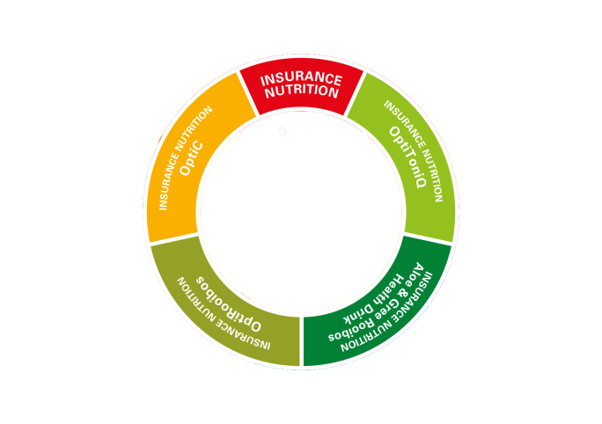
INSURANCE NUTRITION
Notes:
Explain range strategy and how it all fits together
Annique's Forever Healthy Philosophy:
Annique’s Forever Healthy range of vitamin and mineral supplements has been created by nutritional experts to provide the optimum balance between science and nature.
Advanced, complex scientific formulas, combined with the best nature has to offer, has produced a range that will help to improve and preserve your health and wellbeing.
The range was compiled to be easy to use, simple to understand and to make the choice of supplements most beneficial to your individual needs.
The optimum balance between science and nature. The range allows for easy recommendations to be made with the composition of different segments:
Core Nutrition with OptiFlora forms the nucleus of Forever Healthy. Great health starts in the digestive system, where nutrients from food and supplements are broken down, absorbed and distributed to the rest of the body. An unhealthy or damaged digestive tract and diseased organs will starve the rest of the body of essential nutrients and allow toxins into the bloodstream.
Baseline Nutrition with OptiMega, OptiVite and OptiCalMag make up the foundation of your daily supplementation. Supplements in this category should be taken daily.
Insurance Nutrition: Your safety net, Insurance Nutrition provides a means to proactively manage your potential health risks, by providing the necessary nutrients to maintain health and prevent disease and illness. These supplements provide essential protection and should also be taken daily for optimum results with OptiC, OptiToniQ+, OptiRooibos and Aloe and Green Rooibos Health Drink.
Specific Indications are tailor made solutions that offer an array of solutions for people with specific health conditions and concerns. These supplements should be used in addition to the Core, Baseline and Insurance Nutrition categories, when the need arises with OptiDerm, OptiCalm and Zerotox.
Advanced Nutrition brings forward-thinking natural health solutions. When your body is making healthy cells, key processes are supported and your brain and DNA is protected, you live a longer, healthier life with NAD and CBD
Optimum Nutrition means giving yourself the best possible intake of nutrients to allow your body to be as healthy as it possibly can with Lifestyle Shake, Rooibos & Herbs Teas, Bone Broth and Superfoods.
Superfoods, a sub-division of Optimum Nutrition, give your diet a healthy boost. These supplements pack a huge nutritional punch with Yellow and White Superfoods. We recommend that you take Superfoods in conjunction with our Forever Healthy Core, Baseline and Insurance Nutrition so that you get the widest range of benefits.

Slide 11
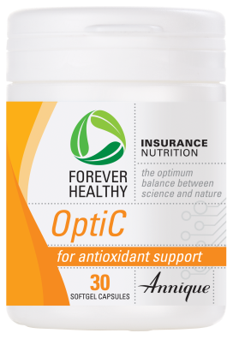
UNIQUE BENEFITS
OptiC
Unique formula
Zinc and selenium aid in absorption
Rooibos aids in absorption
No
stomach
upset
Dosage: 2 per day
Notes:
OptiC
UNIQUE BENEFITS
Unique formula with added zinc and selenium for improved results
Buffered Vitamin C – does not cause stomach upset
Added Green Rooibos extract makes our Vitamin C a powerful antioxidant
Easy to swallow softgel capsules
Recommended Dosage
Adults: Take 1 - 2 capsules per day
Not recommended for children under 3 years
When the first signs of cold or flu start, take 1 capsule every 2 hours for 3 days

Slide 12
OptiC
PRODUCT STORY
Notes:
An OptiC a day will keep the doctor away.

Slide 13
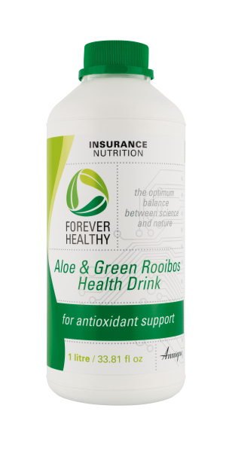
Aloe Drink
UNIQUE BENEFITS
Aloe Ferox, Rooibos = indigenous
Great taste
RECOMMENDED FOR:
Digestive health
Ulcerative colitis
Stomach ulcers
Immune system
Colon
Cleanser
Dosage: 50ml 2 x per day
Notes:
UNIQUE BENEFITS
Aloe Ferox and Green Rooibos = both indigenous to SA
Great taste
Natural colon cleanser
RECOMMENDED FOR:
Immune system
Digestive health
Osteoarthritis
Ulcerative colitis
Fever
Stomach ulcers
Asthma
Side effects of radiation treatment

Slide 14
Aloe Drink
PRODUCT STORY
Notes:
Aloe Drink is like your drain cleaner it makes sure your pipes are clean and functioning properly.
Unhealthy pipes can lead to disease.

Slide 15
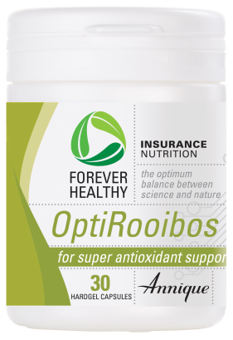
OptiRooibos
UNIQUE BENEFITS
Rooibos benefits in capsule form
Ideal if you don’t enjoy the taste of Rooibos
Rooibos in a capsule
Dosage: 1-3 per day
Notes:
OptiRooibos
UNIQUE BENEFITS
Rooibos benefits in a capsule form
Ideal for those clients who don’t enjoy the taste of Rooibos tea
Easy to swallow
Superior shelf life since capsules are completely sealed and air tight
Recommended Dosage
Children: from the age of 6 months: 1 capsules per day
Adults: 1 – 3 capsules per day, or as recommended by your health care practitioner

Slide 16
OptiRooibos
PRODUCT STORY
Notes:
Antioxidants are like your cells’ personal body guard, that help to neutralise the harmful free radicals that might harm them.
They keep law and order in your body

Slide 17
OptiToniQ+
UNIQUE BENEFITS
RECOMMENDED FOR:
Diabetes
Gout
Sinus
Supports respiratory health
Blood pressure
84 bio-available minerals and trace elements
Organic
pH
Balancer
Dosage: 16 drops per day
Notes:
UNIQUE BENEFITS
84 bio-available minerals and trace elements
100% organic Himalayan salt
Can be used from 6 months
Balance your body’s pH
RECOMMENDED FOR:
Diabetes: Promotes blood sugar health
Gout
Sinus
Supports respiratory health
Muscle cramps
Improves bone strength
Vascular health
Libido
Regulates blood pressure

Slide 18
OptiToniQ+
PRODUCT STORY
Notes:
Every pool needs a working filter to ensure a crystal clear pool.
Keeps your pools pH balanced so that algae and other nasties do not overtake and cause havoc OptiToniQ+ is like your body’s filter

